Slide 1
Ready for the Interview
N-400 Part 10: Your Marital History
Your details
Your spouse’s details
Your former spouse’s details

Slide 2
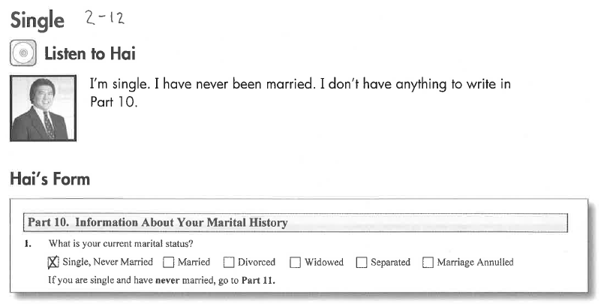
Listen to Hai - Single
Key Vocab:
Single = not married (never married)

Slide 3
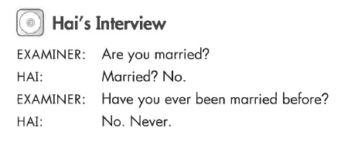
Hai’s Interview
Key Vocab:
Married before = previous, former, in the past

Slide 4
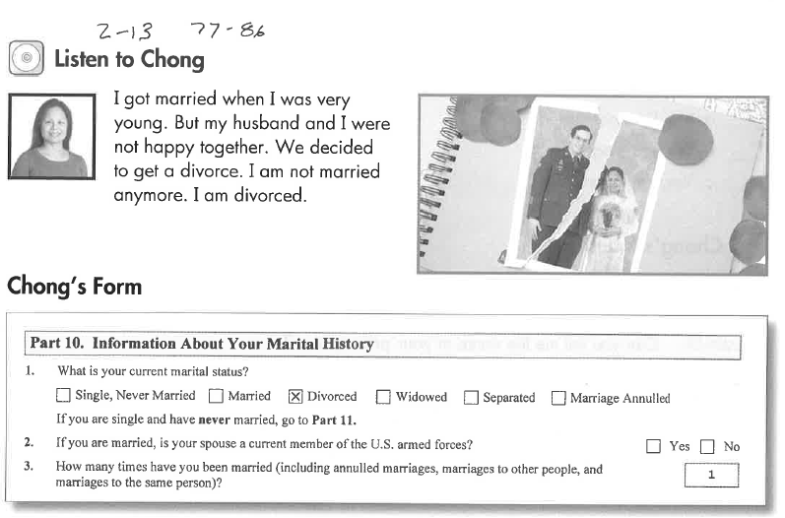
Listen to Chong – Divorced

Slide 5
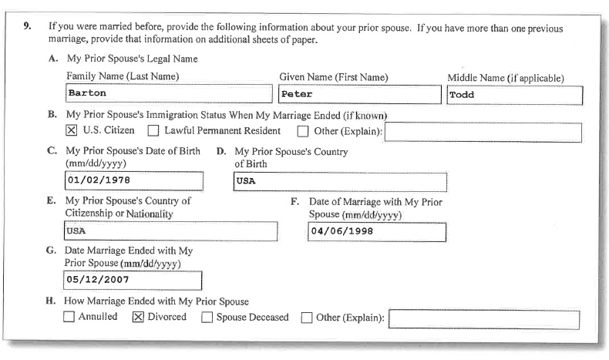
Chong’s N-400 Form
Key Vocab:
My Prior Spouse = married before

Slide 6
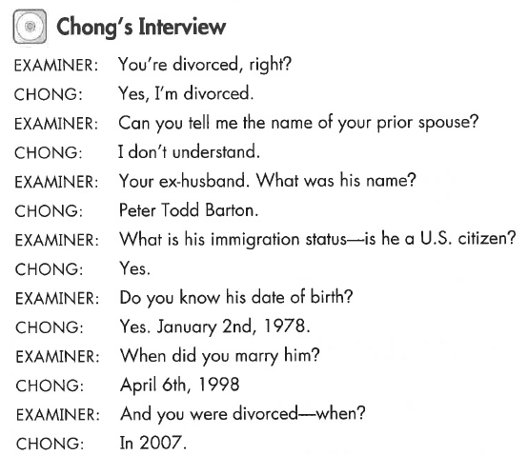
Chong’s Interview
Key Vocab:
Prior spouse = ex-husband = former, before
Immigration status = Green Card

Slide 7
Listen to Susan - Married
Key Vocab:
Date of marriage

Slide 8
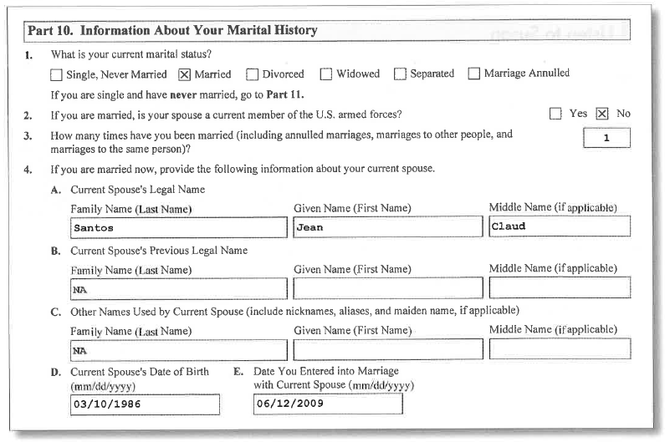
Susan’s N-400 Form
Key Vocab:
Current = now, today

Slide 9
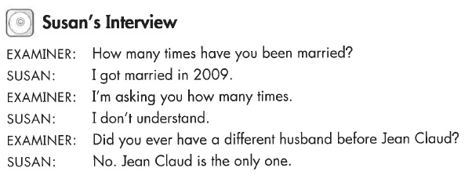
Susan’s Interview
Key Vocab:
How many times?

Slide 10
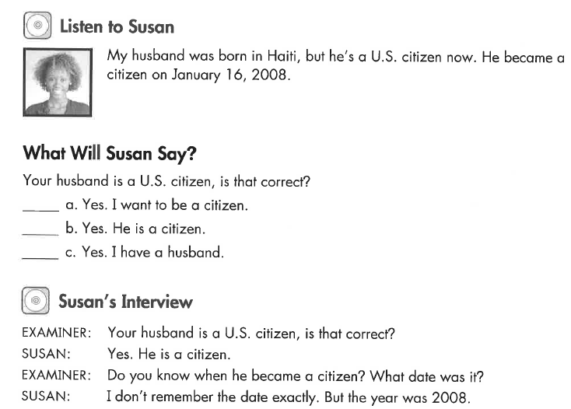
Listen to Susan
Key Vocab:
When he became a US citizen

Slide 11
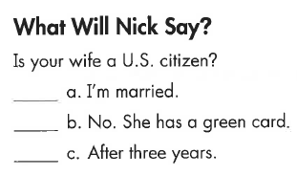
Listen to Nick
Key Vocab:
Not a US citizen.

Slide 12
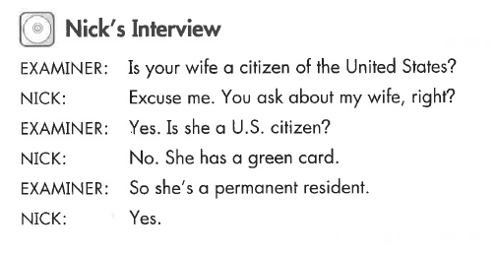
Nick’s Interview

Slide 13
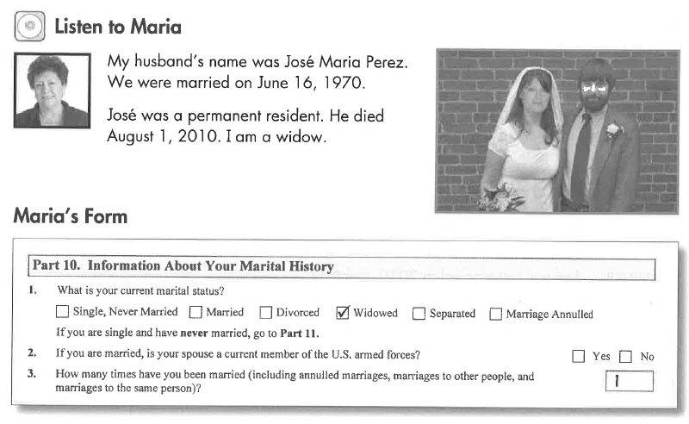
Listen to Maria – Widow
Key Vocab:
Widow = spouse died

Slide 14
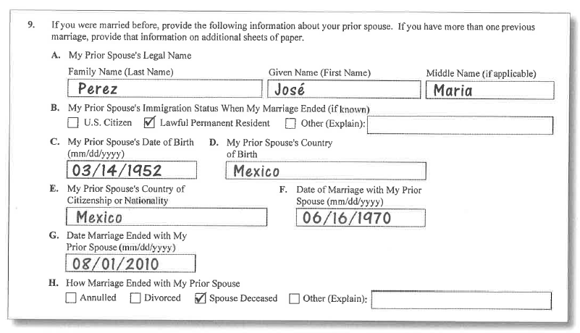
Maria’s N-400 Form
Key Vocab:
My Prior Spouse = married before, ex-spouse

Slide 15
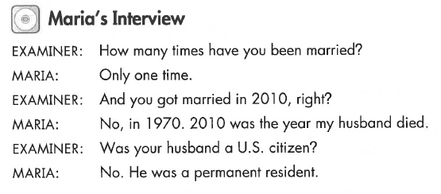
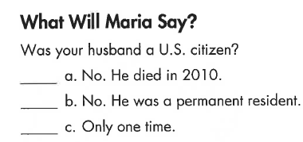
Maria’s Interview

Slide 16
Listen to Susan
Key Vocab:
Former wife = previous = before = ex-wife.

Slide 17
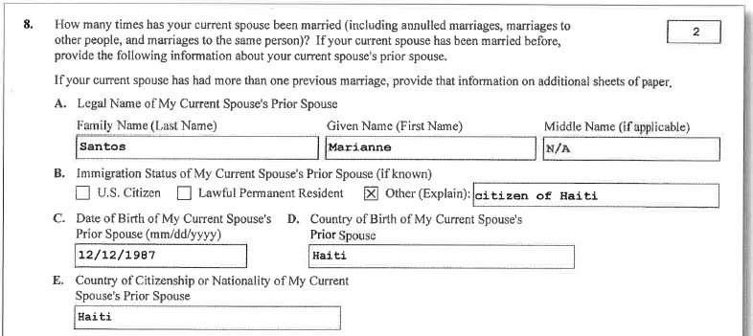
Susan’s N-400 Form
Key Vocab:
My Prior Spouse = married before

Slide 18
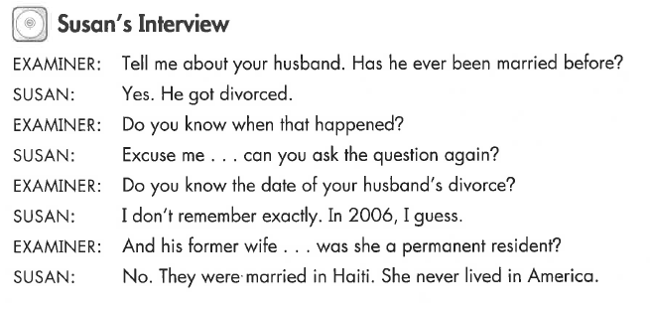
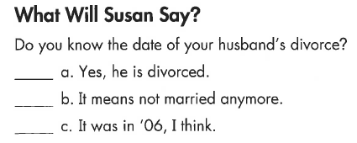
Susan’s Interview
Key Vocab:
Married before
Former wife

Slide 19
Ways to Say “My Other Spouse”
Married Before
Married Right Now
Former
My former husband
Previous
My previous wife
Ex
My ex-husband
Prior
My wife prior to my current wife.
Past
My husband in the past.
Spouse
My wife
My husband
Current
My current husband

Slide 20
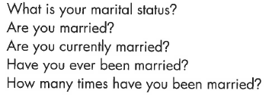
What Will YOU Say?
I’m single / married / divorced / widowed
We married on (month, day, year)
Yes, this is my first marriage.
No, I have been married before.

Slide 21
What Will YOU Say: Your Spouse & Ex-Spouse
Name/s | What is your spouse’s name? Has he/she used any other names? | His/her name is (first, middle, last) No – no other names. Yes – he/ she used to be called (first, middle, last)
DOB | What is his/her date of birth? When was he/she born? | His/her date of birth is _________________________________ (month, day, year)
Where Born | Was he/she born in the US? | No, he/she wasn’t. Yes, he/she was born in (San Francisco, California)
Military | Is he/she a member of the Armed Forces? Is she/he currently in the military? | No, he/she’s not. Yes, he/she is.
Occupation | Where does he/she work? Who does he/she work for? Who is his/her employer? What does he/she do for a living? | He/she works for (company name). He/she is a (job title).
Address | Where does he/she live? | He/she lives at (full address) He/she lives with me.
Residence Status | Is he/she a US citizen? When did he/she become a US citizen? What is his/her immigration status? Is he/she a permanent resident? | No, he/she’s not a US citizen. Yes, he/she is a US citizen. He/she became a US citizen on _________________________________ (month, day, year) He/she is a permanent resident.

