Slide 1
Ready for the Interview
N-400 Part 11: Your Children

Slide 2
Listen to Hai
Key Vocab:
I don’t have any

Slide 3
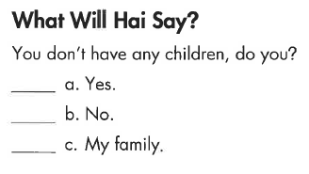
Hai’s Interview
Key Vocab:

Slide 4
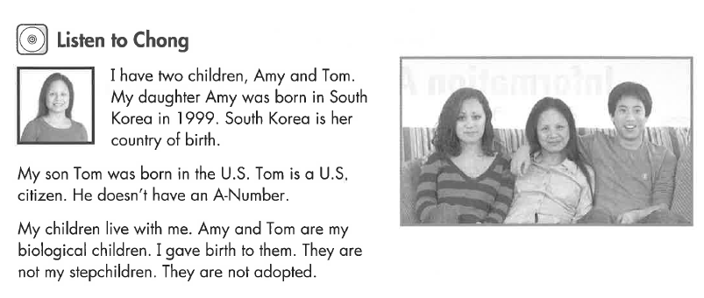
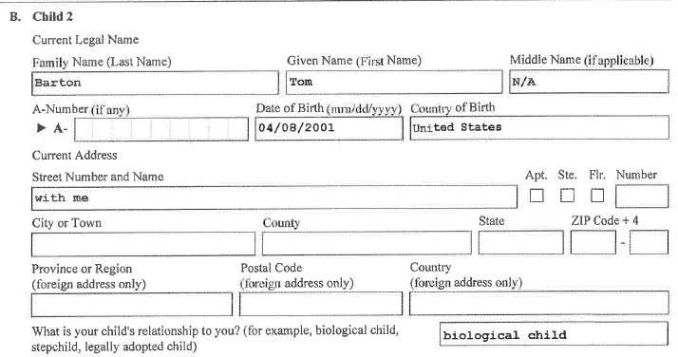
Listen to Chong
Key Vocab:
Born = birth
Biological child (gave birth)
Step child (2nd spouse’s child)
Adopted child (legal adoption, no family connection)

Slide 5
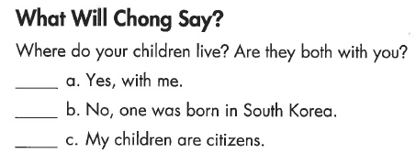
Chong’s Interview
Key Vocab:
Live with me

Slide 6
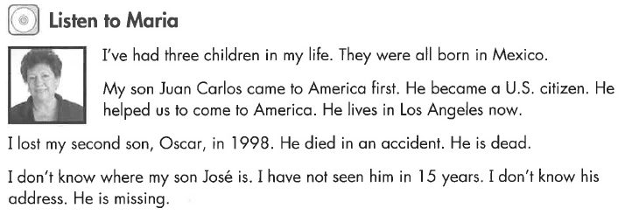
Listen to Maria
Key Vocab:
Dead = no longer alive
Missing = don’t know where he is, lost

Slide 7
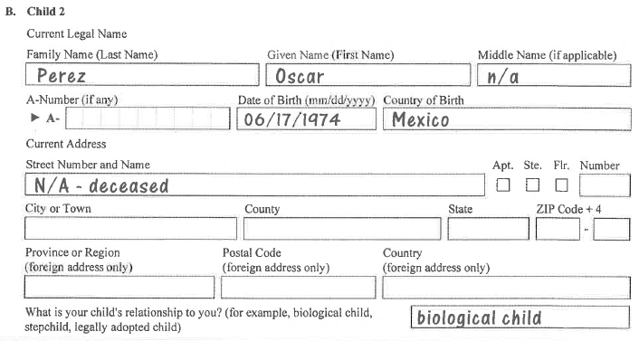
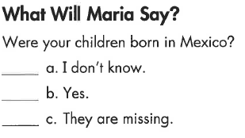
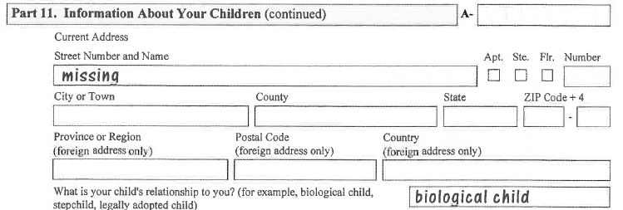
Maria’s Form
Key Vocab:
Deceased = dead

Slide 8
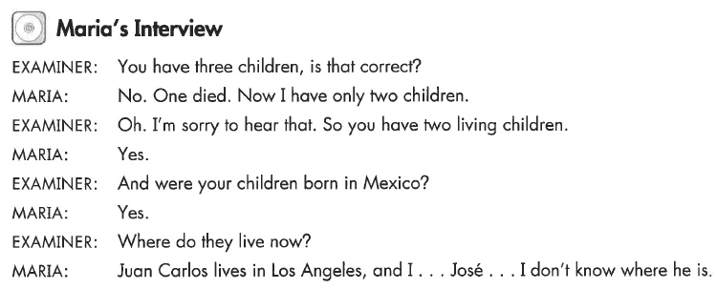
Maria’s Interview
Key Vocab:

Slide 9
What Will YOU Say?
I don’t have any children.
I have one son
I have 2 daughters
He is called (Sergei)
She is called (Marta)
They are called (Sergei & Marta)
(Marta) was born on (month, day, year)
(Marta) was born in (Hungary)
They were born in (Hungary)
He/she lives with me.
They live in (New York)

