Slide 1
Ready for the Interview
N-400 Part 12: Additional Information About You: Groups and Associations

Slide 2
Groups
Groups that you belong to
OK for Citizenship
Religious
Labor
Civil Rights
Not Allowed
Totalitarian
Terrorist
Overthrow Gov
Persecution
Nazi
Communist

Slide 3
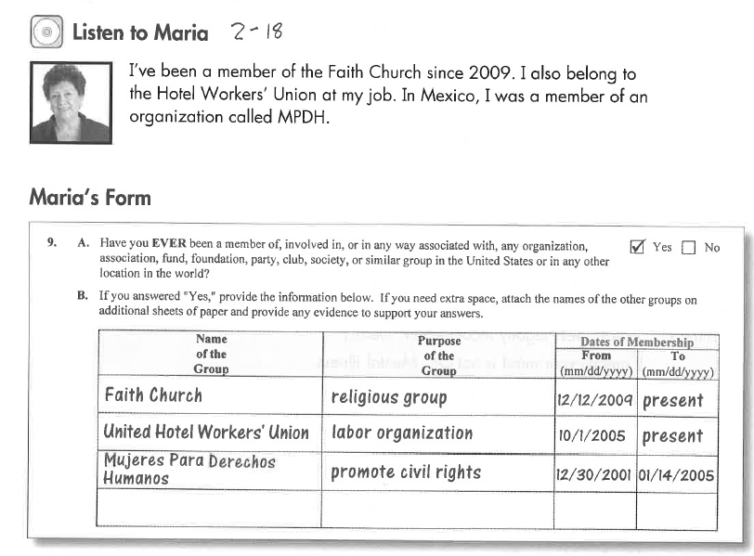
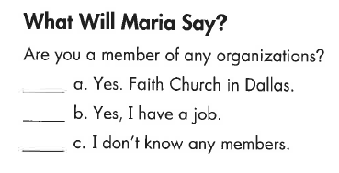
Listen to Maria
Key Vocab:
A member: part of a group
Belong to: join the group

Slide 4
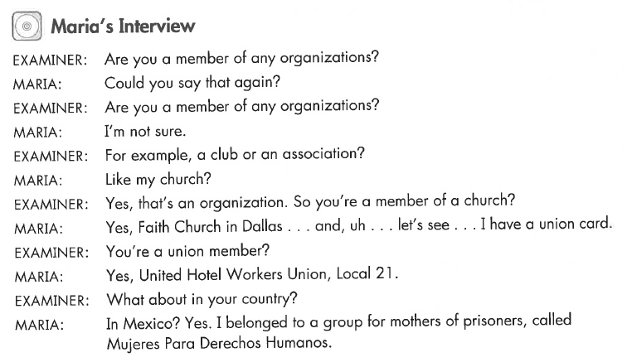
Maria’s Interview
Key Vocab:
An organization

Slide 5
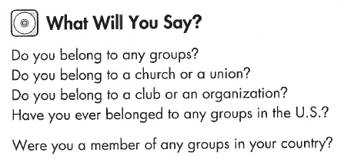
What Will YOU Say?
No, I don’t.
Yes, I belong to a church.
Yes, I belong to a golf club.

Slide 6
Listen to the USCIS Examiner

Slide 7
Listen to the USCIS Examiner
Key Vocab:
Totalitarian group (Nazis, ISIS, Al-Shabab)

Slide 8
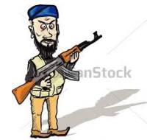
Listen to the USCIS Examiner
Key Vocab:
Overthrow: change the government with violence

Slide 9
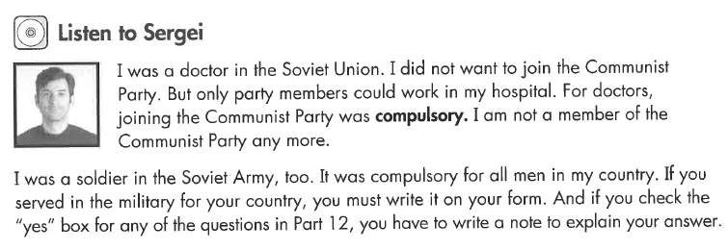
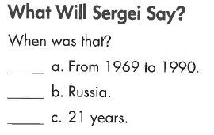
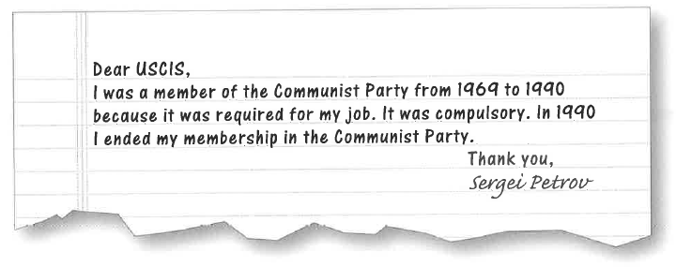
Listen to Sergei
Key Vocab:
Compulsory: required, mandatory, obligatory, must do it, zorunlu

Slide 10
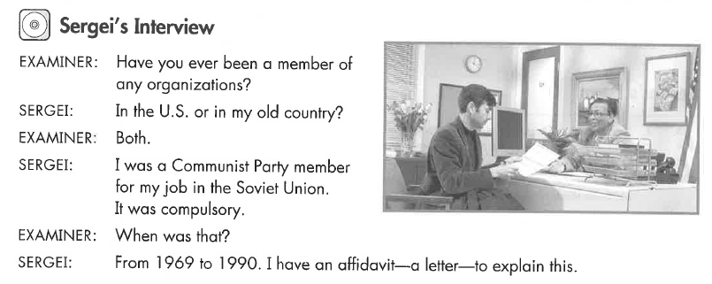
Sergei’s Interview
Key Vocab:
An affidavit: a (legal) letter

Slide 11
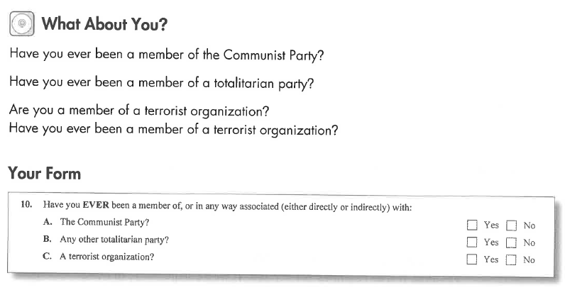
What Will YOU Say?
No, never

Slide 12
Listen to the USCIS Examiner
Key Vocab:
Overthrow: use force/violence to change the government, a coup, a revolution

Slide 13
Listen to the USCIS Examiner
Key Vocab:
Persecute: kill or oppress because of religion, race, sexual orientation or politics.

Slide 14
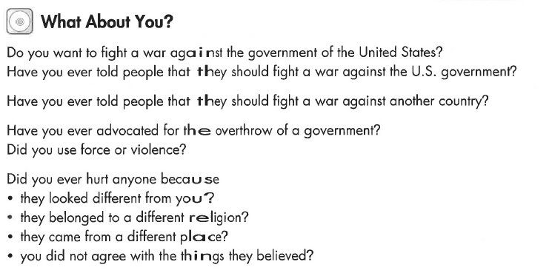
What Will YOU Say?
No, never
Key Vocab:
Advocate: support, recommend, speak in favor

Slide 15
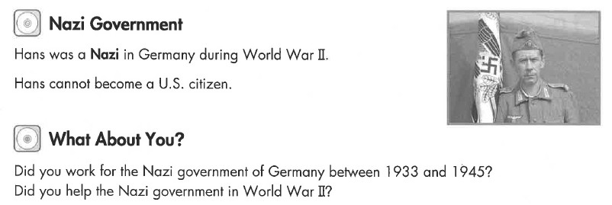
Listen to the USCIS Examiner

Slide 16
Human Rights & War Crimes
Human Rights & War Crimes
Genocide
Torture
Forced Sex
Religious Oppression

Slide 17
Listen to the USCIS Examiner
Key Vocab:
Human rights: rights that the government cannot deny – speech, justice, liberty, etc.

Slide 18
Listen to the USCIS Examiner
Key Vocab:
Genocide: extermination of a whole race of people

Slide 19
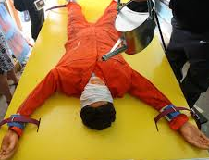
Listen to the USCIS Examiner
Key Vocab:
Torture: causing pain and injury for information or cruelty.

Slide 20
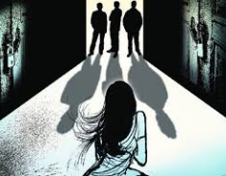
Listen to the USCIS Examiner
Key Vocab:
Forced sex: rape, sex with no consent/agreement

Slide 21
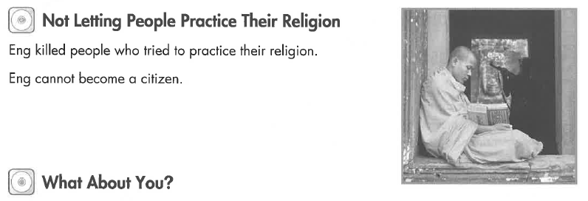
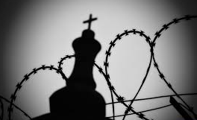
Listen to the USCIS Examiner
Key Vocab:
Practice religion: go to church without violence

Slide 22
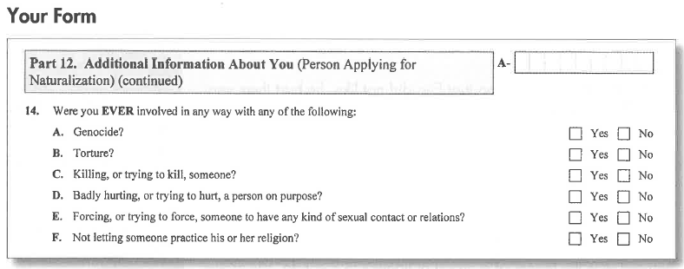
What Will YOU Say?
No, never

Slide 23
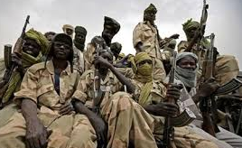
Military Groups
Military Groups
Military unit
Rebel group
Militia
Guerilla group
Insurgent group
Paramilitary group
Vigilante
Against the
government

Slide 24
Listen to the USCIS Examiner
Key Vocab:
Human rights: rights that the government cannot deny – speech, justice, liberty, etc.

Slide 25
Listen to the USCIS Examiner
Key Vocab:
Rebel, guerilla, insurgent: military unit fighting against the government

Slide 26
Listen to the USCIS Examiner
Key Vocab:
Paramilitary, militia: not part of the government’s military forces

Slide 27
Listen to the USCIS Examiner
Key Vocab:
Vigilante: not part of the government’s police force

Slide 28
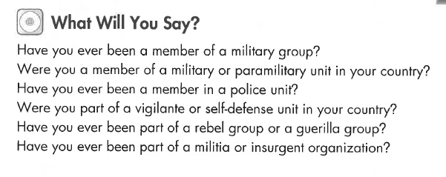
What Will YOU Say?
No, never

Slide 29
Listen to the USCIS Examiner
Key Vocab:
Detention center
Labor camp

Slide 30
Listen to the USCIS Examiner
Key Vocab:
Broken the law: commit a crime

Slide 31
What Will YOU Say?
No, never

Slide 32
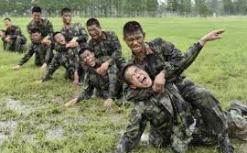
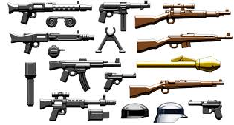
Listen to the USCIS Examiner
Key Vocab:
Weapons
Military training

Slide 33
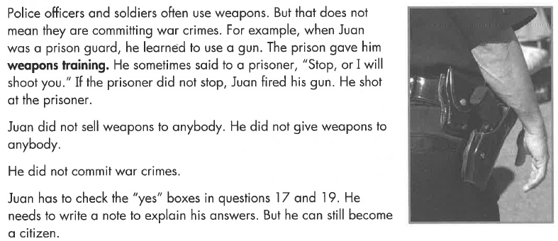
Listen to the USCIS Examiner

Slide 34
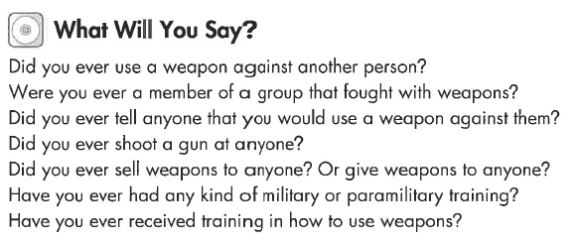
What Will YOU Say?
No, never

Slide 35
Listen to the USCIS Examiner
Key Vocab:
Child soldiers: under 15 years old
Conscript: forced military service.

Slide 36
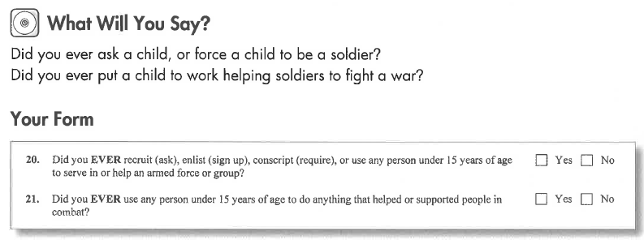
What Will YOU Say?
No, never

