Slide 1
Ready for the Interview
N-400 Part 12: Additional Information About You: Illegal Activities

Slide 2
Listen to the USCIS Examiner

Slide 3
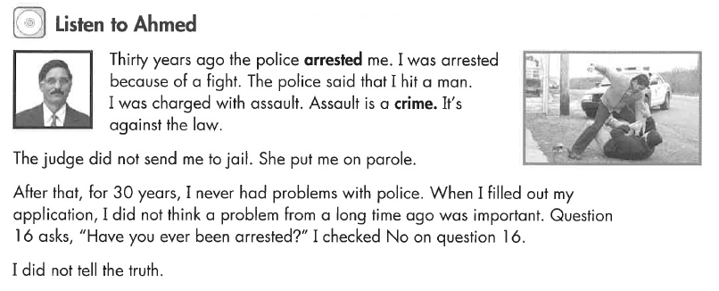
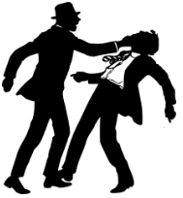
Listen to Ahmed
Key Vocab:
Arrested: stopped by the police.
Assault: hit someone
Parole: not jail, but report to police regularly

Slide 4
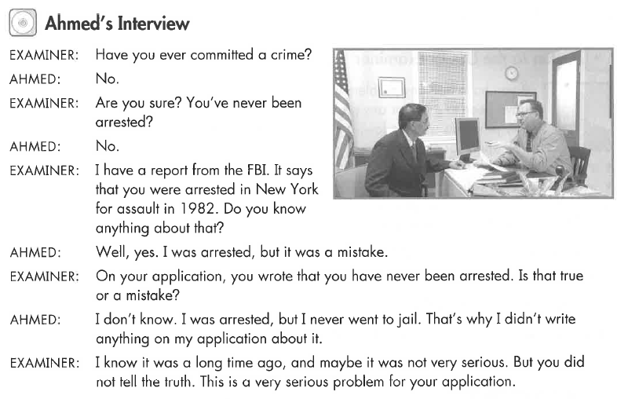
Ahmed’s Interview
Key Vocab:
Committed a crime

Slide 5
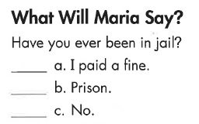
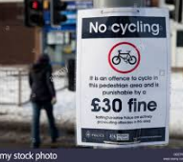
Listen to Maria
Key Vocab:
A fine: $ as punishment

Slide 6
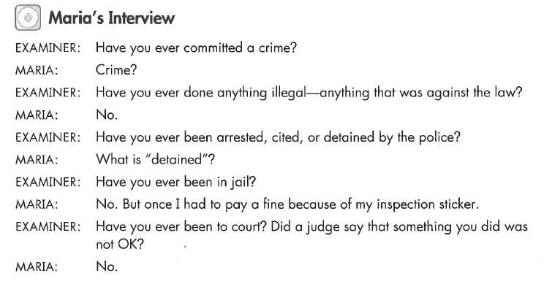
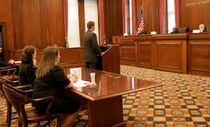
Maria’s Interview
Key Vocab:
Court, judge

Slide 7
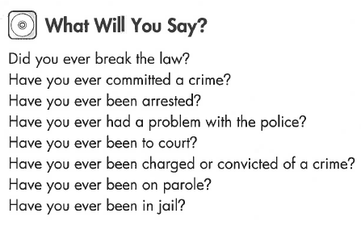
What Will YOU Say?
No, never
Key Vocab:
Crime, arrested, convicted, parole, jail

Slide 8
Listen to the USCIS Examiner

Slide 9
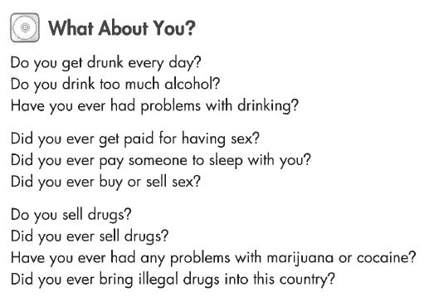
What Will YOU Say?
No, never

Slide 10
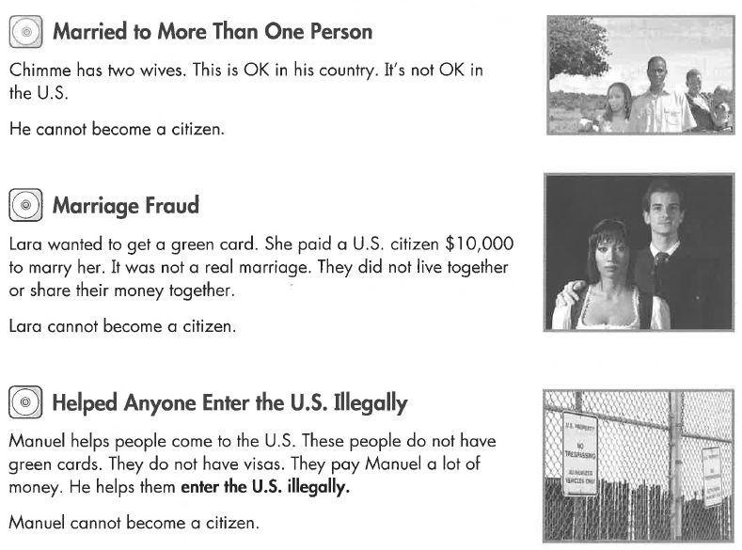
Listen to the USCIS Examiner

Slide 11
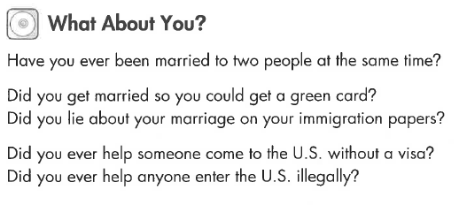
What Will YOU Say?
No, never

Slide 12
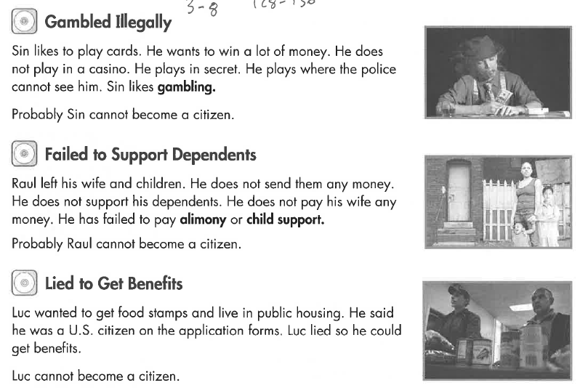
Listen to the USCIS Examiner

Slide 13
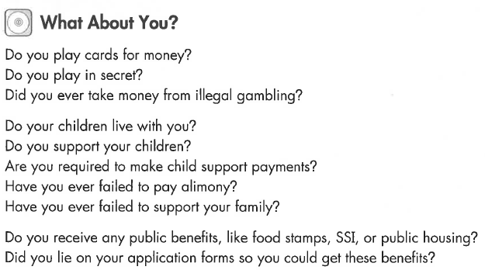
What Will YOU Say?
No, never

Slide 14
Listen to the USCIS Examiner
Key Vocab:
False, mislead, lie: not true

Slide 15
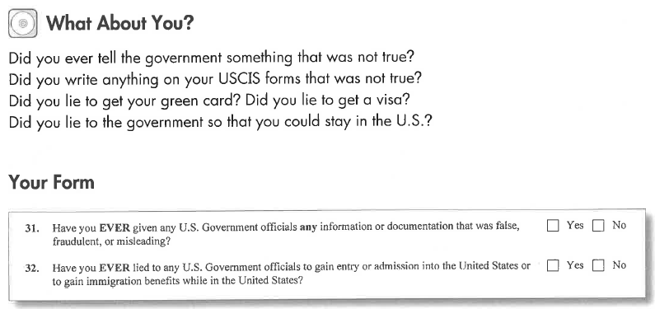
What Will YOU Say?
No, never

Slide 16
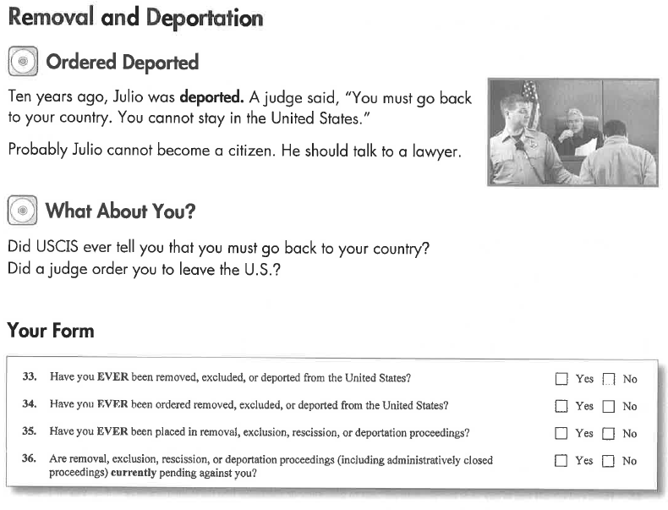
Listen to the USCIS Examiner

Slide 17
Listen to the USCIS Examiner

Slide 18
What Will YOU Say?
No, never

Slide 19
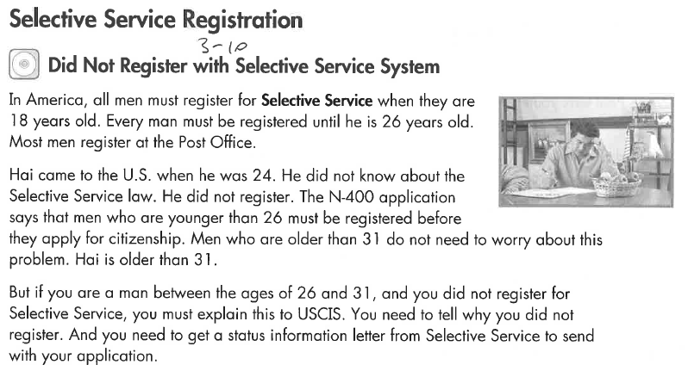
Listen to the USCIS Examiner

Slide 20
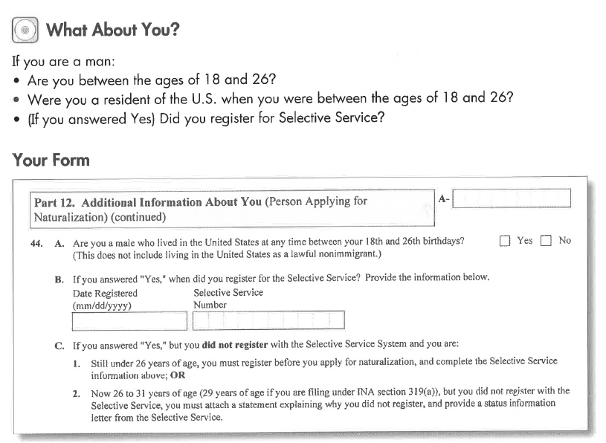
What Will YOU Say?

