Slide 1
Ready for the Interview
N-400 Part 13: The Oath’s Requirements

Slide 2
Listen to Maria

Slide 3
What About You?
Yes I do!!!

Slide 4
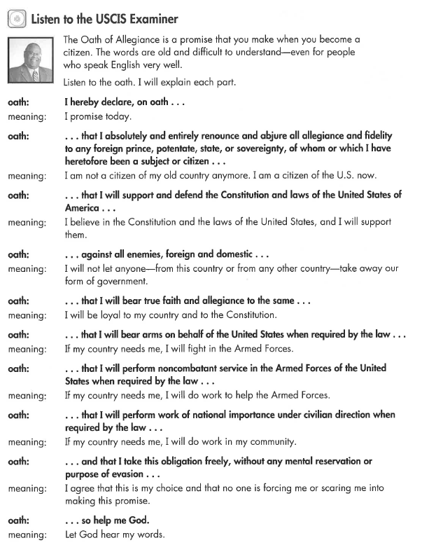
Listen to the USCIS Examiner

Slide 5
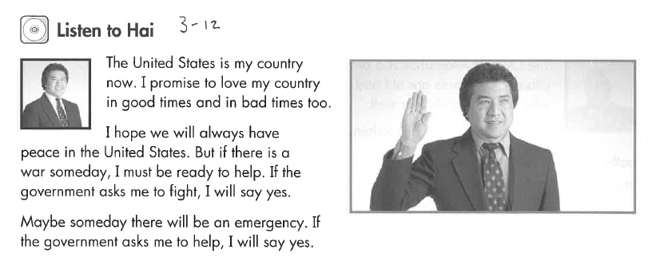
Listen to Hai

Slide 6
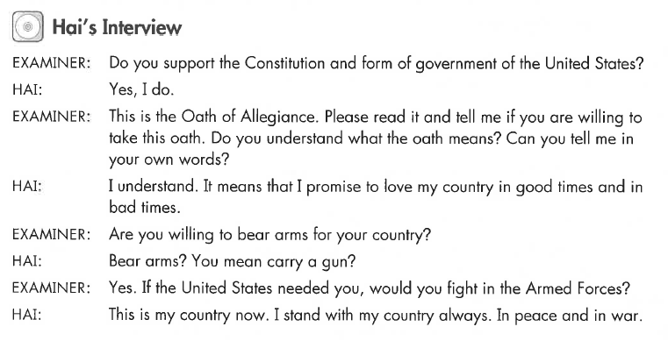
Hai’s Interview

Slide 7
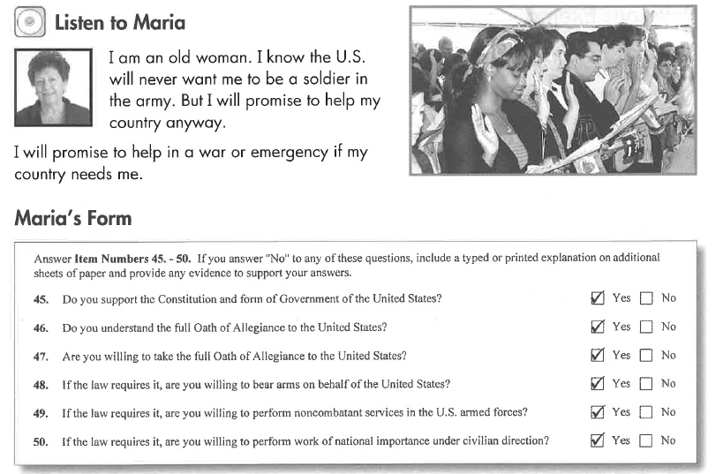
Listen to Maria

Slide 8
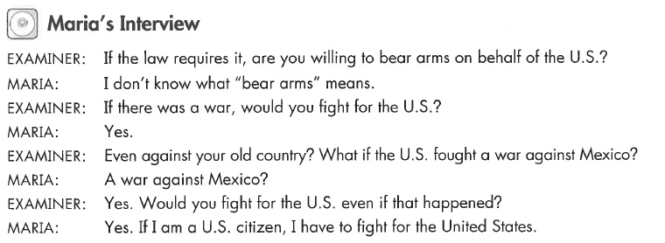
Maria’s Interview

Slide 9
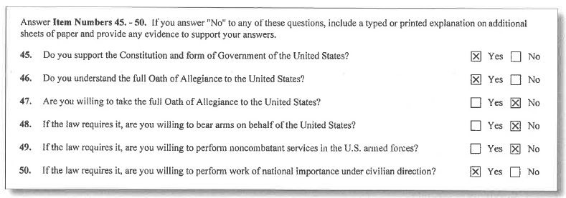
Listen to Susan: Religious Exemptions

Slide 10
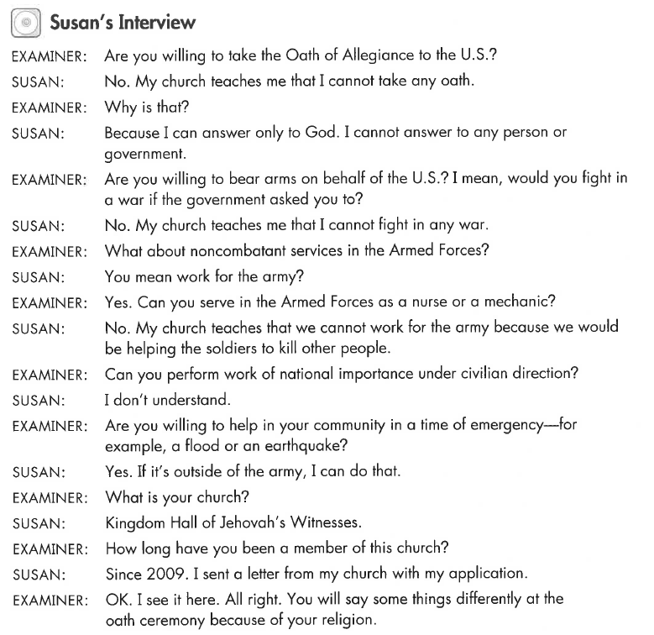
Susan’s Interview

Slide 11
What Will YOU Say?
Yes I do!!
I promise to be
loyal to the US

