Slide 1
Ready for the Interview
N-400 Part 12: Additional Information About You: Civic Responsibility

Slide 2
Listen to the USCIS Examiner
Key Vocab:
The past: before, not now

Slide 3
Claim to Be a US Citizen
Key Vocab:
Claim: to lie, to say you are something but you are not.

Slide 4
Registering to Vote
Key Vocab:
Register to vote

Slide 5
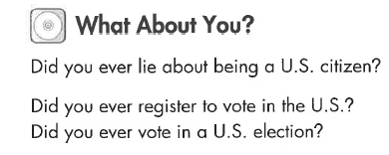
What About you?
No, never

Slide 6
Title of Nobility
Key Vocab:
Title of nobility
Get rid of: lose, drop, eliminate

Slide 7
Mentally Ill
Key Vocab:
Mentally ill.
Legally incompetent: court appoints a guardian to make legal decisions

Slide 8
What About you?
No, never

Slide 9
Failure to Pay Taxes
Key Vocab:
Fail to pay taxes: did not pay taxes
Owe money: must pay money

Slide 10
Claim to be a Nonresident
Key Vocab:
Nonresident: does not live in the US

Slide 11
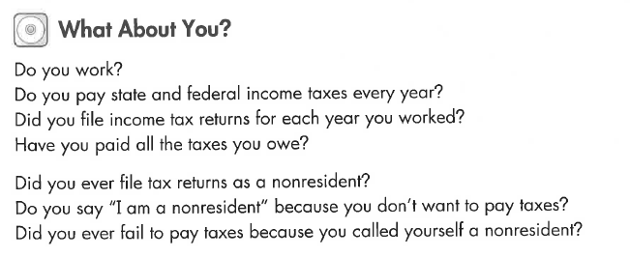
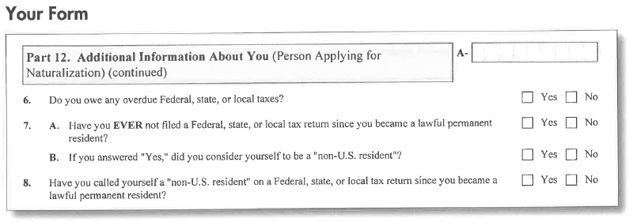
What About you?

Slide 12
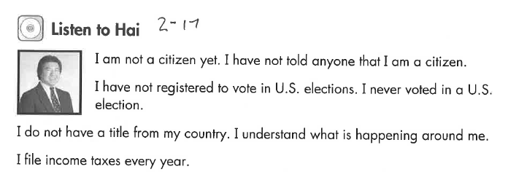
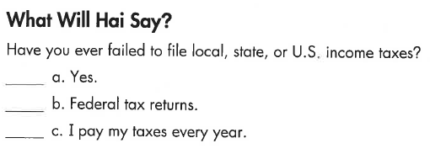
Listen to Hai

Slide 13
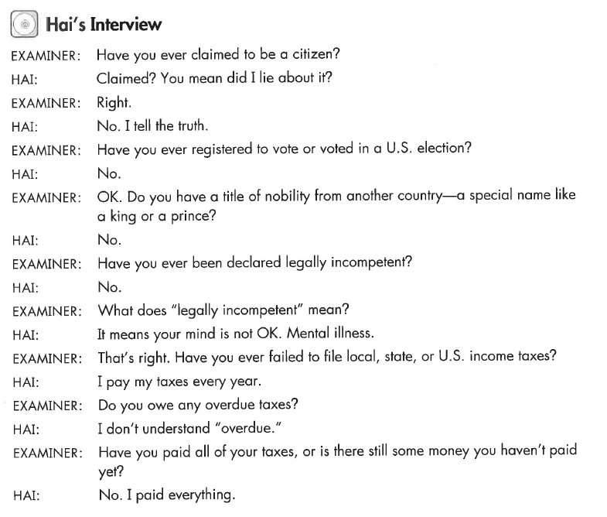
Hai’s Interview

