Slide 1
Small Talk & N-400
At the beginning of the interview, the officer might ask you first some simple “small talk” questions (about every day life) to be friendly and make you feel comfortable.
The purpose is to see if you understand basic English
http://uscitizenshipsupport.com/us-citizenship-test-small-talk/
Notes:
Printable activities and powerpoints for reading and dictation can be found on http://USCitizenshipTeachers.org

Slide 2
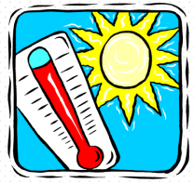
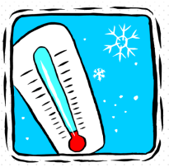
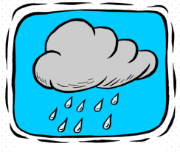
What is the weather today? It is:
hot
cold
sunny
cloudy
Partly
cloudy
snowy
windy
rainy
stormy

Slide 3
What is the weather today? It is:
hot
cold
sunny
cloudy
Partly
cloudy
snowy
windy
rainy
stormy

Slide 4
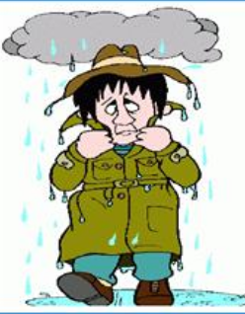
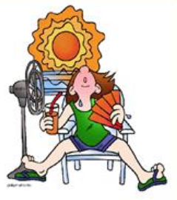
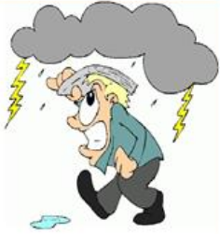
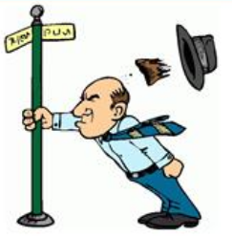
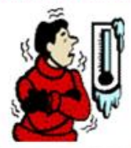
What is the weather today? It is:
sunny
rainy
hot
stormy
windy
snowy
Partly
cloudy
cold

Slide 5
Weather
How is the weather today?
It’s good.
It’s hot, isn’t it?
Yes, it is!
Not too bad.
Is it still windy?
Yes, it is.
No, much better.
Is it cloudy outside?
Not too bad.
Did the rain stop, yet?
Yes, much better.
No, still raining.

