Slide 1
USCIS Citizenship Interview & Test
N-400 Interview 02
Link

Slide 2

Interview 2
I’m fine, thank you.

Slide 3
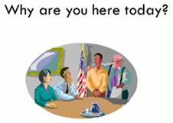
Interview 2
I’m here for my citizenship interview

Slide 4
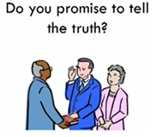
The Oath
Yes I do.

Slide 5
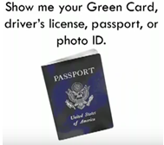
Interview 1
Here are my Green Card and passport.

Slide 6
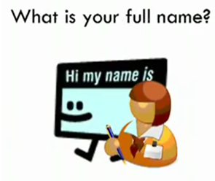
Interview 2
My full name is …

Slide 7
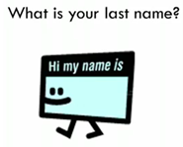
Interview 2
My last name is …

Slide 8

Interview 2
.

Slide 9
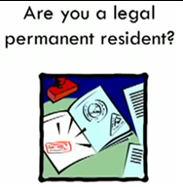
Interview 2
Yes, I am

Slide 10

Interview
I have been a permanent resident for (number) years.

Slide 11
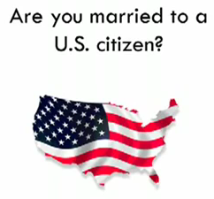
Interview
No, I am not OR
Yes, I am

Slide 12
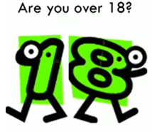
Interview 2
Yes, I am

Slide 13
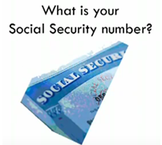
Interview 2
My Social Security number is (number)

Slide 14

Interview 2
My date of birth is (month / day / year)

Slide 15
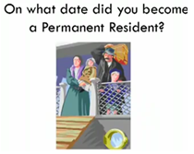
Interview 2
I became a permanent resident on (month / year)

Slide 16
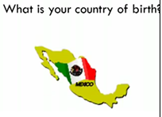
Interview 2
My country of birth is (country)

Slide 17

Interview 2
My country of nationality is (country)

Slide 18

Interview 2
I am:
Russian
Mexican
Iranian
Ethiopian
Chinese
Lebanese
Taiwanese
Japanese
Turkish

Slide 19

Interview 2
I am …

Slide 20

Interview 2
My address is …

Slide 21

Interview 2
My number is …

Slide 22

Interview 2
No, I don’t OR
Yes, it is …

Slide 23
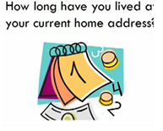
Interview 2
I have lived here for (years)

Slide 24

Interview 2
I lived in ...

Slide 25

Interview 2
Yes, I do
No, I do not

Slide 26

Interview 2
I work at (name)

Slide 27
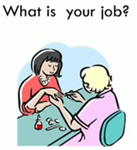
Interview 2
I am a (job)

Slide 28
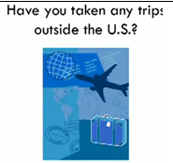
Interview 2
No, I have not.
Yes, I have.

Slide 29
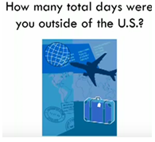
Interview 2
I was outside the US for (number) days

Slide 30

Interview 2
(Number)

Slide 31

Interview 2
I left on (date) and came back on (date)

Slide 32

Interview 2
I went to (country)

Slide 33

Interview 2
I have been married (number)

Slide 34
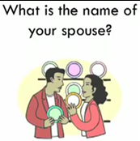
Interview 2
His/her name is …

Slide 35
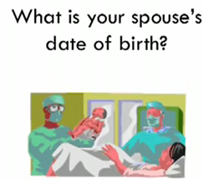
Interview 2
His/her date of birth is …

Slide 36

Interview 2
We got married on (month / year)

Slide 37

Interview 2
No OR
Yes

Slide 38
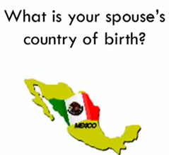
Interview 2
He was born in (country)

Slide 39

Interview 2
I have one child / (number) children
I don’t have children

Slide 40
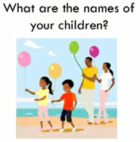
Interview 2
…

Slide 41
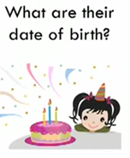
Interview 2
dates

Slide 42

Interview 2
Country

Slide 43
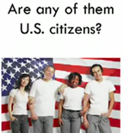
Interview 1
No OR
Yes

Slide 44

Interview 2
They live (with me), in (San Jose) …

Slide 45

Interview 2
No, I have not

Slide 46
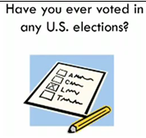
Interview 2
No, I have not

Slide 47

Interview 2
Yes I do

Slide 48
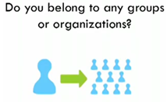
Interview 2
No OR
Yes, I belong to (church / union)

Slide 49

Interview 2
No, never

Slide 50

Interview 2
No, never

Slide 51
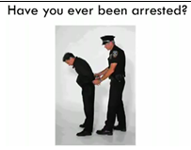
Interview 2
No, never
(If you have, please prepare a statement to take with you to your interview)

Slide 52

Interview 2
No, never

Slide 53

Interview 2
No, never

Slide 54

Interview 2
No, never

Slide 55
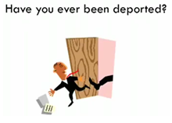
Interview 2
No, never

Slide 56
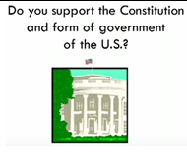
Interview 2
Yes I do

Slide 57

Interview 2
Yes I do. It means that I will be loyal to the United States.

Slide 58
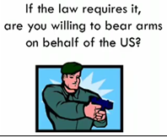
Interview 2
Yes I am
If your religion prohibits you from bearing arms, take a letter from your church to your interview.

Slide 59

Interview 2
Awesome!!!!!

