Slide 1
Welcome to US Citizenship Class
Campbell Adult and Community Education (CACE)
Alison McLin
amclin@cuhsd.org
http://http://uscitizenshipcourse.weebly.com

Slide 2
My Background
From the United Kingdom (Scotland)
Lived in Japan, China, Hong Kong, Singapore, France, Germany
Currently: High School teacher – languages, computer programming, web design and US Government/Economics
Previously: Corporate Trainer for BP; Business Analyst for IBM
Married an American in 1998
Became a US Citizen in 2005

Slide 3
This 15-week class is for people who:
Have already submitted (or will soon submit) their N-400 application form.
You may file Form N-00 90 calendar days before you complete your permanent residence requirement.
Eligibility is based on:
Being a Permanent Resident for at least 5 years; or
Being a Permanent Resident for at least 3 years if you are married to a US citizen.
This means that you should take this class when you have had a Green Card for 5 years.
Speak, read & write English at high beginner or intermediate level.

Slide 4
By the end of the course, you will:
Know the process to become a US citizen.
Know what to expect at your interview and test.
Know and understand the answers to all 100 civics questions.
Be ready for the English reading and writing test
Better understand American accents
Know what to do after you’ve become a US citizen.

Slide 5
You must also study on your own.
Review the handouts from the class
Learn the answers to the civics test questions
Practice writing sentences.

Slide 6
Test Exemptions
Some people do not have to take the full test.
It depends on your age and how long you’ve been a permanent resident.
Those eligible for an exemption are those who are
aged over 50 and
have lived in the US as a Permanent Resident for at least 15 years.

Slide 7
Test Exemptions

Slide 8
Test Exemptions

Slide 9
Outline of the Naturalization Interview (10 – 15 minutes)
Small Talk: Introduction to the Examiner
English Test: Oral Review of the N-400 application form (oral response 20 to 70 questions and commands)
Reading Test: correctly read 1 out of 3 sentences (oral response)
Writing Test: correctly write 1 out of 3 dictated sentences (written response)
Civics Test: correctly answer 6 out of 10 questions of the 100 USCIS Civics and History Test (oral response)

Slide 10
Weekly Agenda
Every week, our focus will be for you to practice every component of the interview:
Small talk activities
Oral review of each section of your N-400
Mock interviews
Respond to basic commands
Ask for clarification or for repetition if you don't understand what is being asked by the USCIS officer.
A civics topic (list of topics)
Reading questions
Writing questions

Slide 11
Class Objectives
To prepare for the naturalization interview and test
be able to respond to questions about your application
be able to respond to simple commands and to engage in "small talk"
know the answers to 100 questions about American history and government
be able to read a sentence and to write a sentence from dictation
Every class session will include reading, writing, and speaking practice

Slide 12
Some class administration
Name tag *
Orientation Packet
* Please bring the name tag to class each week.

Slide 13
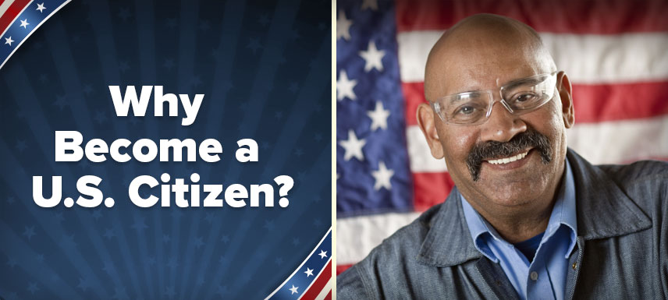
USA Learns: Citizenship 1.1 Steps to Becoming a US Citizen
Why become a US citizen?
Am I eligible to become a US citizen?
Click to launch

Slide 14
Quick Overview of the New N-400
Eligibility
Info about You
Contact info
Accommodations
Residence
Info about Parents
Info for Criminal Records Check
Employment/School
Time Outside the US
Marital History
Children
Additional Info (similar to old Part 11)
Certification/Signature
Interpreter’s Signature
Preparer’s Signature
Signature @ Interview
Renunciation of Foreign Title
Oath of Allegiance

Slide 15
Reading and Writing Vocabulary Tests
Read this sentence.
Write:
Freedom of speech is one right in the Bill of Rights.
Name one right in the Bill of Rights.
F-r-e-e-d-o-m o-f s-p-e-e-c-h . . .

Slide 16
Reading and Writing Vocabulary Lists
Two complementary vocabulary lists.
Sentences based on civics topics.
No official set of reading nor dictation sentences.
READING
People (First/Last Names)
Civics
Places
Holidays
Question Words
Verbs
Function (ex: articles, prep.)
Content (ex: adjectives, numbers)
WRITING
People (Last Names only)
Civics
Places
Months
Holidays
Verbs
Function (ex: pronoun, prep.)
Content (ex: colors, numbers)

Slide 17
USCIS Civics Test
What is the supreme law of the land?
the Constitution

Slide 18
USCIS 100 questions!
AMERICAN GOV’T
A: Principles of American Democracy Qs 01-12
B: System of Government
Intro Qs 1-15
Legislative Branch Qs 16-26
Executive Branch Qs 27-36
Judicial Branch Qs 37-40
Federal/State Government Qs 41-44
Political Parties Qs 45-47
C: Rights and Responsibilities Qs 48-57
AMERICAN HISTORY
A: Colonial Period and Independence Qs 58-70
B: 1800s Qs 71-77
C: Recent American History and Other Important Historical Information Qs 78-87
INTEGRATED CIVICS
A: Geography Qs 88-95
B: Symbols Qs 96-98
C: Holidays Qs 99-100

Slide 19
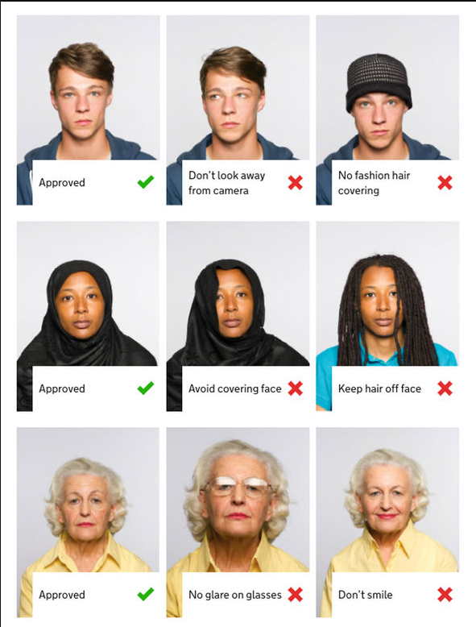
Sending in Your N-400 Form(updated 08/22/2013)
N-400 Form and Information www.uscis.gov/n-400
You Need
Completed N-400 application
2 passport photos.
1 Check for $680 ($595 for the N-400 & $85 for fingerprints (biometrics).
Personal check, cashier’s check, or money order is accepted.
Send 1 check only per person (write your A# on the memo).
Checks should be made payable to Department of Homeland Security or U.S. Citizenship and Immigration Services.
Can I send my spouse’s N-400 in the same envelope?
Yes, you can send your husband or wife’s N-400 in the same envelope.
Include a note: “My spouse and I want our interview on the same day.”

Slide 20
Where do I send the N-400 application?
California & the West Coast Regular Mail:
USCIS
P.O. Box 21251
Phoenix, AZ 85036
California and West Coast
Express Mail:
USCIS
Attn: N-400
1820 E. Skyharbor Circle
Suite 100
Phoenix, AZ 85034
Other locations:
East Coast:
USCIS
P.O. 660060
Dallas, TX 75266
Military:
Nebraska Service Center
P.O. Box 87426
Lincoln, NE 68501-7426

Slide 21
What happens after I send my N-400?
Receive an N-400 Receipt letter from USCIS.
On the top of the letter, there is a 13-character Receipt Number begins with three letters such as (EAC, WAC, LIN, or SRC)
Use the Receipt Number to check your case status 1.usa.gov/Xzr7Ft
Receive a Fingerprint (Biometrics) appt. letter from USCIS.
Go to the Fingerprint appointment.
Receive a Citizenship Interview appt. letter from USCIS.
Go to the Citizenship Interview. Pass!
Don’t pass the Interview! USCIS will re-schedule 1 time for free.
Receive an Oath Of Allegiance Ceremony invitation.
Go to the Oath Ceremony. Swear allegiance to the United States.
Congratulations: you are now a US Citizen!

Slide 22
I have a question! (updated 01/20/2016)
USCIS
www.uscis.gov
1-800-375-5283
INFOPASS
infopass.uscis.gov/
Asian Law Alliance
184 Jackson Street San Jose, CA 95112 (408) 287-9710
www.asianlawalliance.org
International Rescue Committee
1210 South Bascom Ave., Suite 227
San Jose, CA 95128
(408) 277-0255
www.rescue.org/us-program/us-san-jose-ca
SJ Immigrant Info
www.immigrantinfo.org
Catholic Charities
2625 Zanker Rd, San Jose CA 95134 (408) 468-0100
7950 Church St, Gilroy, CA 95020
Phone: (408) 842-4808
www.catholiccharitiesscc.org/immigration-legal-services-program
CET
701 Vine Street,
Office 114 San Jose, CA 95110
(408)-534-5451
cetweb.org/immigration/
Siren
1425 Koll Circle San Jose, CA 95112 (408) 453-3003
www.siren-bayarea.org

Slide 23
Resources
USCIS.gov
USCIS Citizenship Resources Center
USCitizenpod.com
UScitizenshipCourse.weebly.com (my site)

Slide 24
USCIS.gov
3
1. Forms: N-400 Application for Naturalization and other forms
2. Citizenship: Apply for and learn about Citizenship
3. Español: USCIS.gov en Español
4. Check your Case Status
5 Make an InfoPass Appointment
1
2
4
5

Slide 25
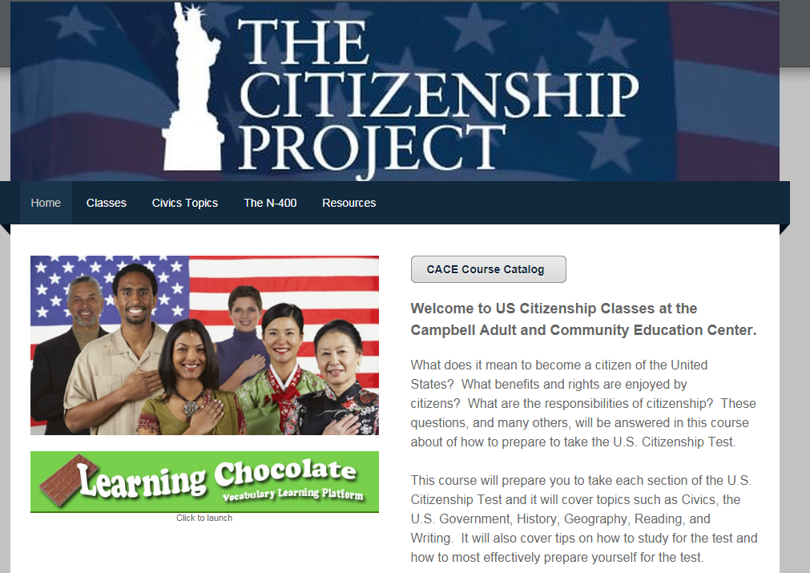
http://www.UScitizenshipPrepCourse.com/

Slide 26
Citizenship Resource Center uscis.gov/citizenship
1

Slide 27
US Citizenship Podcast
uscitizenpod.com daily blog of Citizenship resources & news
Military(8 pgs)
Senior Citizen (8 pgs)
Intermediate (6 pgs)
Typical (4 pgs)
Common / Everyday / Casual (2 pgs)
Simple (2pgs) / Basic (2pgs)
USCitizenpod N-400r practice page
goo.gl/2aOS5m
Easy (15qs) / Elementary (21qs)
Beginning / N-400r Section Interviews

