Slide 1
CitizenVIP ESL
Your Address

Slide 2
Your Address
What is your home address?
Has your address changed since you sent in your application?
What is your address right now?
What is your current address?
Where do you live?
What is your street address?
My current address is (number, street, city, state, zip code)

Slide 3
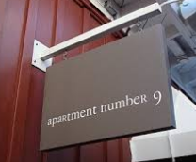
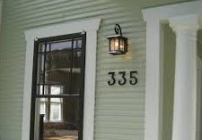
Your Address – House and Apartment Number
What is the number of your building or home?
What is your apartment number?
Is there an apartment number in your address?
My apartment / house number is … .

Slide 4
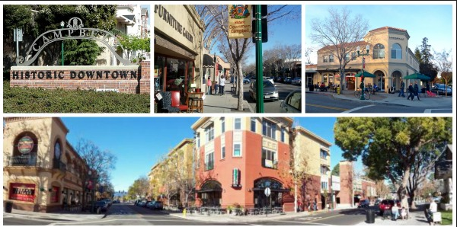
Your Address – City
I live in (Campbell)
What city do you live in?
Spell the city that you live in.

Slide 5
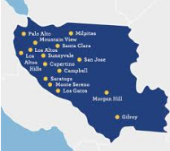
Your Address – County
Santa Clara County
What county do you live in?

Slide 6
Your Address – State
California
What state do you live in?

Slide 7
Your Address – Zip Code
95008
What is your zip code?

Slide 8
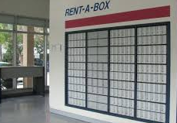
Your Address - Mailing
Do you have a PO Box?
What is your mailing address?
Is your mailing address the same as your home address?
I don’t have a PO Box.
My mailing address is the same as my home address.

Slide 9
Telephone Number
What is your telephone number?
What is your home ‘phone number?
What is your cell phone number?
My number is (XXX) XXX XXXX
My cell phone number is the same as my home number.

Slide 10
Email Address
Do you have an email address?
What is your email address?
Spell your email address.
I don’t have an email address.
My email address is (blah-blah AT yahoo dot com)

Slide 11
Practice in Pairs:
What is your current home address?
My current address is …
What is the number of your home / apartment?
The number is …
What city do you live in?
I live in (Campbell)
What county do you live in?
Santa Clara County
What state do you live in?
California
What is your zip code?
95008 (nine five zero zero eight)
Do you have a PO Box? What is your mailing address?
I don’t have a PO Box. My mailing address is the same as my home address.
What is your phone number?
My number is (XXX) XXX XXXX
What is your email address?
I don’t have email.
My email address is …

