Slide 1
USA Learns Citizenship
2.3 Information About You

Slide 3
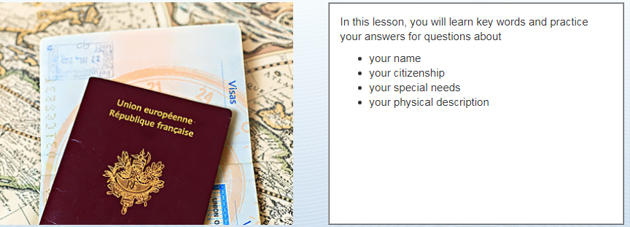
Learning Goals

Slide 4
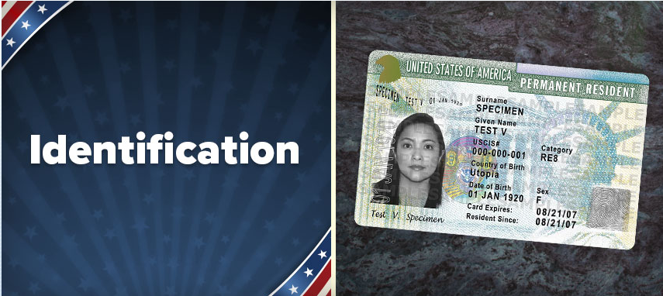

Slide 5
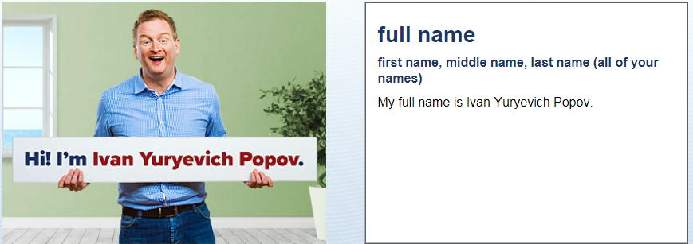
Identification
What is your full name?
My full name is …

Slide 6
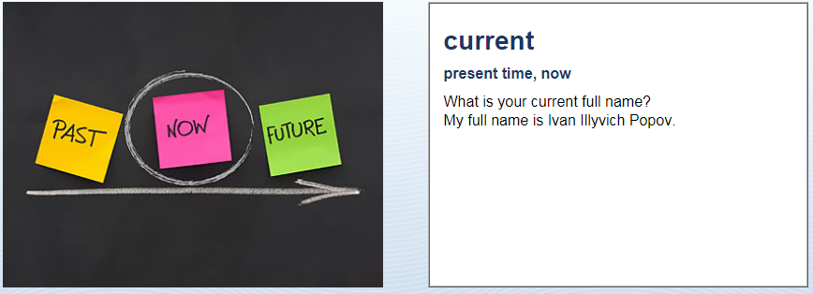
Identification
My current full name is …

Slide 7
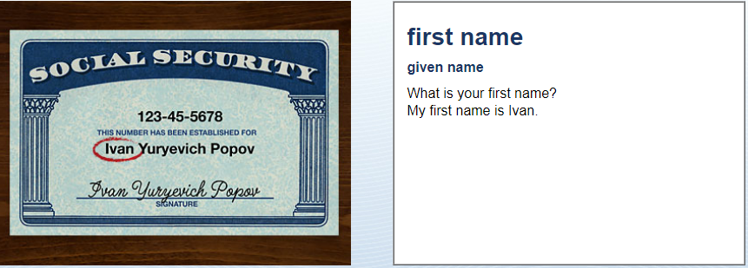
Identification
My first name is …

Slide 8
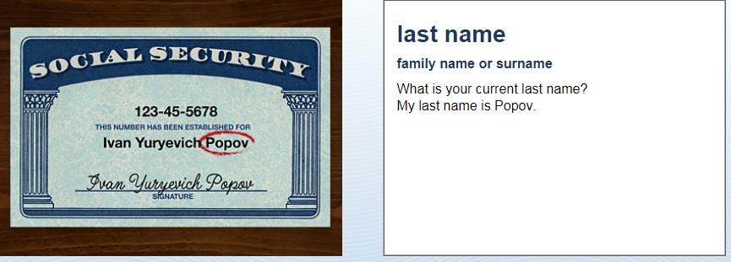
Identification
My last name is …

Slide 9
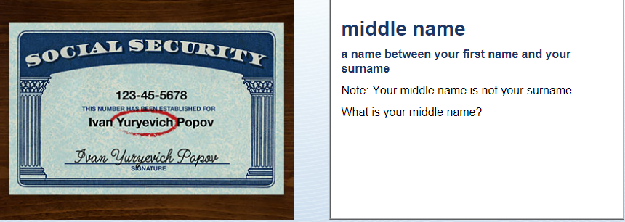
Identification
My middle name is …
OR I don’t have a middle name

Slide 10
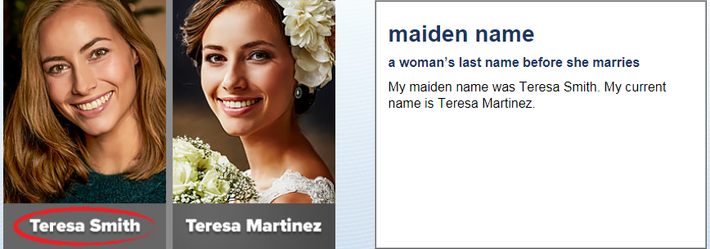
Identification
My maiden name was …

Slide 11
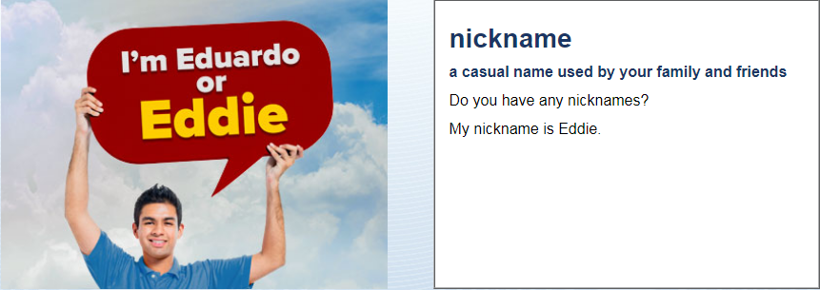
Identification
My nick name is …
OR I don’t have a nick name

Slide 12
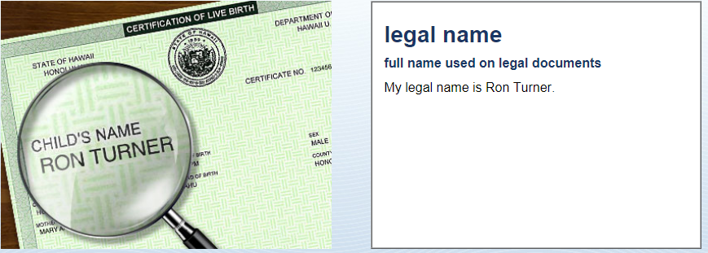
Identification
The name on your passport
My legal name is …

Slide 13
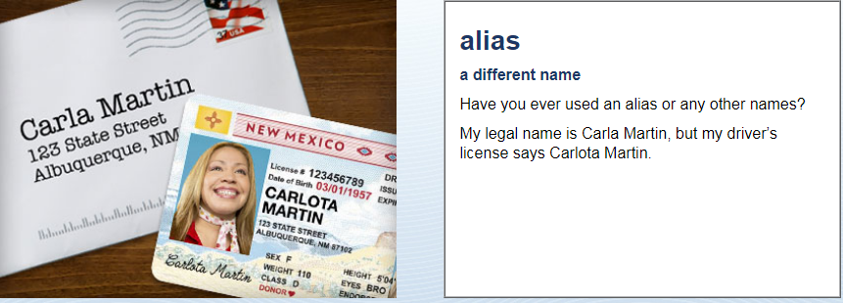
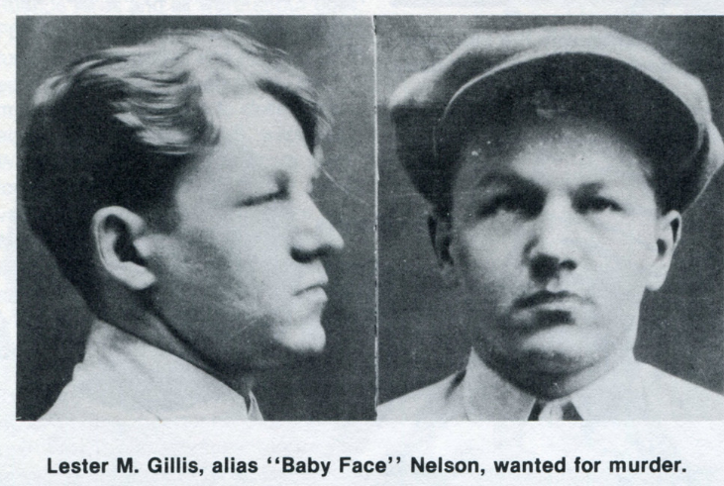
Identification
My alias is …
OR I don’t have an alias

Slide 14
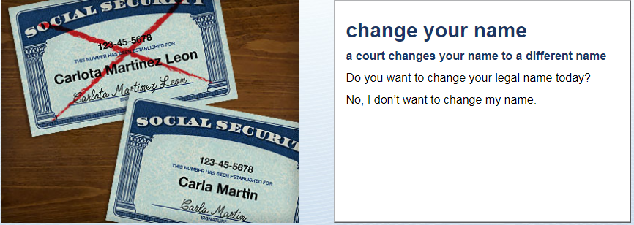
Identification
No, I don’t want to change my name.
OR Yes, I would like to change my name to …

Slide 15
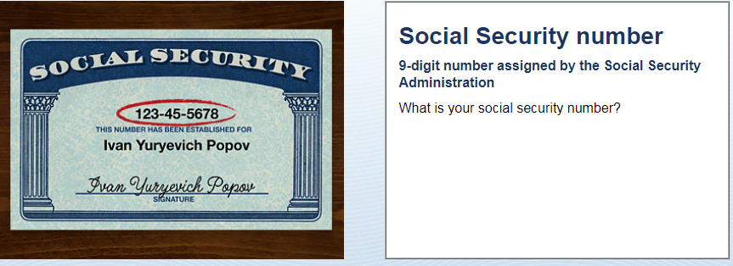
Identification
My social security number is XXX-XX-XXXX

Slide 16
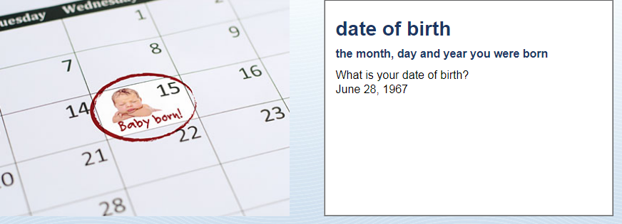
Identification
My date of birth is (month, day, year)

Slide 17
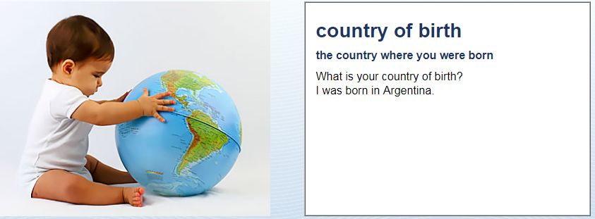
Identification
I was born in …

Slide 18
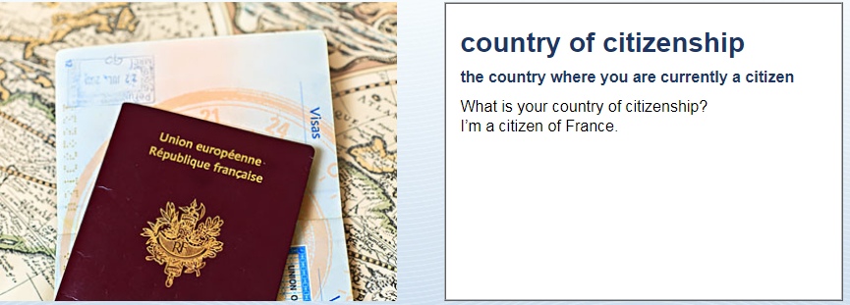
Identification
You have a passport for this country
I’m a citizen of (country)…

Slide 19
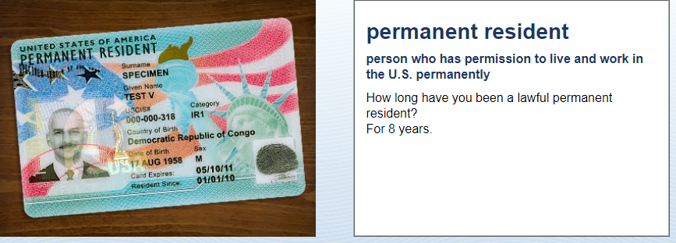
Identification
I have been a permanent resident for (number) years.

Slide 20
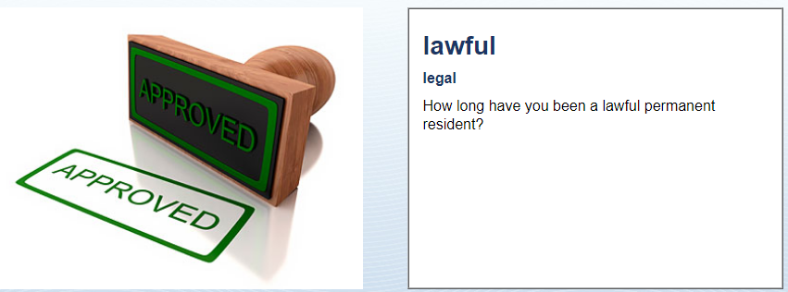
Identification
I have been a lawful permanent resident since (month, day, year).

Slide 21
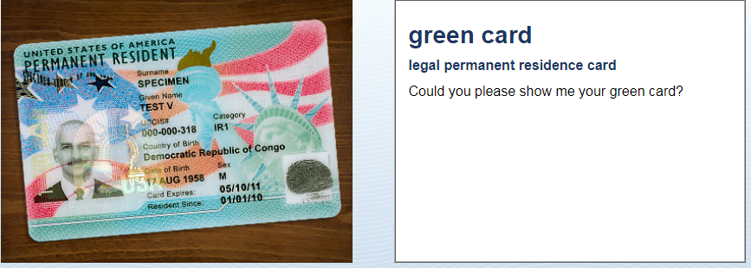
Identification
Yes, here it is.

Slide 22
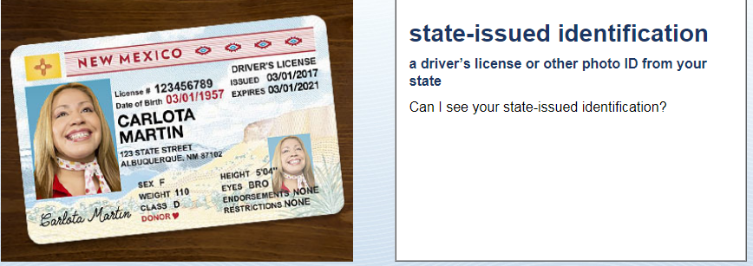
Identification
Photo ID
Here are my driver’s license, green card and passport.

Slide 24
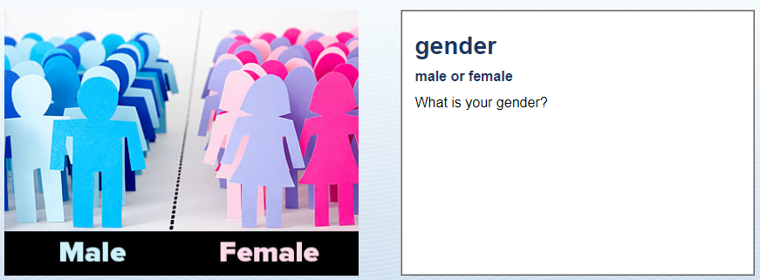
Physical Description
I am …

Slide 25
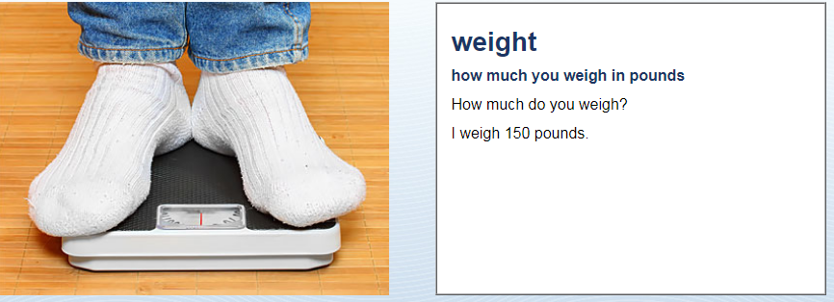
Physical Description
I weigh …

Slide 26
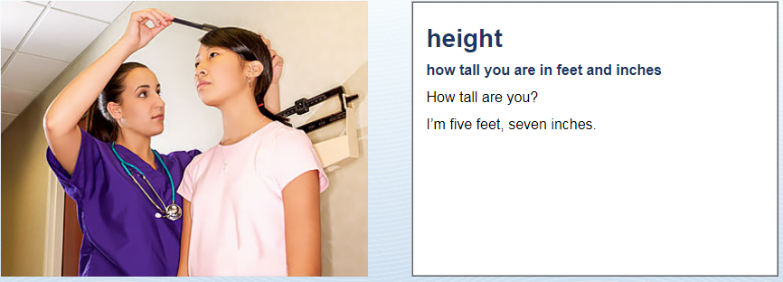
Physical Description
I am …

Slide 27
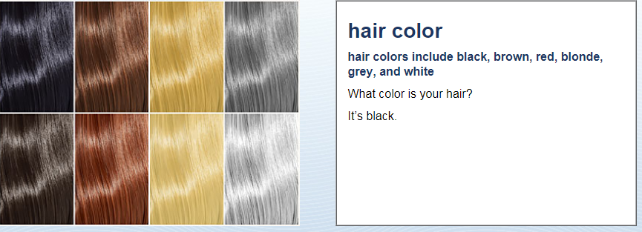
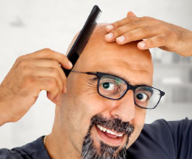
Physical Description
It is …
OR: I am bald

Slide 28
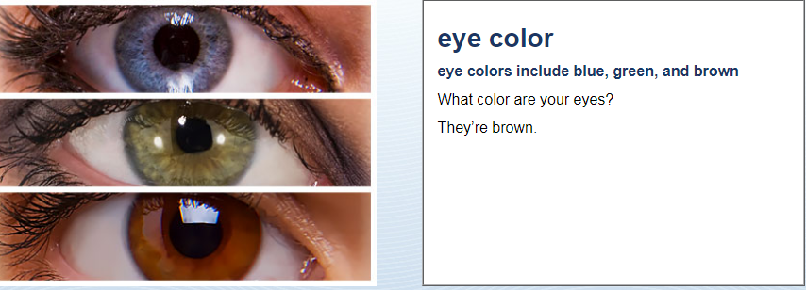
Physical Description
They are …

Slide 30
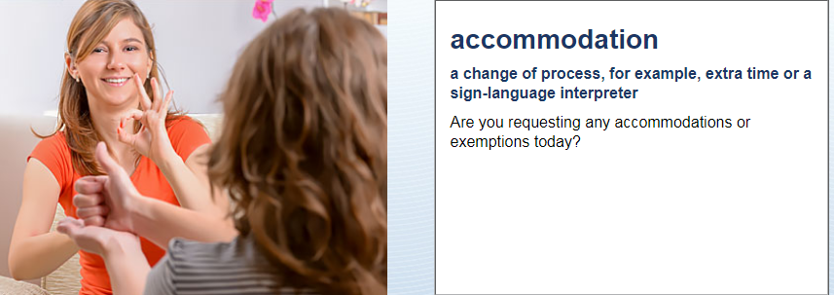
Accommodations
No, I’m not

Slide 31
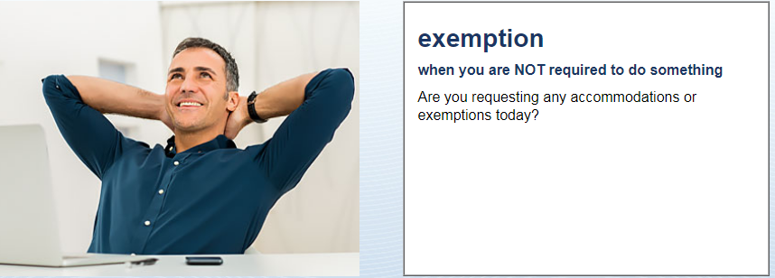
Accommodations
No, I’m not

Slide 32
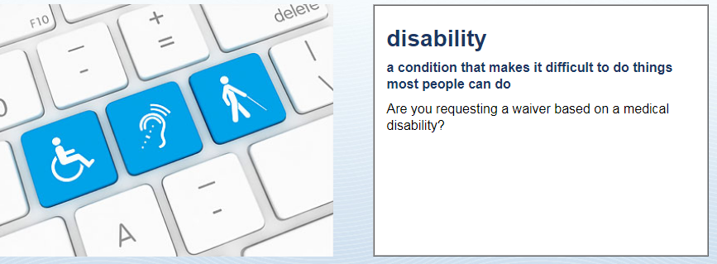
Accommodations
No, I’m not

Slide 33
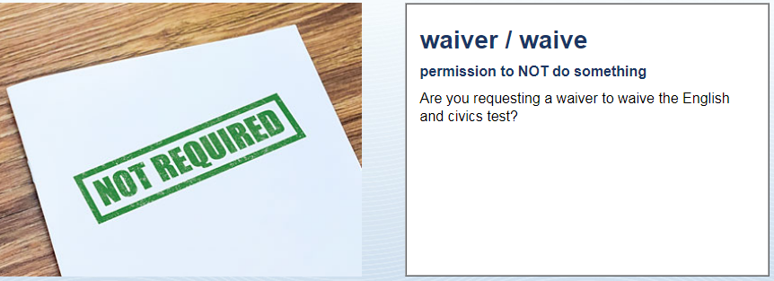
Accommodations
No, I’m not

Slide 34
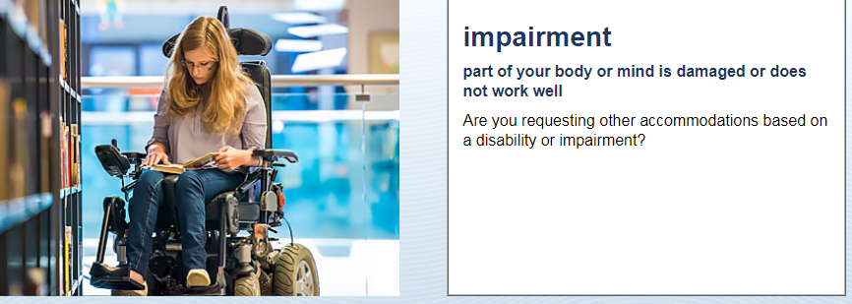
Accommodations
No, I’m not

Slide 35
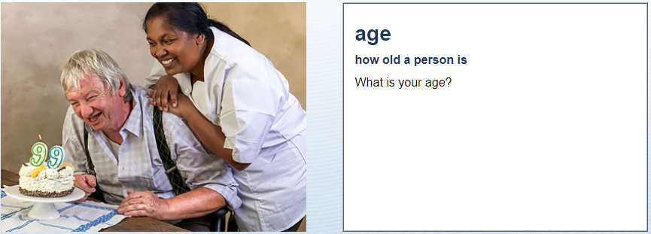
Accommodations
How old are you?
I am …

Slide 36
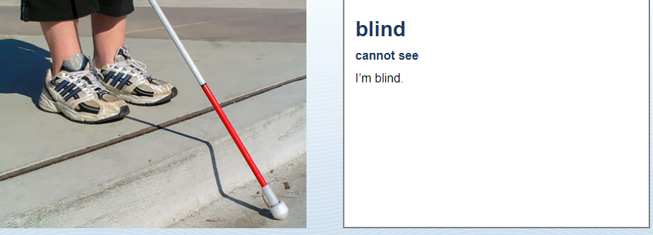
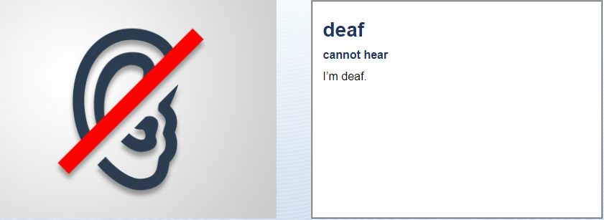
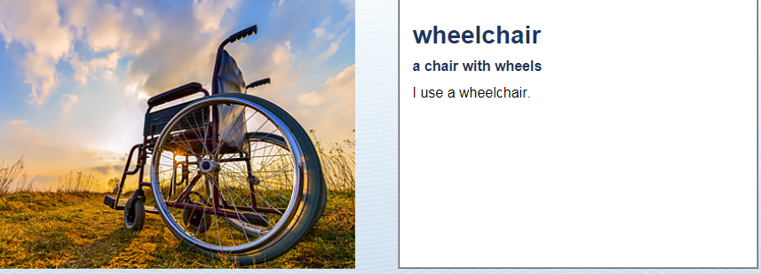
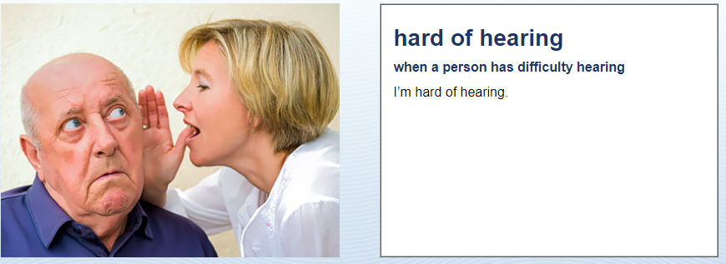
Accommodations

