Slide 1
USA Learns Citizenship
2.3 Information About You

Slide 3
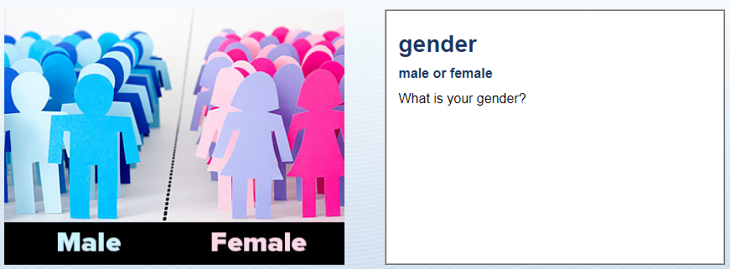
Physical Description
I am …

Slide 4
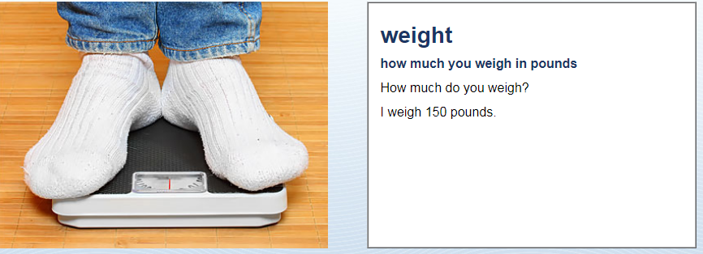
Physical Description
I weigh …

Slide 5
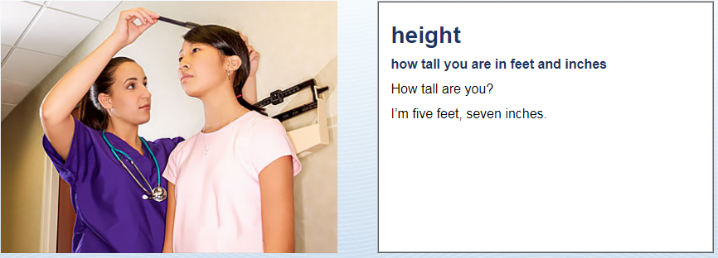
Physical Description
I am …

Slide 6
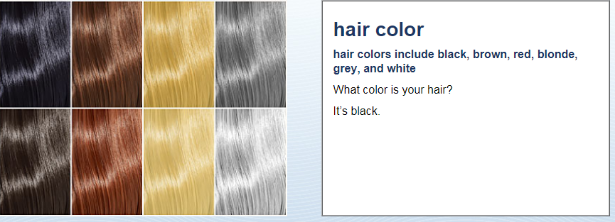
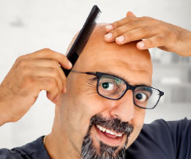
Physical Description
It is …
OR: I am bald

Slide 7
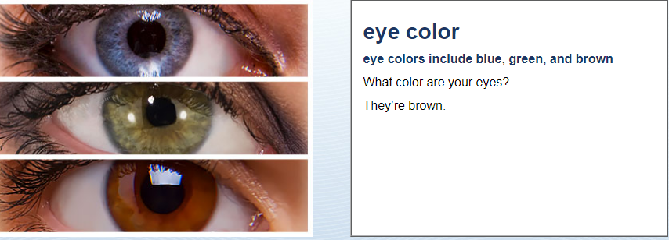
Physical Description
They are …

Slide 9
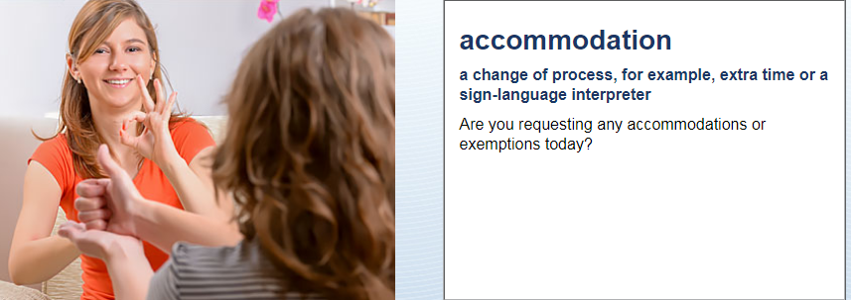
Accommodations
No, I’m not

Slide 10
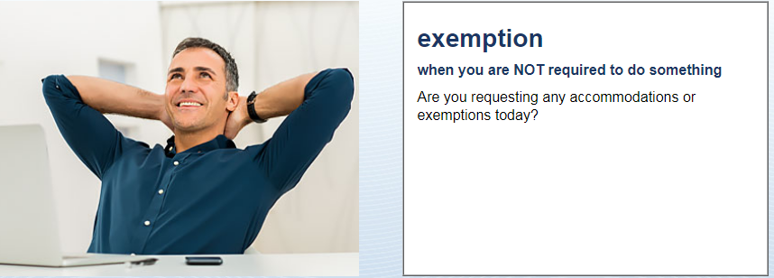
Accommodations
No, I’m not

Slide 11
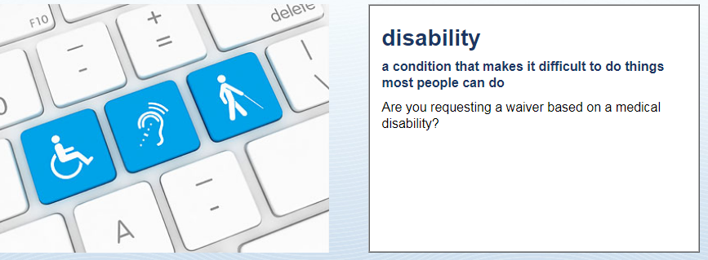
Accommodations
No, I’m not

Slide 12
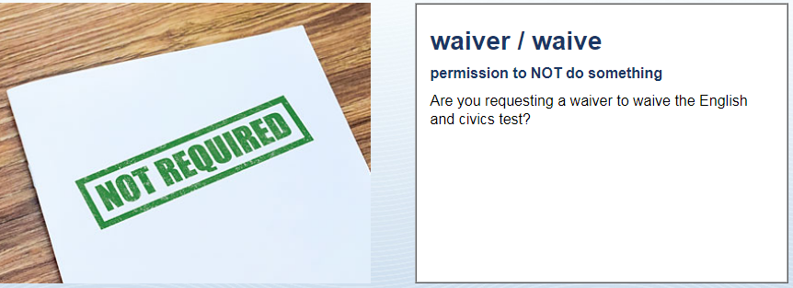
Accommodations
No, I’m not

Slide 13
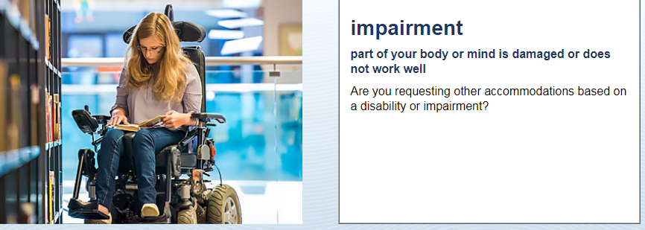
Accommodations
No, I’m not

Slide 14
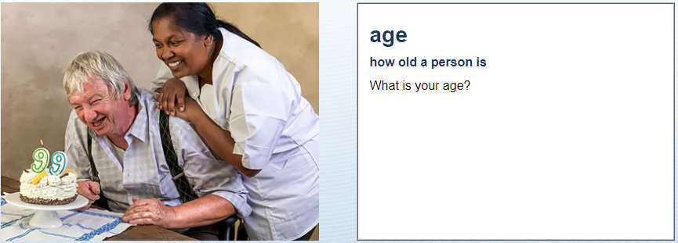
Accommodations
How old are you?
I am …

Slide 15
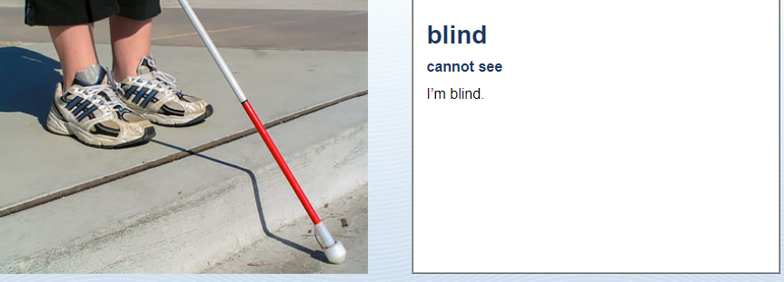
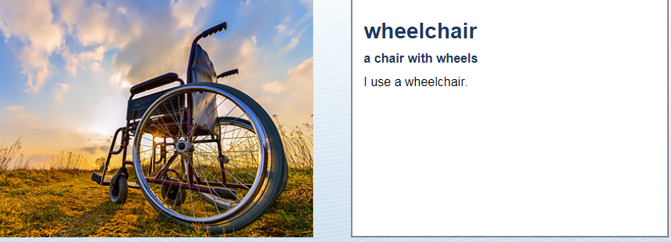
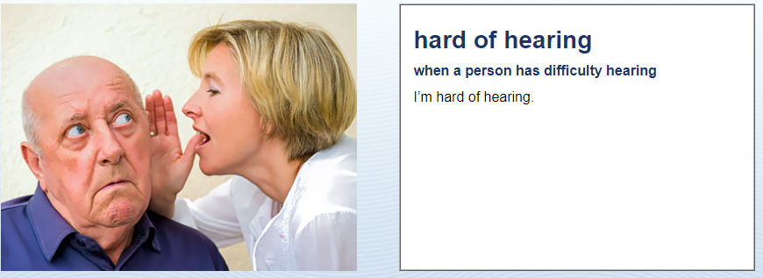
Accommodations

