Slide 1
USA Learns Citizenship
2.4 Contact Information

Slide 4
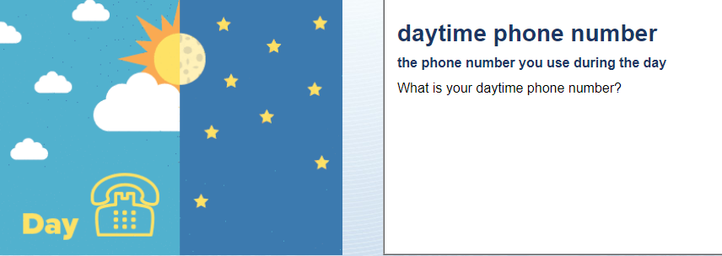
Telephone and Email
My number is …

Slide 5
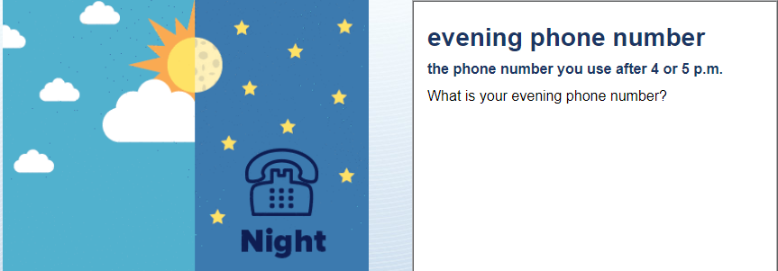
Telephone and Email
My number is …
OR: My evening number is the same as my daytime number.

Slide 6
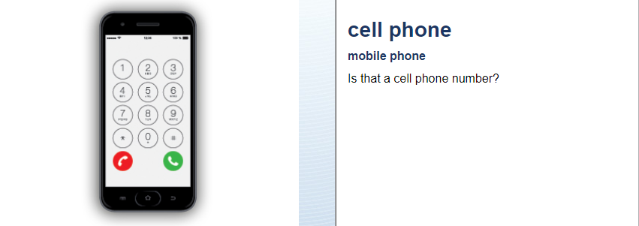
Telephone and Email
Yes, it is.
OR: No, my cell phone number is (xxx) xx xxxx

Slide 7
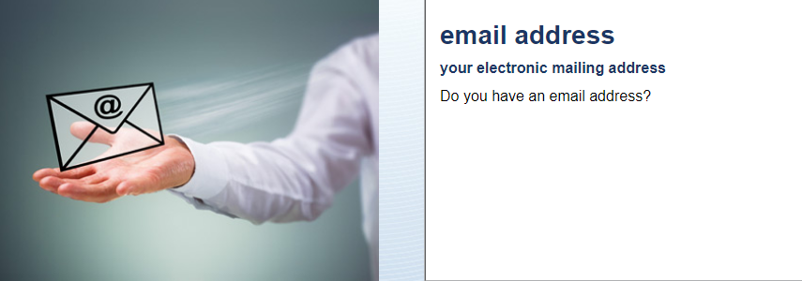
Telephone and Email
My email address is …

Slide 8
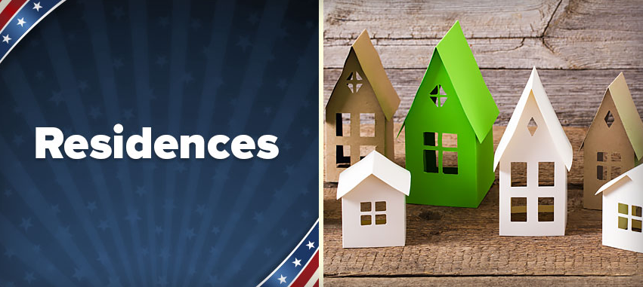

Slide 9
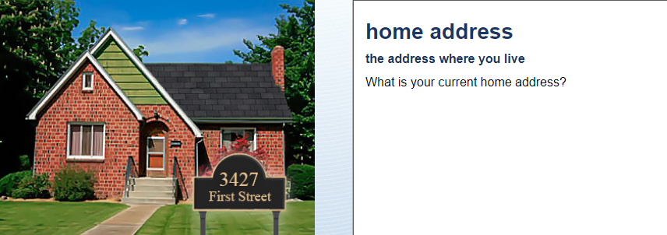
Residences
My current home address is …

Slide 10
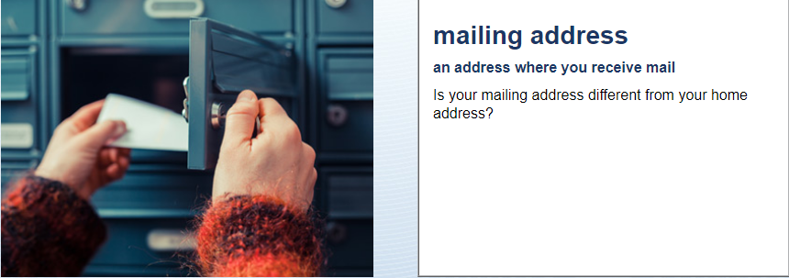
Residences
No.
OR: Yes, my mailing address is …….

Slide 11
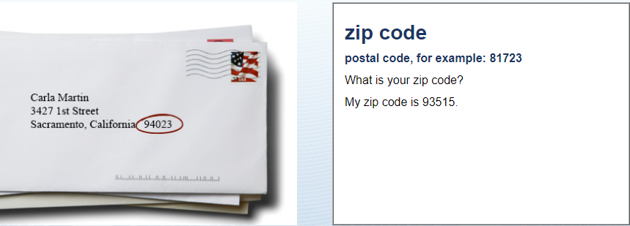
Residences
My zip code is …

Slide 12
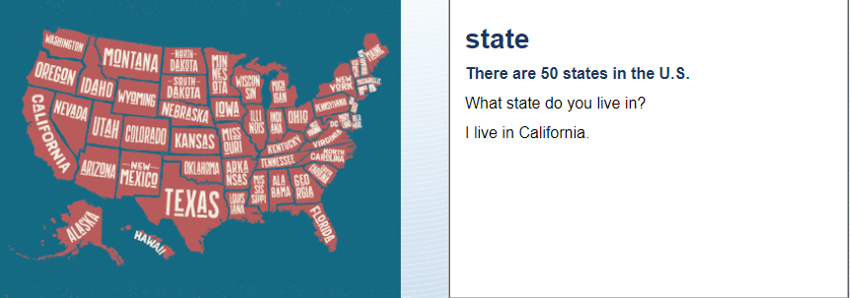
Residences
I live in California

Slide 13
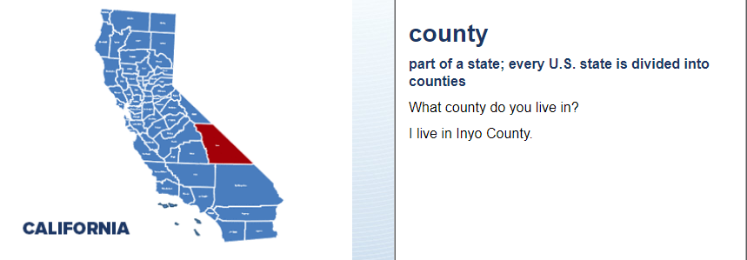
Residences
I live in Santa Clara county.

Slide 14
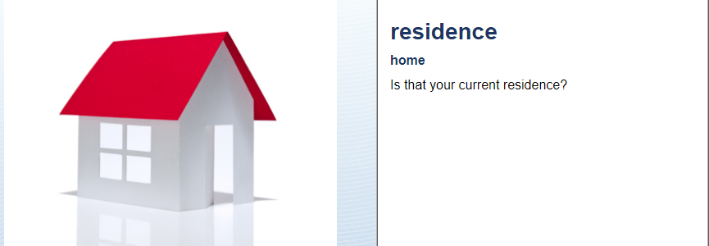
Residences
Yes, it is.

Slide 15
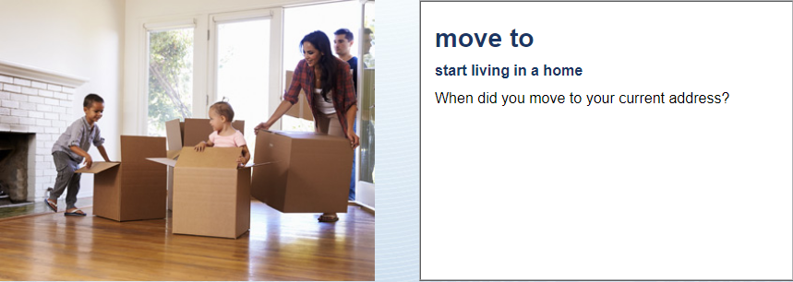
Residences
I moved there in …(month, day, year)

Slide 16
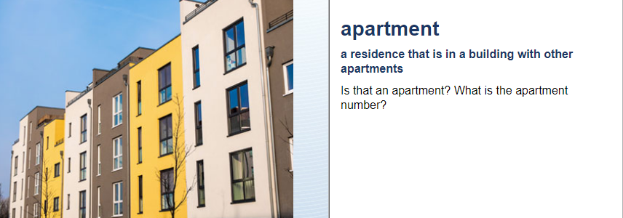
Residences
No, it is not an apartment.
OR: Yes, it is apartment number …

Slide 17
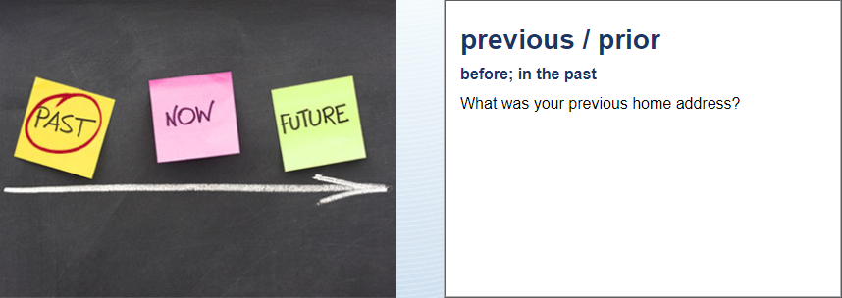
Residences
My previous address was …

