Slide 1
USA Learns Citizenship
2.5 Employment, Schools, and Travel

Slide 3
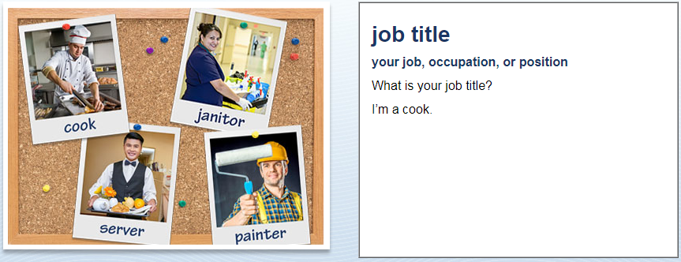
Jobs and School
What’s your job title?
I’m a teacher.

Slide 4
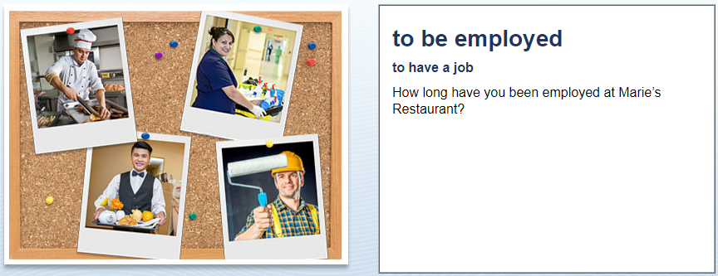
Jobs and School
I have been employed there since May 2015
I have worked there since May 2015
Since May 2015

Slide 5
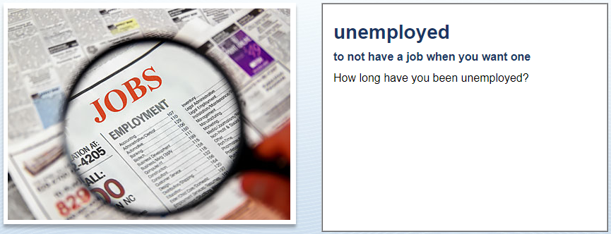
Jobs and School
I have been unemployed since June of this year.
since June of this year.

Slide 6
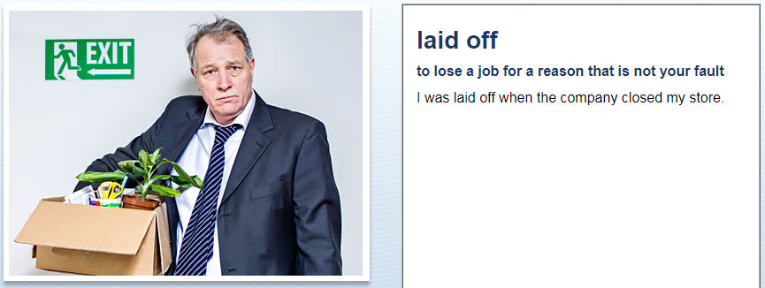
Jobs and School
Why were you laid off?
I was laid off when the company closed the store.

Slide 7
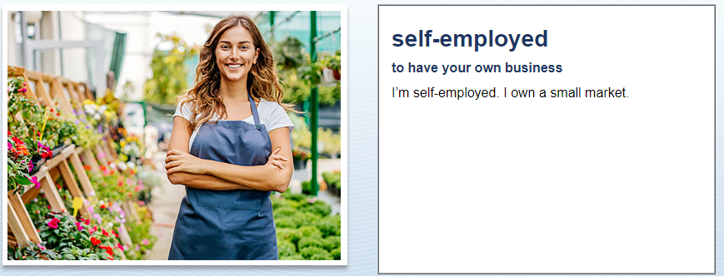
Jobs and School
Are you self-employed?
Yes, I’m self-employed: I own a small market.

Slide 8
Jobs and School
When did you start working
at your most recent job?
I started working at my most recent job last year.
Last year.

Slide 9
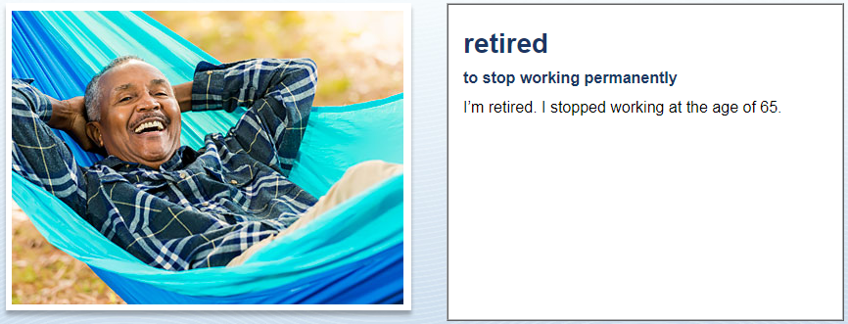
Jobs and School
What do you do for a living?
Do you work?
I’m retired.

Slide 10
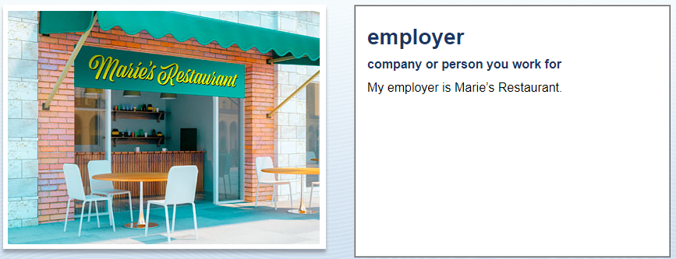
Jobs and School
Who is your employer?
My employer is Costco.
I work at Costco

Slide 11
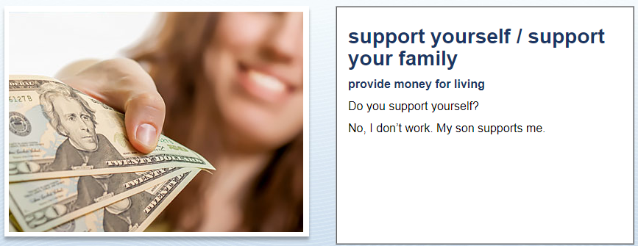
Jobs and School
How do you support yourself?
I work at Costco
I don’t work - my husband (son) supports me.

Slide 12
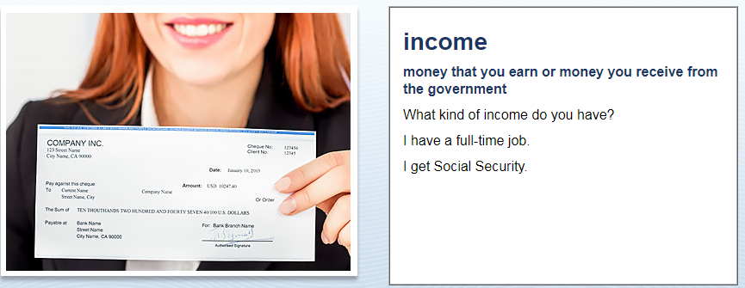
Jobs and School
What kind of income do you have?
I have a full-time job.
I have a part-time job.
I’m retired – I have Social Security
My daughter supports me.

