Slide 1
USA Learns Citizenship
2.5 Employment, Schools, and Travel

Slide 3
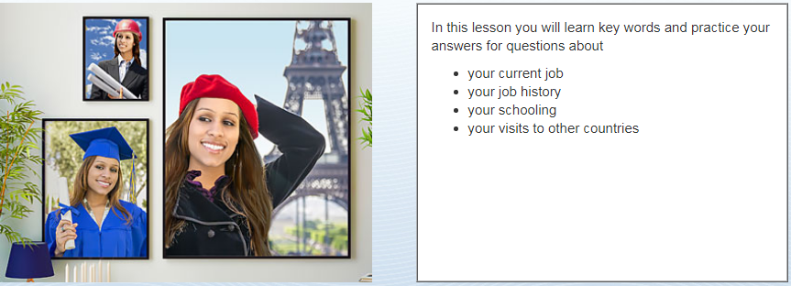
Objectives

Slide 5
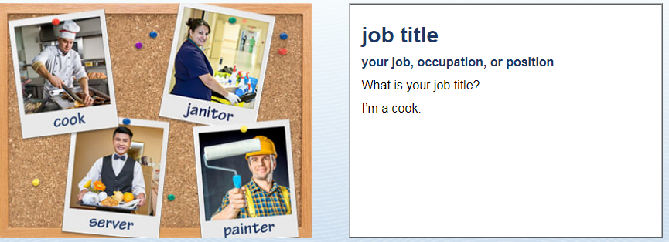
Jobs and Schools
Teacher
Student
Housewife
I’m a …
OR: I’m retired / unemployed

Slide 6
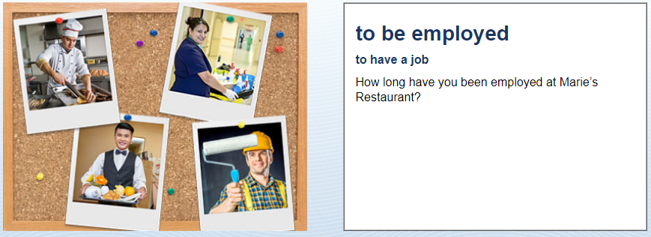
Jobs and Schools
I’ve been employed there since (date)…
OR: I’ve worked there for (number) years

Slide 7
Jobs and Schools
Since (date) …

Slide 8
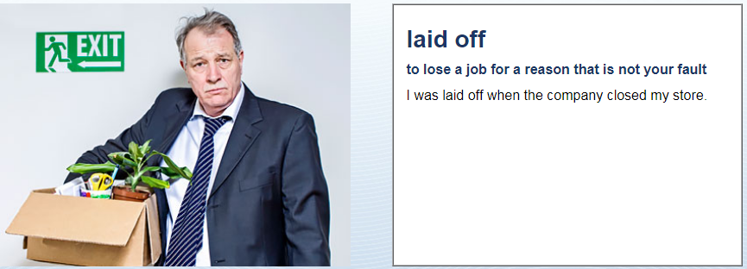
Jobs and Schools
Why were you laid off?

Slide 9
Jobs and Schools
Are you self-employed?
No – I work for (company).
OR: Yes, I own a small (restaurant)

Slide 10
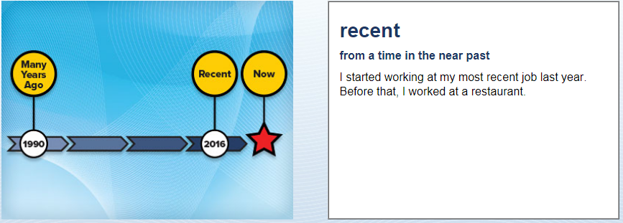
Jobs and Schools
When did you start working at your most recent job?
Current job
Now
I started working at my most recent job in (Date)…

Slide 11
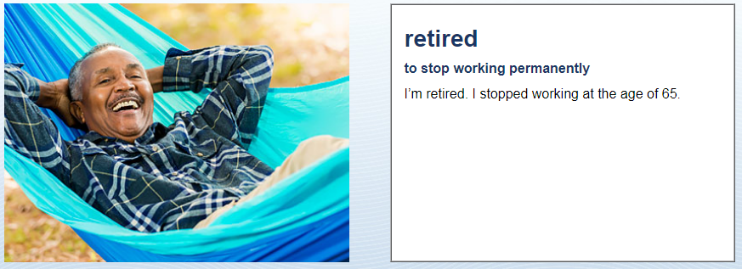
Jobs and Schools
I’m retired. I retired in (date).

Slide 12
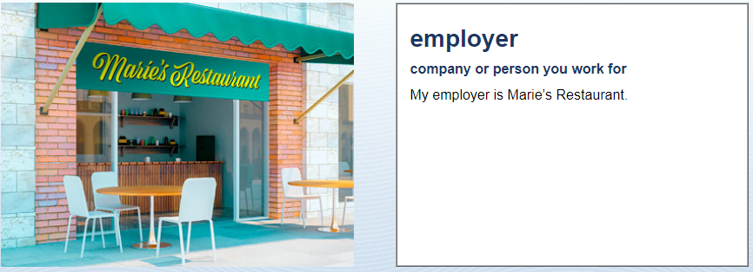
Jobs and Schools
Who is your employer?
My employer is (company name) …

Slide 13
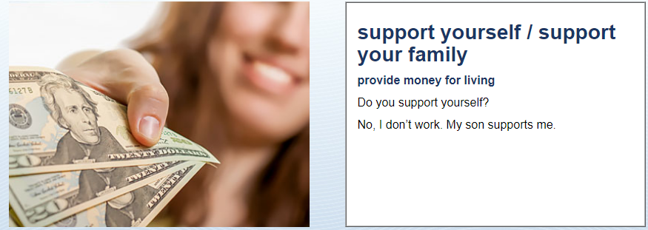
Jobs and Schools
How do you support yourself?
What do you do for a living?
$$$$?????
I work as a (job title) …
OR: I don’t work; my husband supports me.

Slide 14
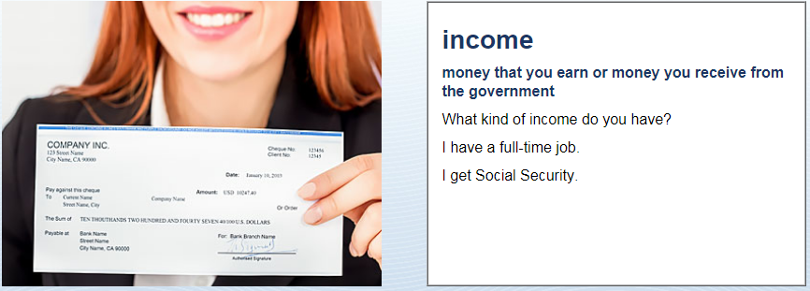
Jobs and Schools
I have a full-time job as a (job title) ….
I get Social Security.
I have a (retirement) pension.

