Slide 1
USA Learns Citizenship
2.5 Employment, Schools, and Travel

Slide 3
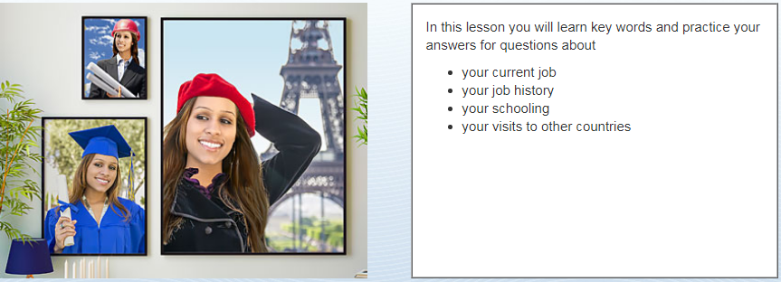
Objectives

Slide 5
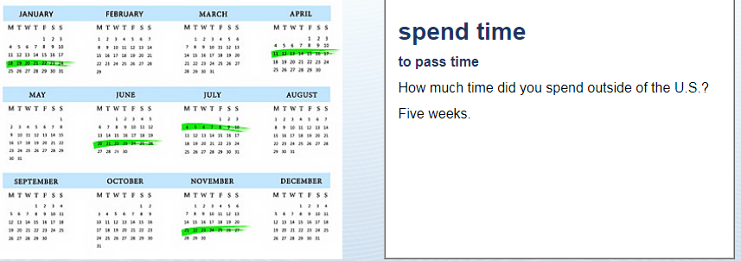
Time Outside the US
I spent (weeks) outside the US

Slide 6
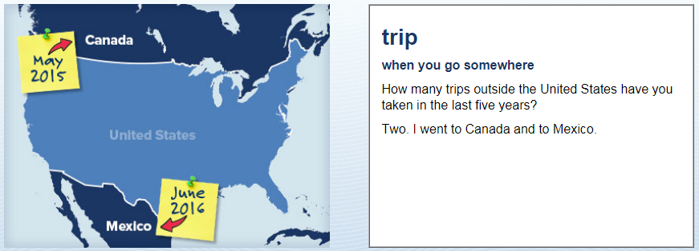
Time Outside the US
(Number): I went to X and Y…

Slide 7
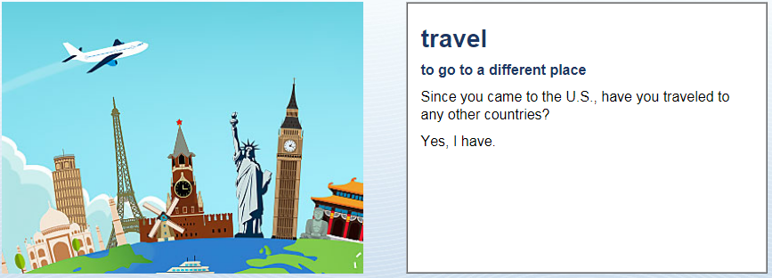
Time Outside the US
Yes, I have. I went to … .
OR: No, I have not

Slide 8
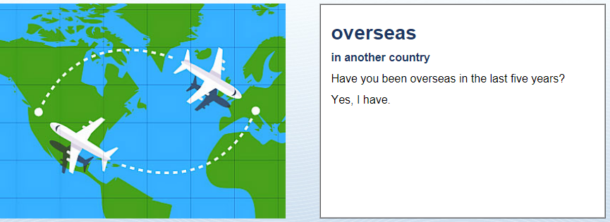
Time Outside the US
Yes, I have. I went to (country) for (weeks)
OR: No, I have not.

Slide 9
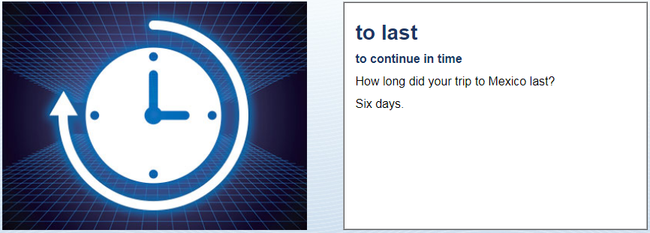
Time Outside the US
My trip lasted (number) weeks

Slide 10
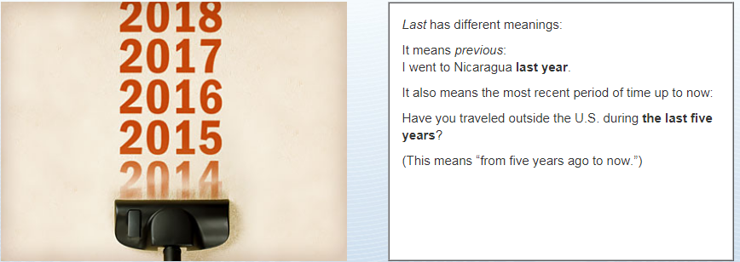
Time Outside the US

Slide 11
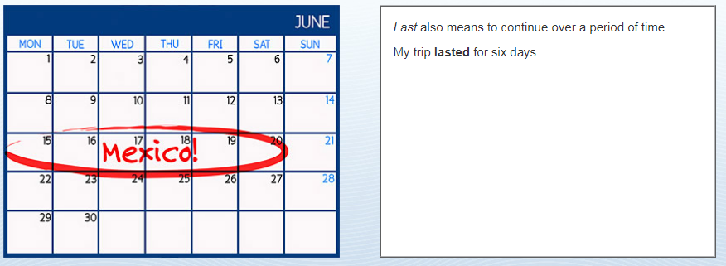
Time Outside the US

Slide 12
Time Outside the US

