Slide 1
USA Learns Citizenship
2.6 Family Relationships

Slide 3
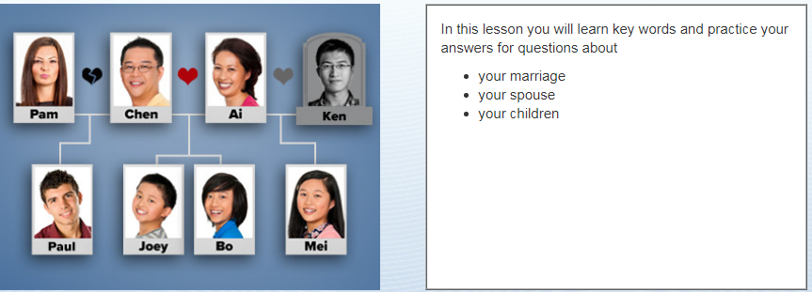
Objectives

Slide 5
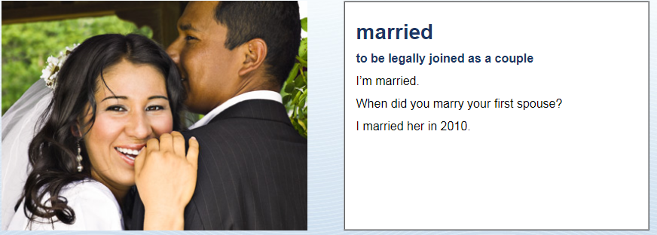
Marital History
When did you get married?
We got married in (date) …

Slide 6
Marital History

Slide 7
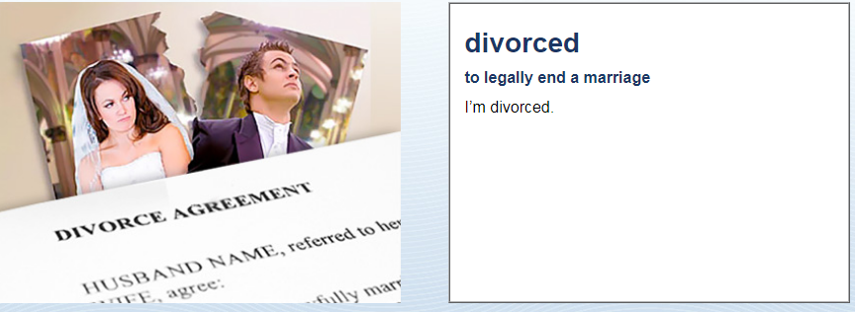
Marital History
When did you get divorced?
We got divorced in (date) …

Slide 8
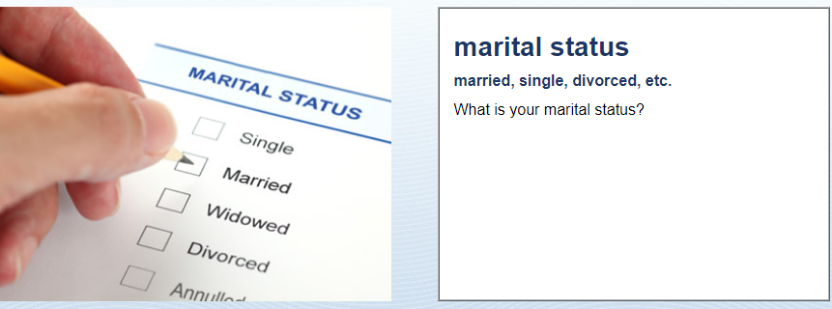
Marital History
Single
Married
Divorced
Widowed
I’m …

Slide 9
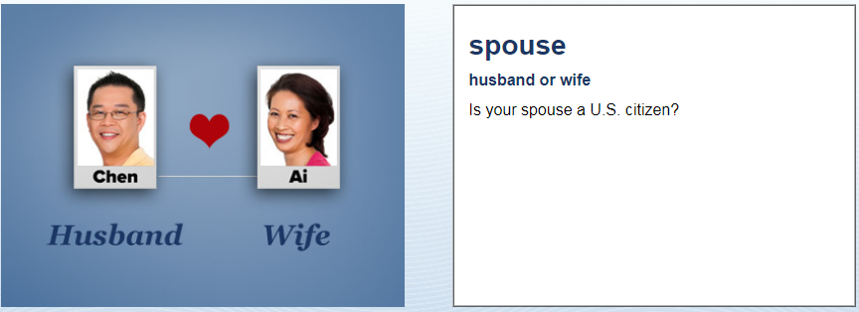
Marital History
Yes, s/he is.
OR: No, s/he is not.

Slide 10
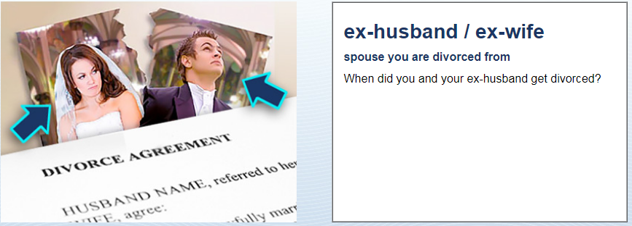
Marital History
We got divorced in (date) …

Slide 11
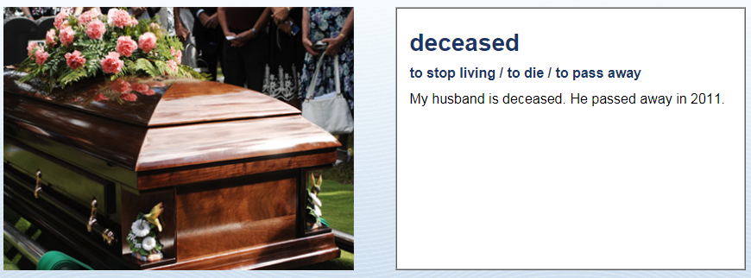
Marital History
Is your spouse deceased?
Yes, s/he passed away in (date) …
OR: No, s/he is not

Slide 12
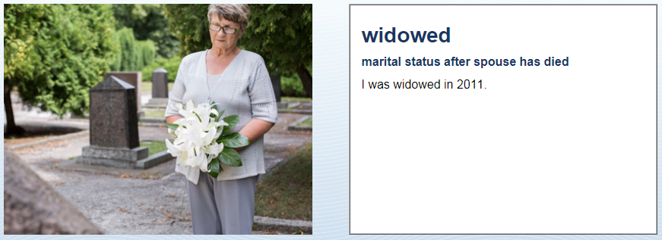
Marital History
When were you widowed?
I was widowed in (date) …

Slide 13
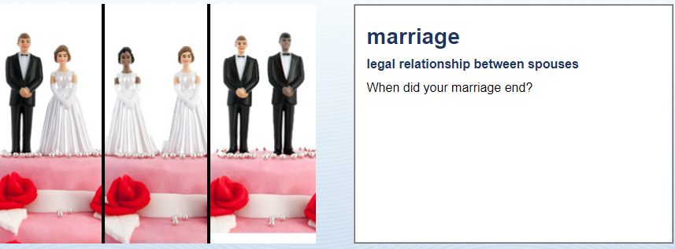
Marital History
The marriage ended in (date) …

Slide 14
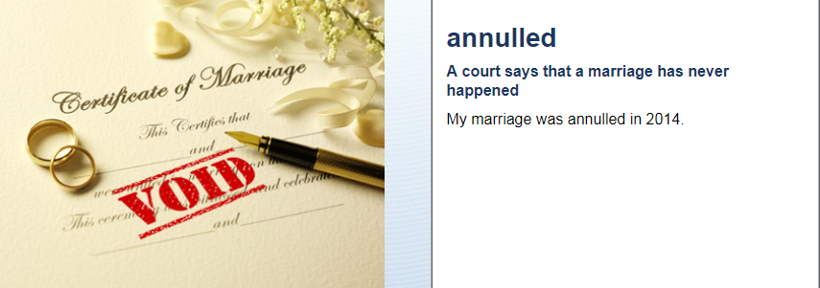
Marital History

Slide 15
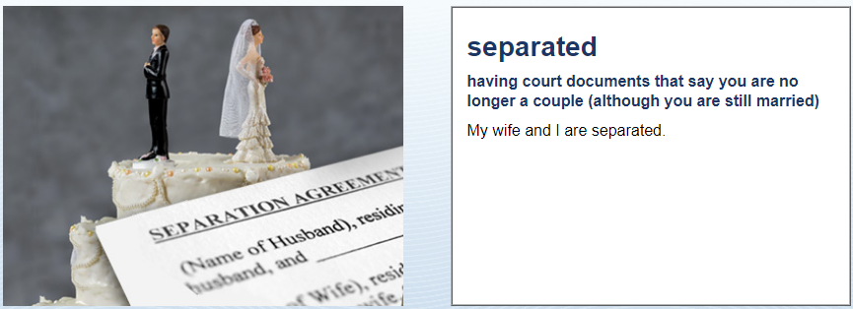
Marital History
Are you legally separated
from your spouse?
Yes, I am.
OR: No, I am not.

Slide 16
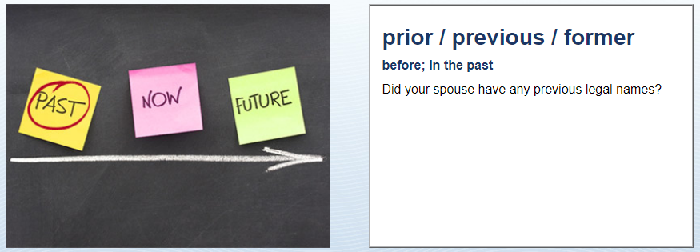
Marital History
Was your previous spouse
a US citizen?
Yes, s/he was
OR no, s/he was not

Slide 17
Marriages
Current Marital Status
Single
Married
Date
Spouse Current Address
Spouse Immigration Status
Divorced
Date: marriage & divorce
Spouse Current Address
Spouse Immigration Status
Widowed
Date: marriage & death
Spouse Immigration Status
Be prepared to answer same questions about your previous marriage/s

