Slide 1
USA Learns Citizenship
2.8 Memberships and Associations

Slide 4
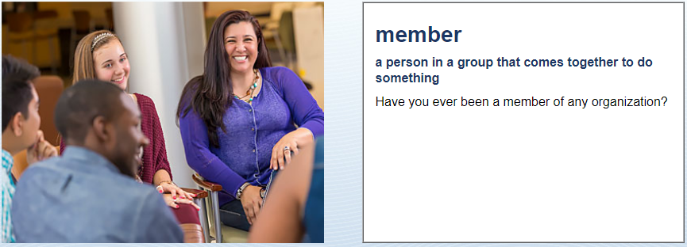
Groups
Church
Union
Yoga group
Reading club
Golf club
No, never
Yes, I belong to a church

Slide 5
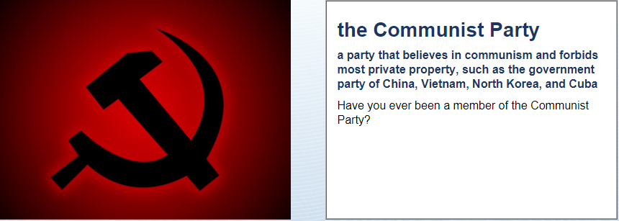
Groups
No, never
What is Communism?
No freedom – like China or North Korea.

Slide 6
Have (were, did) you ever … ?
Usually, the answer is No
Have you ever …
Been a terrorist?
Been a habitual drunk?
Been a Communist?
Been a drug dealer?
Been a Nazi?

Slide 7
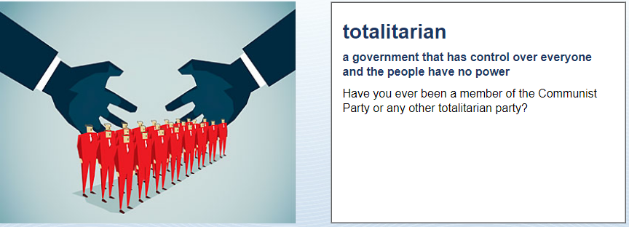
Groups
No, never
What is totalitarianism?
No freedom – like Nazi Germany

Slide 8
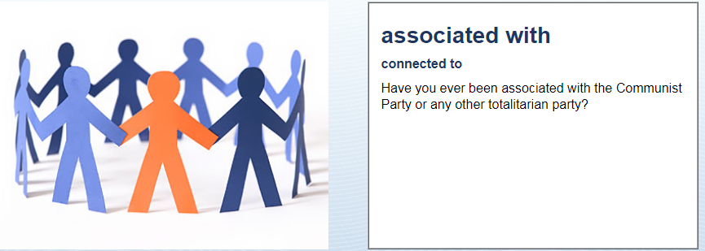
Groups
No, never

Slide 9
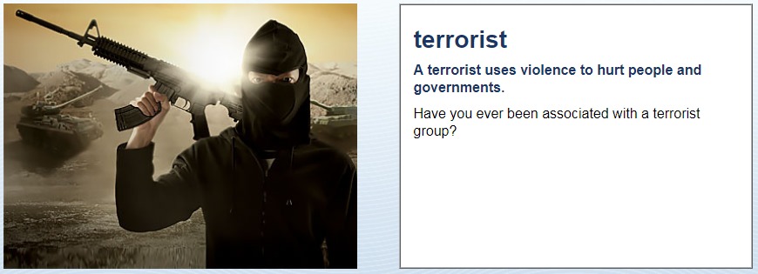
Groups
No, never
What is terrorism?
A terrorist group uses violence to hurt people - like ISIS

Slide 10
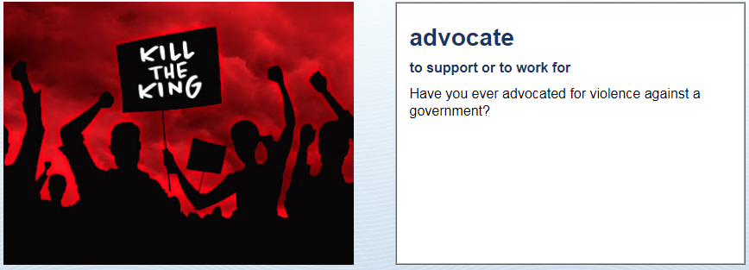
Groups
No, never

Slide 11
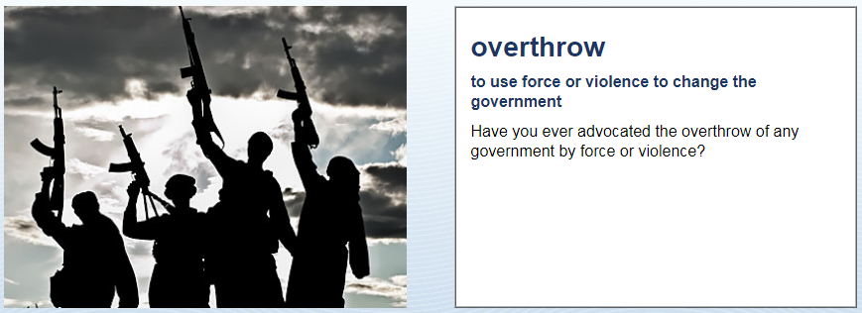
Groups
No, never

