Slide 1
Basic Citizenship Interview Quiz
Review

Slide 2
Green card

Slide 3
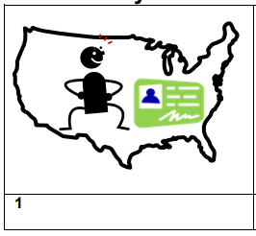
Legal permanent resident

Slide 4
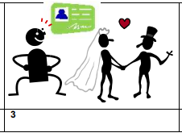
eligibility

Slide 5
Full name

Slide 6
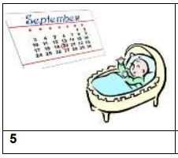
Date of birth

Slide 7
Date of residence

Slide 8
Country of birth

Slide 9
Country of nationality

Slide 10
disability

Slide 11
Phone number

Slide 12
Home address

Slide 13
Parent is a US citizen

Slide 14
work

Slide 15
school

Slide 16
travel outside the US

Slide 17
single

Slide 18
married

Slide 19
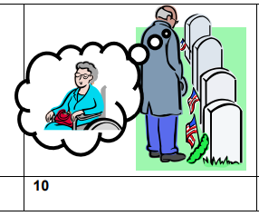
widowed

Slide 20
divorced

Slide 21
children

