Slide 1
Basic Citizenship Interview Quiz
Review

Slide 2
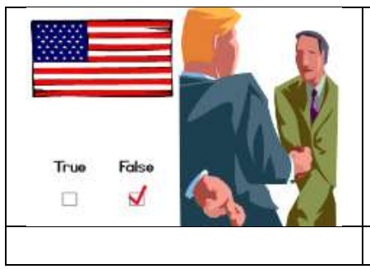
Claim to be a US citizen

Slide 3
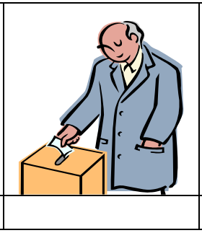
vote

Slide 4
nobility

Slide 5
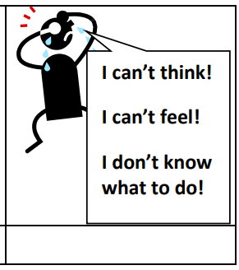
Legally incompetent

Slide 6
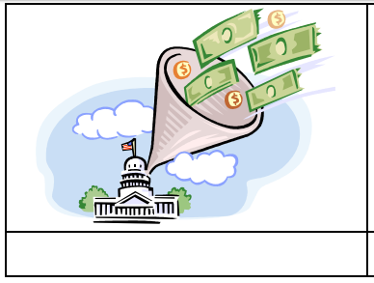
taxes

Slide 7
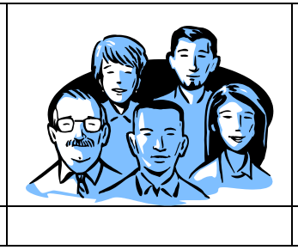
group

Slide 8
communist

Slide 9
terrorist

Slide 10
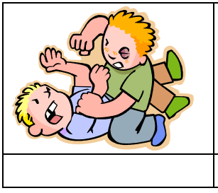
Hurt or kill

Slide 11
Military unit

Slide 12
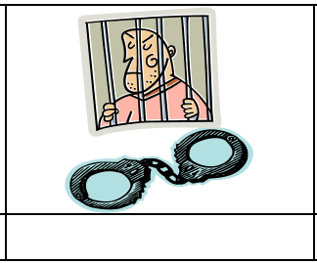
arrested

Slide 13
Habitual drunkard

Slide 14
illegal drugs

Slide 15
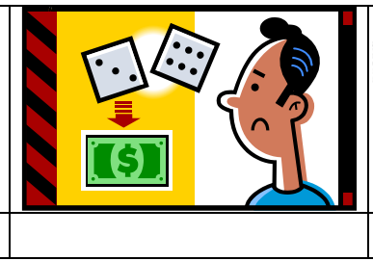
illegal gambling

Slide 16
Lie to get benefits

Slide 17
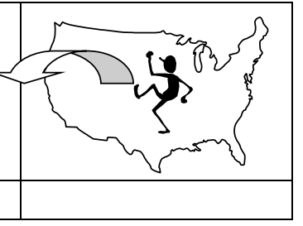
deported

Slide 18
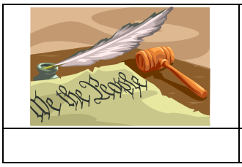
US Constitution

Slide 19
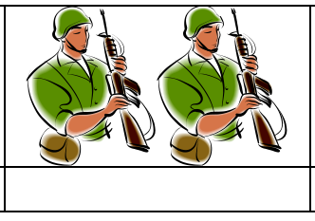
Bear arms

Slide 20
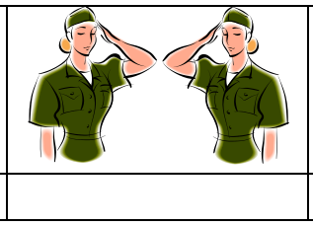
Non-combatant

Slide 21
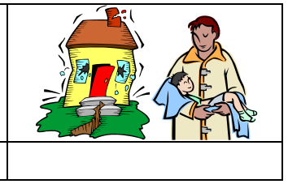
National emergency

