Slide 1
Basic Citizenship Interview Quiz
Review

Slide 2
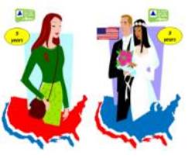
Eligible

Slide 3
Legal name

Slide 4
accommodation

Slide 5
Phone number

Slide 6
Home address

Slide 7
US citizen

Slide 8
Hispanic

Slide 9
work

Slide 10
trips

Slide 11
married

Slide 12
children

Slide 13
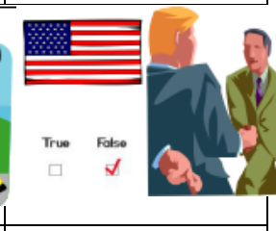
claim

Slide 14
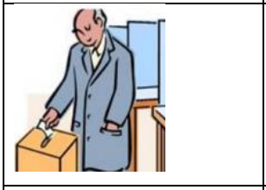
voted

Slide 15
taxes

Slide 16
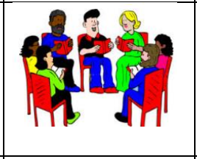
groups

Slide 17
Communist

Slide 18
terrorist

Slide 19
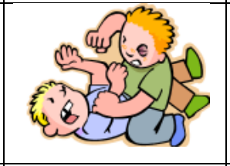
Hurt or killed

Slide 20
Rebel group

Slide 21
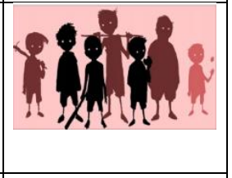
gang

Slide 22
Marry Green Card

Slide 23
weapons

Slide 24
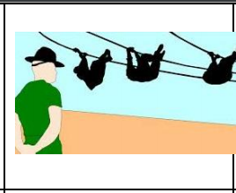
Military training

Slide 25
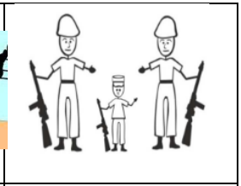
Child soldier

Slide 26
arrested

Slide 27
drunkard

Slide 28
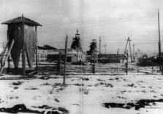
Labor camp

Slide 29
US armed forces

Slide 30
Lie for welfare

Slide 31
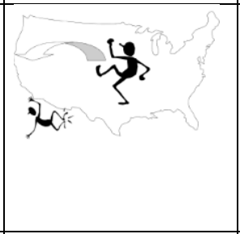
Deported

Slide 32
Bear arms

Slide 33
Constitution

Slide 34
killed

Slide 35
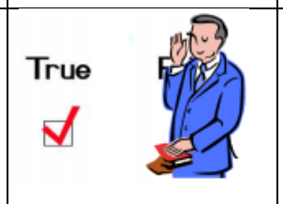
Oath

Slide 36
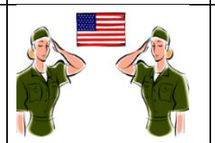
Non-combatant

Slide 37
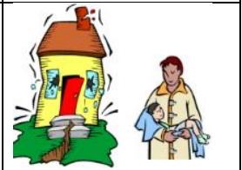
National emergency

