Slide 1
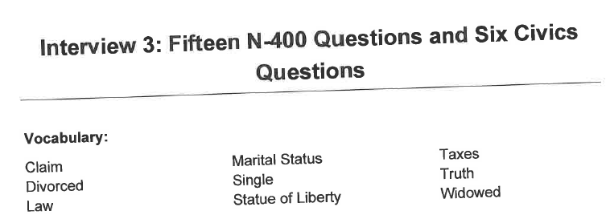
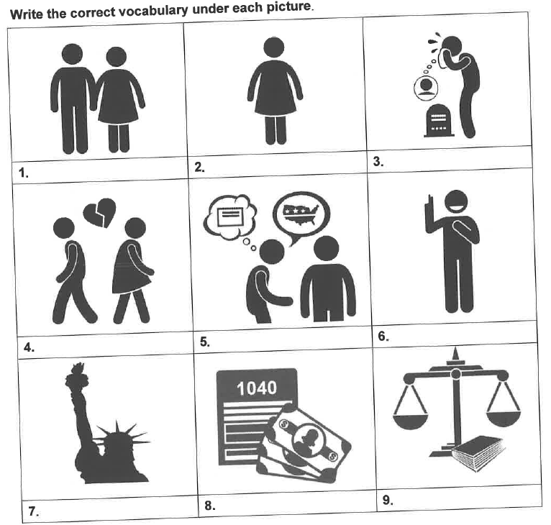
Marital status
Single
Widowed
Divorced
Claim
Truth
Statue of
Liberty
Taxes
Law

Slide 2
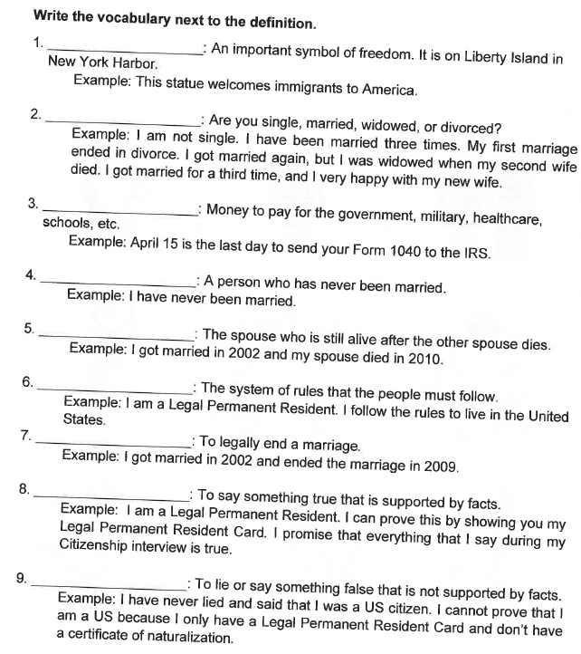
Statue of Liberty
Marital status
Taxes
Single
Widowed
Law
Divorced
Truth
Claim

