Slide 1
Civics Corner
Part 05

Slide 2
Saturday Closures
October 12
November 30
December 21 & 28
January 4
February 22
April 11
May 23
Last class = May 30

Slide 3
First Interview Questions!
Why are you here today?
I’m here for my citizenship interview.
I want to become a US citizen
Why do you want to become a US citizen?
I love America!
I want to be able to vote.
I want a US passport.
I want to live with my family.

Slide 4
First Interview Questions!
How are you eligible to become a US citizen?
I have been a permanent resident for (>5) years.
OR
I have been a permanent resident for 3 years and I’m married to a US citizen.

Slide 5
First Interview Questions!
Please remain standing and raise your right hand. Repeat after me:
I promise to tell the truth, the whole truth and nothing but the truth, so help me God.
Do you understand what an oath is?
Yes, it is a promise to tell the truth
What did you just promise?
I promised to tell the truth.

Slide 6
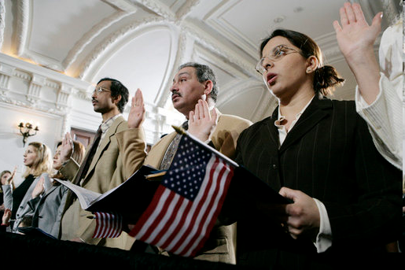
Review of Last Week’s Civics Qs
Q31 - 40

Slide 7
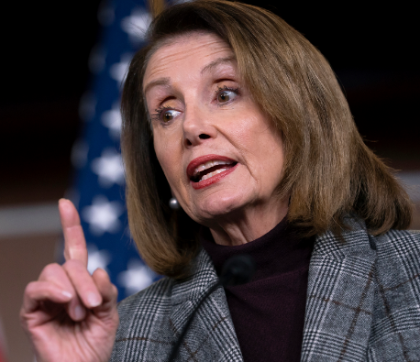
Question 31 If both the President and the Vice President can no longer serve, who becomes President?
the Speaker of the House

Slide 8
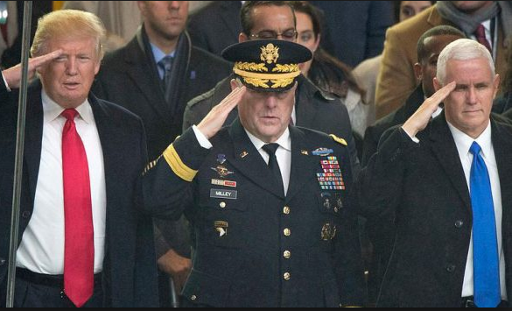
Question 32 Who is the Commander and Chief of the military?
the President

Slide 9
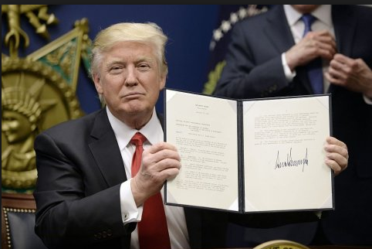
Question 33 Who signs bills to become law?
the President

Slide 10
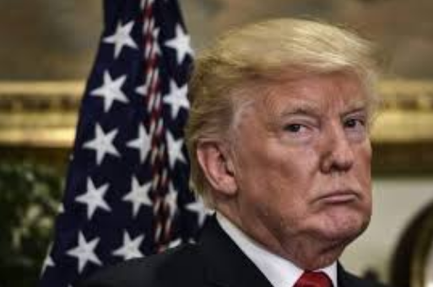
Question 34 Who vetoes bills?
the President

Slide 11
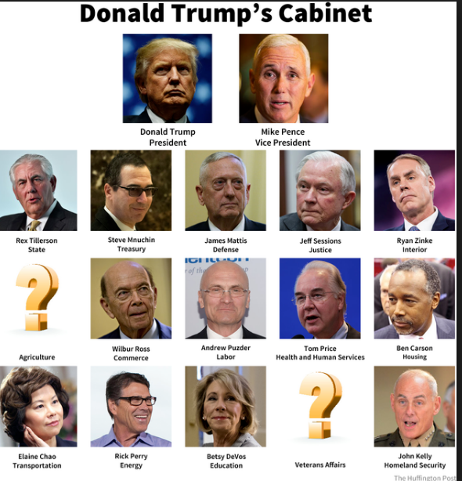
Question 35 What does the President’s Cabinet do?
advises the President

Slide 12
Question 36 What are two Cabinet-level positions?
Secretary of Defense
Secretary of State

Slide 13
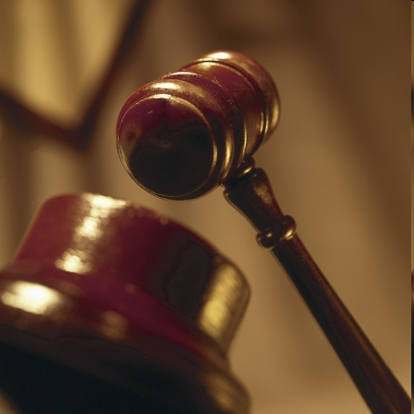
Question 37 What does the judicial branch do?
reviews laws
explains the laws
resolves disputes

Slide 14
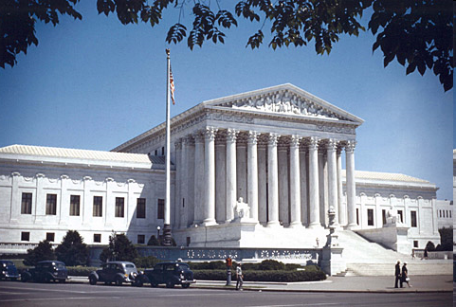
Question 38 What is the highest court in the United States?
the Supreme Court

Slide 15
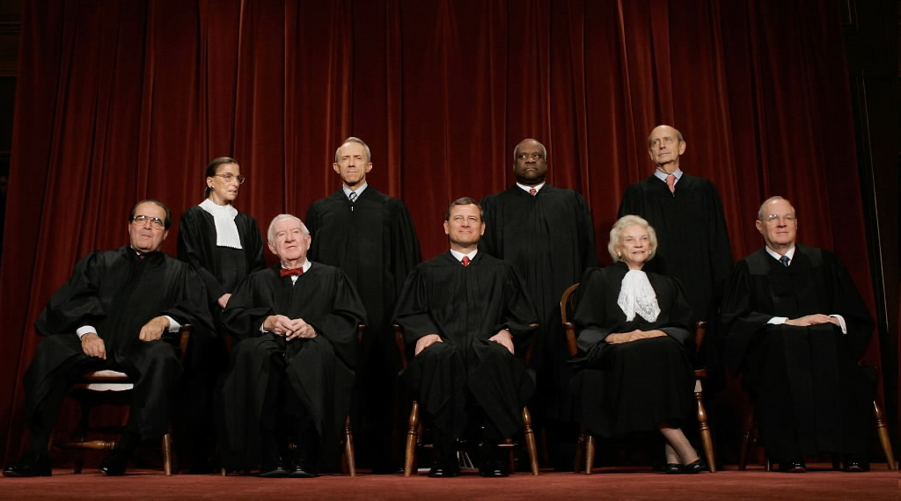
Question 39 How many justices are on the Supreme Court?
nine (9)

Slide 16
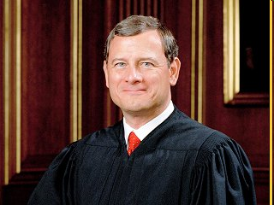
Question 40 Who is the Chief Justice of the United States?
John Roberts

Slide 17
Preparing for the Oath:
Congress

Slide 18
Dictation Practice
Read the sentences out loud.
Write down the sentences that I dictate.

Slide 19
Read.
16
Who lived in America first?
Write.
The American Indians lived here first.

Slide 20
Read.
17
When is Independence Day?
Write.
Independence Day is in July.

Slide 21
Read.
18
Who was the first President?
Write.
Washington was the first President.

Slide 22
Read.
19
Where does Congress meet?
Write.
Congress meets in Washington.

Slide 23
Read.
20
When is Columbus Day?
Write.
Columbus Day is in October.

Slide 24
Dictation Review
The American Indians lived here first.
Independence Day is in July.
Washington was the first President.
Congress meets in Washington.
Columbus Day is in October.
Notes:
16. R: Who lived in America first?
W: The American Indians lived here first.
17. R: When is Independence Day?
W: Independence Day is in July.
18. R: Who was the first President?
W: Washington was the first President.
19. R: Where does Congress meet?
W: Congress meets in Washington.
20. R: When is Columbus Day?
W: Columbus Day is in October.

Slide 25
More Admin
On my desk:
Please fill in the Interview Date sheet.
Please email me your results after you’ve had your interview: amclin@cuhsd.org
Did everyone sign in???

Slide 26
Take a Break!! 10 minutes

