Slide 1
Civics Corner
Part 07

Slide 2
Saturday Closures
November 30
December 21 & 28
January 4
February 22
April 11
May 23
Last class = May 30

Slide 3
Interview Small Talk
How are you?
I’m good, thank you. And you?
How’s the weather outside?
Oh, not bad
How did you come here today?
I drove my car; my daughter drove me.
What’s the traffic like?
Not too bad – only 20 minutes to get here.

Slide 4
Interview Small Talk
Why did you come here today?
I want to become an American citizen
Why do you want to be a U. S. citizen?
I want to vote, have a US passport, live with my family
Have you studied for the citizenship test?
Yes, I’m taking a citizenship course in Campbell
Do you have your permanent resident card?
Yes, here is my green card, my driver’s license and my passport.
How are you eligible to become a US citizen?
I have been a permanent resident for 5 years.

Slide 5
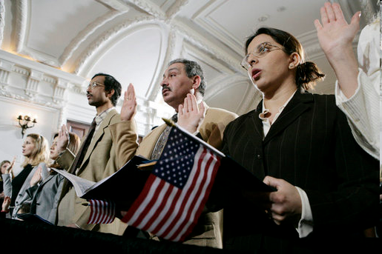
Review of Last Week’s Civics Qs
Q51 – 60

Slide 6
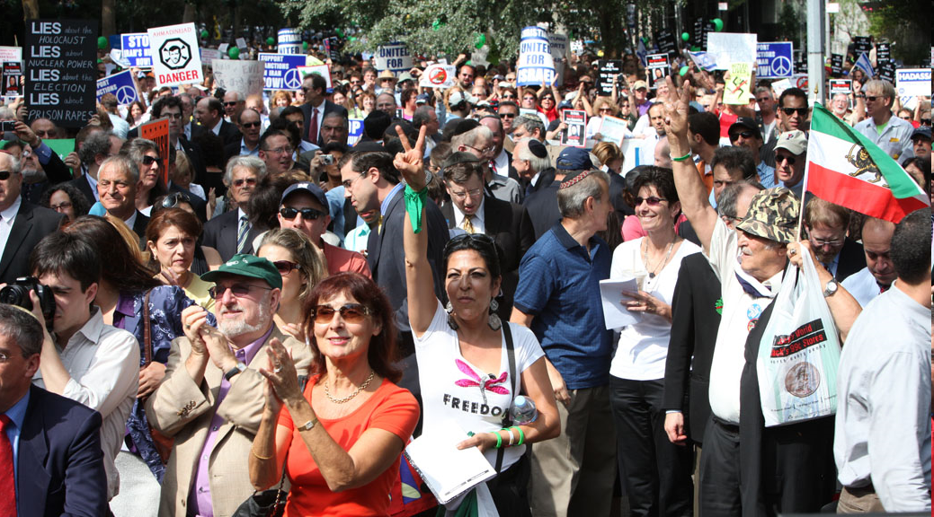
Question 51 What are two rights of everyone living in the United States?
freedom of expression
freedom to petition the government
freedom of speech
freedom of worship
freedom of assembly
the right to bear arms

Slide 7
Question 52 What do we show loyalty to when we say the Pledge of Allegiance?
the United States
the flag

Slide 8
Question 53 What is one promise you make when you become a United States citizen?
give up loyalty to other countries
defend the Constitution and laws of the United States
obey the laws of the United States
serve in the U.S. military (if needed)
serve (do important work for) the nation (if needed)
be loyal to the United States

Slide 9
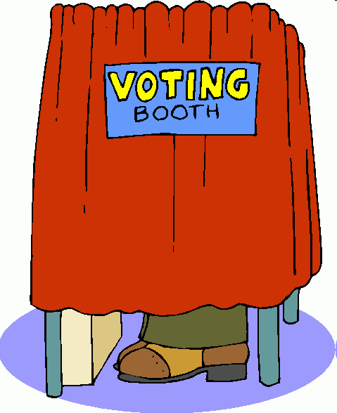
Question 54 How old do citizens have to be to vote for President?
eighteen (18) and older

Slide 10
Question 55 What are two ways that Americans can participate in their democracy?
give an elected official your opinion on an issue
call Senators and Representatives
publicly support or oppose an issue or policy
run for office
write to a newspaper
vote
join a political party
help with a campaign
join a civic group
join a community group

Slide 11
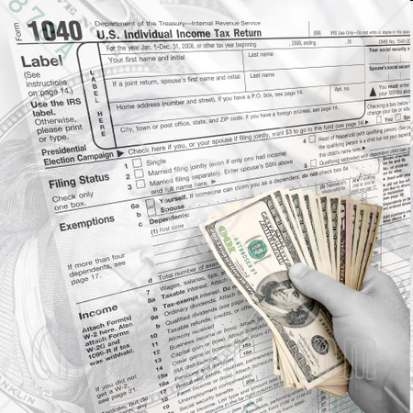
Question 56 When is the last day you can send in federal income tax forms?
April 15

Slide 12
Question 57 When must all men register for the Selective Service?
at age eighteen (18)
between eighteen (18) & twenty-six (26)

Slide 13
Question 58 What is one reason colonists came to America?
freedom
political liberty
religious freedom
economic opportunity
practice their religion
escape persecution

Slide 14
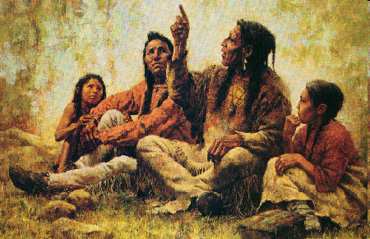
Question 59 Who lived in America before the Europeans arrived?
Native Americans
American Indians

Slide 15
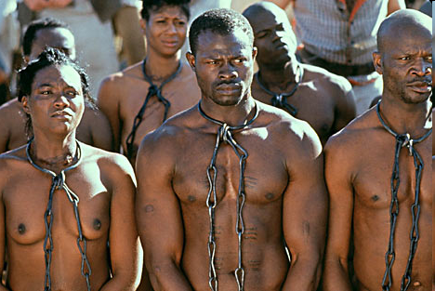
Question 60 What group of people was taken to America and sold as slaves?
Africans
people from Africa

Slide 16
Preparing for the Oath:
Rights

Slide 17
Dictation Practice
Write down the sentences that I dictate.

Slide 18
Read.
26
What state has the most people in Congress?
Write.
California has the most people in Congress.

Slide 19
Read.
27
Where is the White House?
Write.
The White House is in Washington, D.C.

Slide 20
Read.
28
Why do people come to the U.S.?
Write.
They want to be free.

Slide 21
Read.
29
When is Presidents’ Day?
Write.
Presidents’ Day is in February.

Slide 22
Read.
30
What was one of the first states?
Write.
Delaware was one of the first states.

Slide 23
Dictation Review
California has the most people in Congress.
The White House is in Washington, D.C.
They want to be free.
Presidents’ Day is in February.
Delaware was one of the first states.
Notes:
26. R: What state has the most people in Congress?
W: California has the most people in Congress.
27. R: Where is the White House?
W: The White House is in Washington, D.C.
28. R: Why do people come to the U.S.?
W: They want to be free.
29. R: When is Presidents’ Day?
W: Presidents’ Day is in February.
30: R: What was one of the first states?
W: Delaware was one of the first states.

Slide 24
This week’s civics questions
Listen and Read Along:
Q70 - 77

Slide 25
Tardy Policy
I open this classroom at 9.50am
Class starts at 10am
I will lock the door when class starts
If you are late for class you must wait for a break in the lesson before you can enter the classroom.

Slide 26
More Admin
On my desk:
Did everyone sign in???
Does anyone have an interview date soon?
Please fill in the Interview Date sheet.
Please email me your results after you’ve had your interview: amclin@cuhsd.org

Slide 27
Take a Break!! 10 minutes

