Slide 1
Civics Corner
Part 11

Slide 2
Saturday Closures
December 21 & 28
January 4
February 8 & 22
April 4 & 11
May 23
Last class = May 30

Slide 3
New Class Semester 2
January 11: First class in January.
January 25: Final class of semester 1.
February 1: Start of semester 2 (for new students only)
February 8: No class
Feb 15: Semester 2 for returning students.

Slide 4
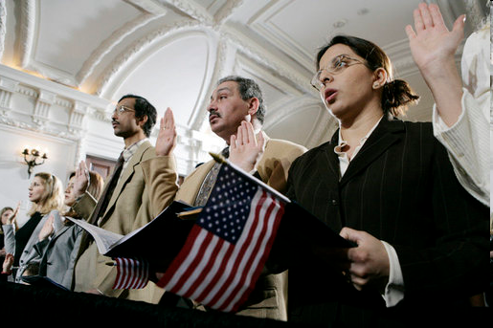
Review of Last Week’s Civics Qs
Q91 - 100

Slide 5
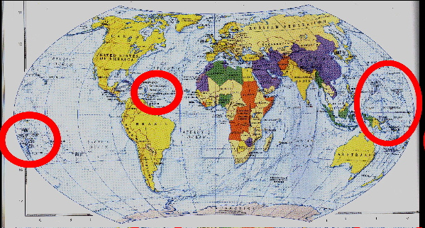
Question 91 Name one U.S. territory.
Puerto Rico
U.S. Virgin Islands
American Samoa
Northern Mariana Islands
Guam

Slide 6
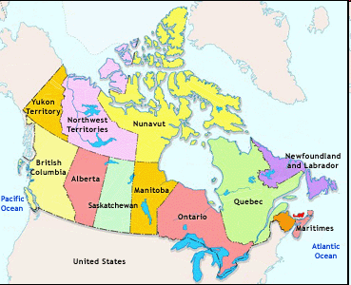
Question 92 Name one state that borders Canada.
Alaska
Washington
New York
Pennsylvania
Maine
Idaho
Montana
North Dakota
Minnesota
Michigan
Ohio
Vermont
New Hampshire

Slide 7
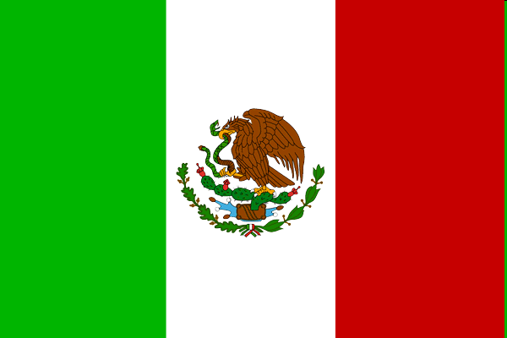
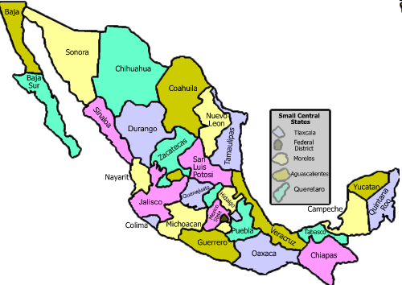
Question 93 Name one state that borders Mexico.
California
Arizona
New Mexico
Texas

Slide 8
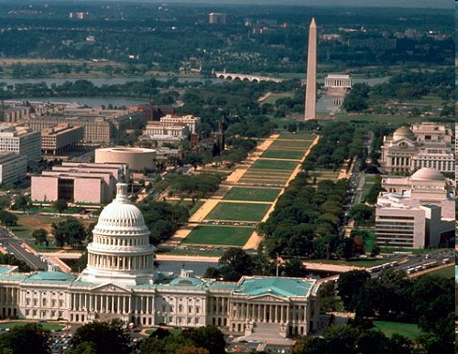
Question 94 What is the capital of the United States?
Washington, D.C.

Slide 9
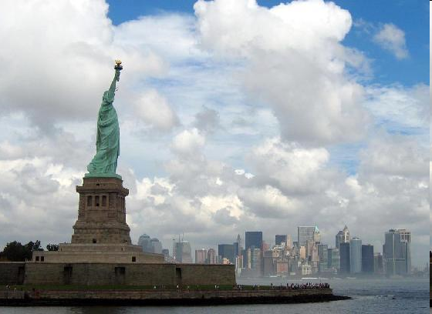
Question 95 Where is the Statue of Liberty?
New York Harbor
Liberty Island

Slide 10
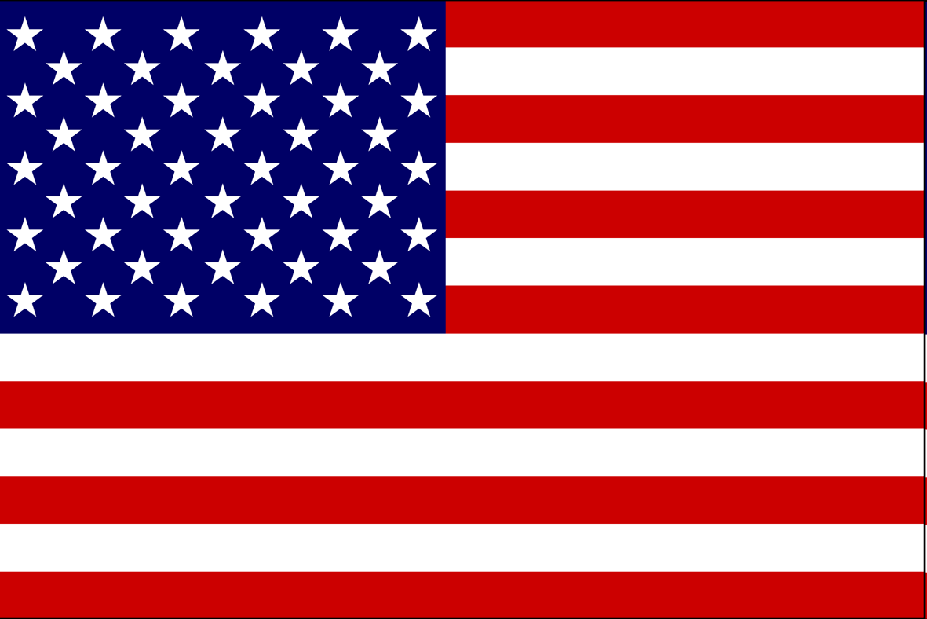
Question 96 Why does the flag have 13 stripes?
because there were 13 original colonies

Slide 11
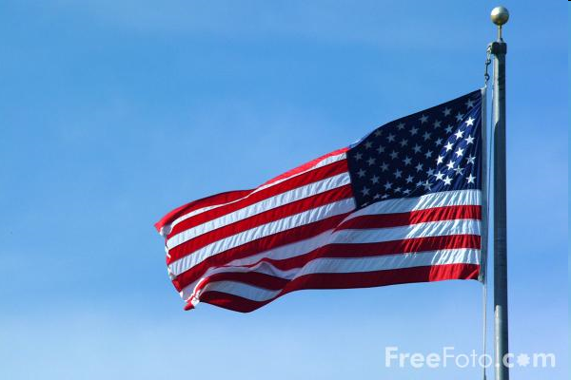
Question 97 Why does the flag have 50 stars?
because there is one star for each state

Slide 12
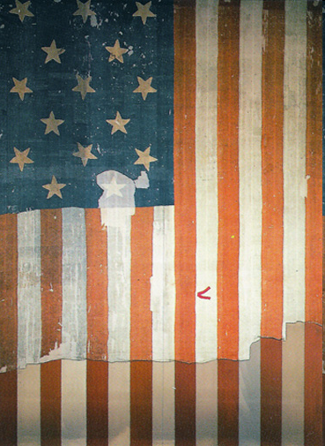
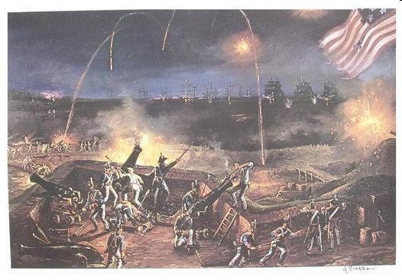
Question 98 What is the name of the national anthem?
The Star-Spangled Banner

Slide 13
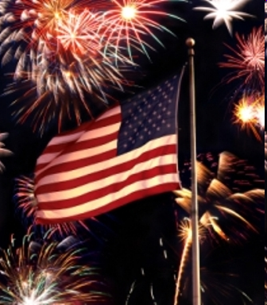
Question 99 When do we celebrate Independence Day?
July 4

Slide 14
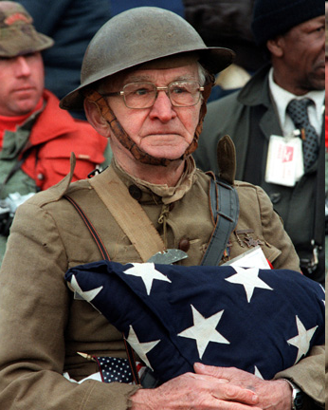
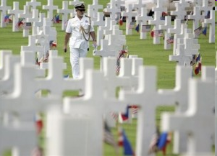
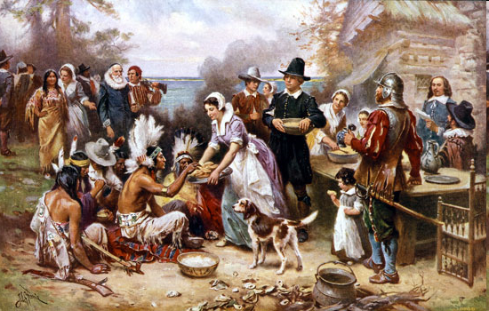
Question 100 Name two national U.S. holidays.
New Year’s Day
Martin Luther King, Jr. Day
Presidents’ Day
Memorial Day
Independence Day
Labor Day
Columbus Day
Veterans Day
Thanksgiving Day
Christmas

Slide 15
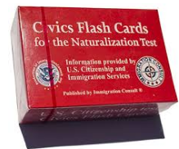
100 Q & A all finished!!
Next 3 weeks we’ll practice using flash cards.

Slide 16
Preparing for the Oath:
Independence

Slide 17
Dictation Practice – Unit 10
Write down the sentences that I dictate.

Slide 18
Read.
46
Who elects Congress?
Write.
The people elect Congress.

Slide 19
Read.
47
Who lives in the White House?
Write.
The President lives in the White House.

Slide 20
Read.
48
How many states are in the United States?
Write.
The United States has 50 states.

Slide 21
Read.
49
Where is the White House?
Write.
The White House is in Washington, DC.

Slide 22
Read.
50
What is on the American flag?
Write.
There are 13 stripes and 50 stars on the American flag.

Slide 23
Dictation Review
The people elect Congress.
The President lives in the White House.
The United States has 50 states.
The White House is in Washington, DC.
There are 13 stripes and 50 stars on the American flag.
Notes:
Who elects Congress?
The people elect Congress.
Who lives in the White House?
The President lives in the White House.
How many states are in the United States?
The United States has 50 states.
Where is the White House?
The White House is in Washington, DC.
What is on the American flag?
There are 13 stripes and 50 stars on the American flag.

Slide 24
More Admin
On my desk:
Did everyone sign in???
Does anyone have an interview date soon?
Please fill in the Interview Date sheet.
Please email me your results after you’ve had your interview: amclin@cuhsd.org

Slide 25
Take a Break!! 10 minutes

