Slide 1
Civics Corner
Part 13

Slide 2
Saturday Closures
February 8 & 22
April 4 & 11
May 23
Last class = May 30

Slide 3
New Class Semester 2
January 25: Final class of semester 1.
February 1: Start of semester 2 (for new students only)
February 8: No class
Feb 15: Semester 2 for returning students.

Slide 4
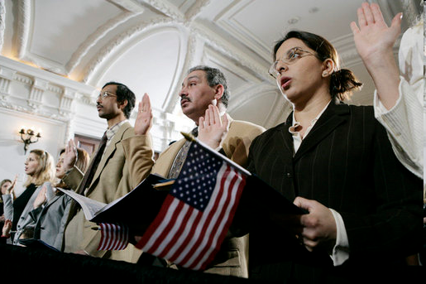
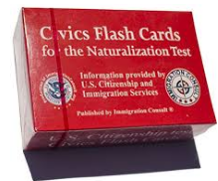
Civics Qs
Flashcards!!

Slide 5
Preparing for the Oath:
1900s

Slide 6
Reading & Writing Practice
Write down the sentences that I dictate.

Slide 7
Read.
56
What did Lincoln do?
Write.
Lincoln freed the slaves.

Slide 8
Read.
57
What President is on the one hundred dollar bill?
Write.
Benjamin Franklin is on the one hundred dollar bill.

Slide 9
Read.
58
In what month do we vote for President?
Write.
We vote for President in November.

Slide 10
Read.
59
What are the 3 first words of the Constitution?
Write.
The 3 first words of the Constitution are We the People.

Slide 11
Read.
60
What is the supreme law of the land?
Write.
The Constitution the supreme law of the land.

Slide 12
Dictation Review
Lincoln freed the slaves.
Benjamin Franklin is on the one hundred dollar bill.
We vote for President in November.
The 3 first words of the Constitution are We the People.
The Constitution the supreme law of the land.
Notes:
What did Lincoln do?
Lincoln freed the slaves.
What President is on the one hundred dollar bill?
Benjamin Franklin is on the one hundred dollar bill.
In what month do we vote for President?
We vote for President in November.
What are the 3 first words of the Constitution?
The 3 first words of the Constitution are We the People.
What is the supreme law of the land?
The Constitution the supreme law of the land.

Slide 13
More Admin
On my desk:
Did everyone sign in???
Does anyone have an interview date soon?
Please fill in the Interview Date sheet.
Please email me your results after you’ve had your interview: amclin@cuhsd.org

Slide 14
Take a Break!! 10 minutes

