Slide 1
Civics Corner
Part 14

Slide 2
Saturday Closures
February 8 & 22
April 4 & 11
May 23
Last class = May 30

Slide 3
New Class Semester 2
January 25: Final class of semester 1.
February 1: Start of semester 2 (for new students only)
February 8: No class
Feb 15: Semester 2 for returning students.

Slide 4
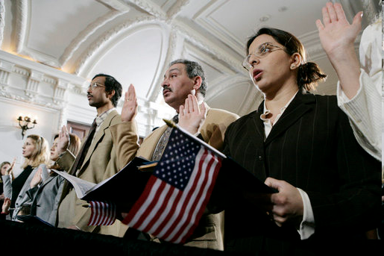
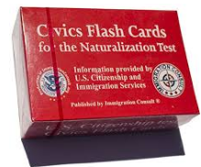
Civics Qs
Flashcards!!

Slide 5
Preparing for the Oath:
Famous Citizens

Slide 6
Dictation Practice
Reading and Writing Sentences Info Sheet

Slide 7
Read.
6
When is Columbus Day?
Write.
Columbus Day is in October.

Slide 8
Read.
8
Who was the second President of the United States?
Write.
Adams was the second President of the United States.

Slide 9
Read.
13
Who elects Congress?
Write.
The citizens of the United States elect Congress.

Slide 10
Read.
15
What country is north of the United States?
Write.
Canada is north of the United States.

Slide 11
Read.
7
When is Thanksgiving?
Write.
Thanksgiving is in November.

Slide 12
Review
Columbus Day is in October.
Adams was the second President of the United States.
The citizens of the United States elect Congress.
Canada is north of the United States.
Thanksgiving is in November.
Notes:
When is Columbus Day?
Columbus Day is in October.
Who was the second President of the United States?
Adams was the second President of the United States.
Who elects Congress?
The citizens of the United States elect Congress.
What country is north of the United States?
Canada is north of the United States.
When is Thanksgiving?
Thanksgiving is in November.

Slide 13
More Admin
On my desk:
Did everyone sign in???
Does anyone have an interview date soon?
Please fill in the Interview Date sheet.
Please email me your results after you’ve had your interview: amclin@cuhsd.org

Slide 14
Take a Break!! 10 minutes

