Slide 1
Easy Citizenship Interview Quiz
Review

Slide 2
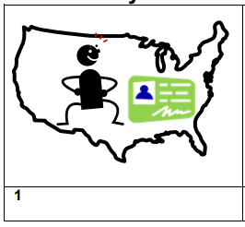
Permanent resident

Slide 3
Name

Slide 4
Phone number

Slide 5
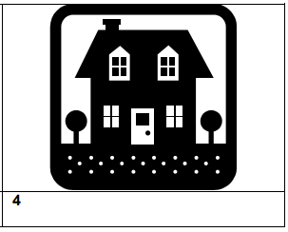
Home address

Slide 6
work

Slide 7
school

Slide 8
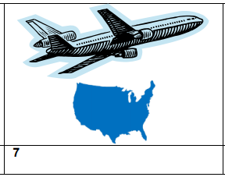
Trips outside the US

Slide 9
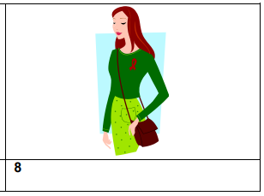
eligible

Slide 10
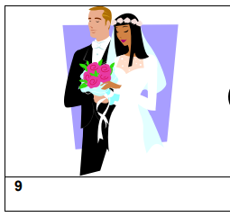
married

Slide 11
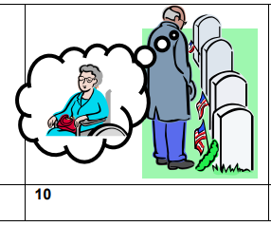
widowed

Slide 12
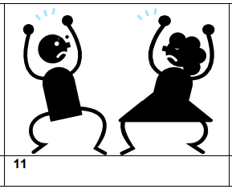
divorced

Slide 13
children

Slide 14
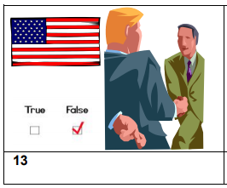
claimed

Slide 15
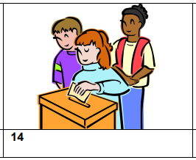
voted

Slide 16
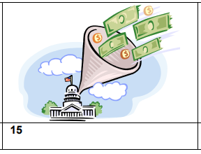
taxes

Slide 17
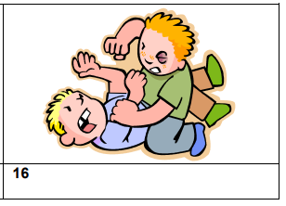
Badly hurt or kill on purpose

Slide 18
arrested

Slide 19
Committed a crime

Slide 20
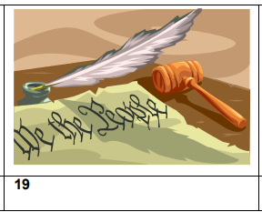
Constitution

Slide 21
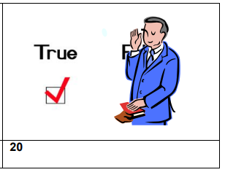
true

