Slide 1
CitizenVIP ESL
Questions

Slide 2
Questions
Answer
A thing / person
Because …
A date
A place
A person

Slide 3
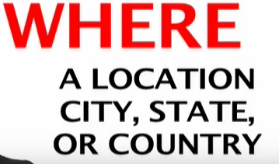
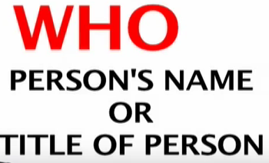
Questions

Slide 4
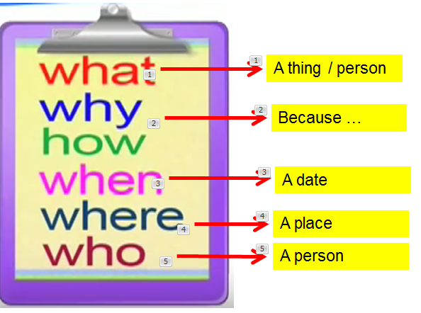
Practice in Pairs
What is your complete name?
How do you spell your last name?
Why do you want to become a US citizen?
When did you become a permanent resident?
Where were you born?
Who is your spouse?

