Slide 1
Essa Lesson 7
Branches of Government Part 1

Slide 2
The 3 Branches of Government
President
Congress
The Courts

Slide 3
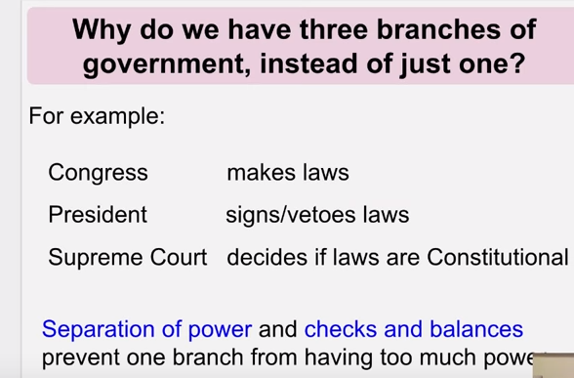
Separation of Powers

Slide 4
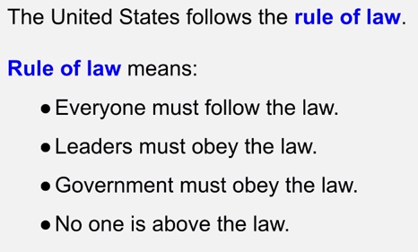
The Rule of Law

Slide 5
The Executive Branch

Slide 6
The Executive Branch

Slide 7
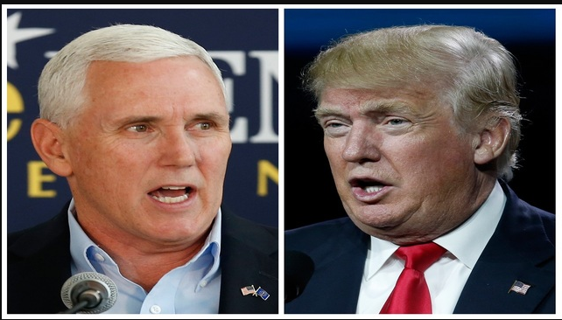
The Executive Branch
Donald Trump and Mike Pence

Slide 8
The Executive Branch

Slide 9
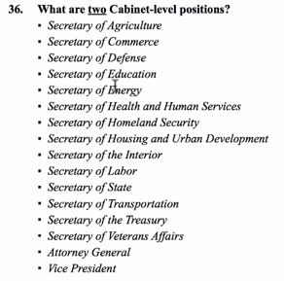
Select two cabinet-level positions

Slide 10
The Executive Branch
Republican

