Slide 1
Intermediate Citizenship Interview
Q & A

Slide 2

How are you eligible to become a US citizen?
I am over 18 years old and have been a:
Permanent resident for 5 years OR
Permanent resident for 3 years and married to a US citizen for 3 years

Slide 3
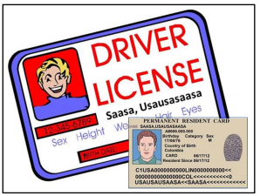
What is your current legal name?
My current legal name is (first, middle, last)

Slide 4

Spell your family name.
G - O – N – Z – A – L – E - S

Slide 5
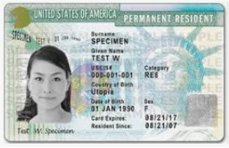
Is the name on your Green Card the same as your current legal name?
Yes.
No – the name on my Green Card is my maiden name. I got married.

Slide 6

What is your Social Security number?
My social security number is 987-65-4321

Slide 7

What is your date of birth?
My date of birth is (month, day, year)

Slide 8
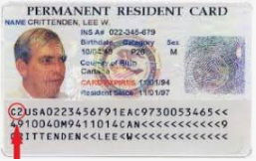
What date did you become a legal permanent resident?
I became a permanent resident on (month, day, year)

Slide 9
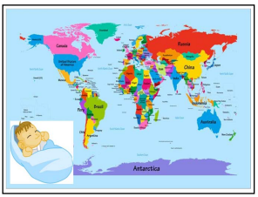
What is your country of birth?
My country of birth is (country)

Slide 10

What is your country of nationality?
My country of nationality is (country)

Slide 11

Are you requesting an accommodation because of a disability?
No, I’m not requesting an accommodation.
Yes, I am deaf / blind

Slide 12

What is your daytime phone number?
My phone number is (XXX) XXX-XXXX

Slide 13

What is your email address?
My email address is joeschmoe@gmail.com
I don’t have an email address

Slide 14

What is your current home address?
My address is …

Slide 15
How long have you lived at your current home address?
I have lived there since (month, year)

Slide 16
What was your previous home address?
My previous address was (street, city, state, zip).
I have always lived at my current home address.

Slide 17
How long did you live at your previous home address?
I lived at my previous address from (month, year) to (month, year)

Slide 18

Was your mother or father a US citizen before your 18th birthday?
No.
Yes – my mother / father was a US citizen.

Slide 19

Was your mother or father a US citizen before you were 18 years old?
No

Slide 20

Are you Hispanic or Latino?
No.
Yes, I’m Latino

Slide 21

How do you support yourself?
I work at (company)
I go to school and work part-time at (company)
I’m retired and get a pension
My spouse works and supports me
My family supports me.

Slide 22
What do you do for a living? What is your job?
I am a (teacher, cleaner, engineer …).
I work full-time.
I work part-time.

Slide 23
How long have you worked at your job?
I have worked there since (month, year)

Slide 24

Have you taken any trips outside the US in the past 5 years?
No, I have not left the US.
Yes.

Slide 25
How many total days were you outside of the US?
I was outside the US for (X) days.

Slide 26

Tell me about your last trip. When did you leave the US?
I left on (month, day, year).

Slide 27

When did you return to the US?
I returned on (month, day, year).

Slide 28
Where did you go?
I went to (country)

Slide 29

What is your current marital status?
I’m single
I’m married
I’m divorced
I’m widowed

Slide 30

How many times have you been married?
I have been married one time / 2 times.
I have never been married.

Slide 31

What is your spouse’s name?
His name is …
Her name is …

Slide 32
What is your spouse’s date of birth?
His/her date of birth is (month, day, year)

Slide 33
What is your current marital status?
I’m single
I’m married
I’m divorced
I’m widowed

Slide 34
How many times have you been married?
I have been married one time / 2 times.
I have never been married.

Slide 35
What is your spouse’s name?
His name is …
Her name is …

Slide 36

What is the date of your marriage?
We got married on (month, day, year)

Slide 37

Is your spouse a U.S. citizen?
Yes: my spouse was born in the US.
Yes: my spouse became a US citizen on (month, day, year)
No: my spouse is a permanent resident.
No: my spouse is a citizen of (Mexico)

Slide 38
What is the name of your prior spouse?
My ex-wife is called …
My ex-husband is called …

Slide 39
Was your prior spouse a US citizen?
Yes – he/she was born in the US.
No – he/she is a Permanent Resident.

Slide 40

Do you have any children?
No, I have no children.
Yes, I have one child.
Yes, I have 2 children.

Slide 41
What are their names?
S/he is called … .
They are called … .

Slide 42
Are they a US citizen?
Yes – he/she is a US citizen.
No – he/she is not a US citizen.

Slide 43
What is their date of birth?
(Name) was born on (month, day, year)

Slide 44
What is your children’s country of birth?
He / she was born in the US.
They were born in (Japan)

Slide 45
Where do your children live?
They live with me.
She lives in San Francisco.
He lives in Taiwan.

Slide 46

Have you ever claimed to be a US citizen?
No

Slide 47

Have you ever voted in any US elections?
No

Slide 48

Do you have any title of nobility in a foreign country?
No

Slide 49

Have you ever been declared legally incompetent?
No

Slide 50

Do you pay your taxes every year?
Yes, I do

Slide 51
Do you belong to any groups or organizations?
No
Yes, I am a member of a church.
Yes, I am a member of a golf club.

Slide 52

Have you ever been a member of the Communist party?
No

Slide 53

Have you ever been a terrorist or committed acts of violence?
No, never

Slide 54

Have you ever badly hurt or killed a person on purpose?
No, never

Slide 55

Have you ever participated in a rebel group, militia, or army?
No, never

Slide 56

Have you ever worked in a place like a prison or labor camp?
No, never

Slide 57

Have you ever participated in a rebel group, militia, or army?
No.

Slide 58

Have you ever been a member of a gang?
No.

Slide 59
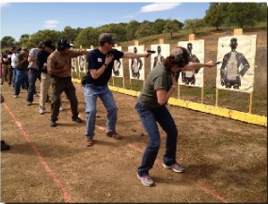
Have you ever received military or weapons training?
No.

Slide 60

Have you ever forced a child to become a soldier?
No, never

Slide 61

Have you ever been a habitual drunkard?
No, never

Slide 62

Have you ever been arrested?
No, never

Slide 63

Have you ever sold or smuggled illegal drugs or narcotics?
No, never

Slide 64

Have you ever helped anyone enter the US illegally?
No, never

Slide 65

Have you ever gambled illegally? What is illegal gambling?
No, never.
You play cards and don’t pay taxes.

Slide 66

Have you failed to support your dependents of pay alimony?
No, never

Slide 67

Have you ever lied to the US Government to get public benefits (e.g. welfare)?
No, never

Slide 68

Have you ever been deported?
What is deported?
No, never.
I get sent back to my old country.

Slide 69

Have you ever served in the US military?
No, never

Slide 70

Do you support the Constitution and the form of government of the US?
Yes, I do

Slide 71

Are you willing to take the full Oath of Allegiance to the US Government?
Yes, I am

Slide 72

Do you understand the full Oath of Allegiance to the United States?
Yes, I do

Slide 73

If the law requires it, are you willing to bear arms in the US Army?
What is “bear arms”?
Yes, I am.
I will use a gun to protect the US.

Slide 74

Are you willing to perform non-combatant services for the US Army? What is “non-combattant”?
Yes, I am.
I help the military but no gun – like a doctor.

Slide 75

Are you willing to help the government during a national emergency?
Yes, I am.

Slide 76

Congratulations! You’ll be a great US citizen!!
Thank you!!!!

