Slide 1
N-400 Practice Interview
Part 12: Info About You
Q9 – 21 Affiliations, Acts of Violence, Prison, Gang, Weapons & Child Soldiers

Slide 2

Do you belong to any groups or organizations?
No
Yes, I belong to a church

Slide 3

Have you ever been a member of the Communist party?
No, never

Slide 4

Have you ever been a member of a totalitarian party? What is a totalitarian party?
No.
Like Nazi Germany

Slide 5

Have you ever been a terrorist?
No, never

Slide 6
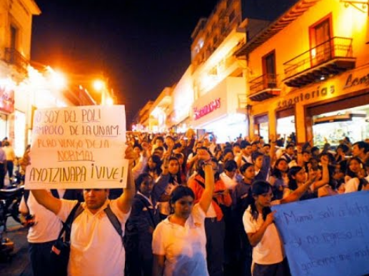
Have you ever advocated the overthrow of any government by force or violence?
No, never

Slide 7
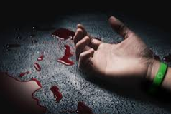
Have you ever badly hurt or killed a person on purpose?
No, never

Slide 8
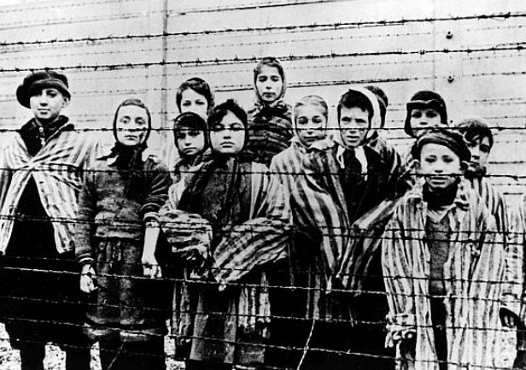
Have you ever persecuted any person because of race, religion, national origin, member of any particular social group, or political opinion?
No, never

Slide 9
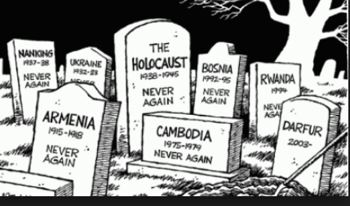
Have you ever participated in genocide? What is genocide?
No, never.
To kill a whole race of people – like the Holocaust.

Slide 10

Have you ever tried to hurt or kill someone on purpose?
No, never.

Slide 11

Have you ever raped anyone?
What is rape?
No, never.
Force someone to have sex.

Slide 12
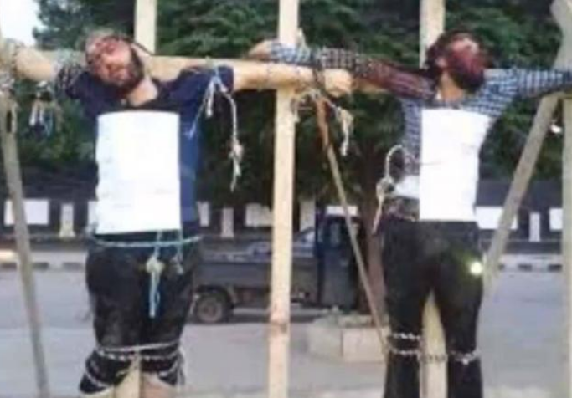
Have you ever stopped someone from practicing his religion?
No, never.

Slide 13
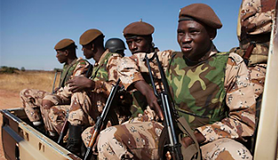
Have you ever participated in a military unit or rebel group?
No, never

Slide 14
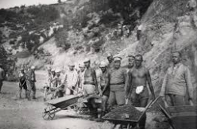
Have you ever worked in a place like a prison or labor camp?
No, never

Slide 15
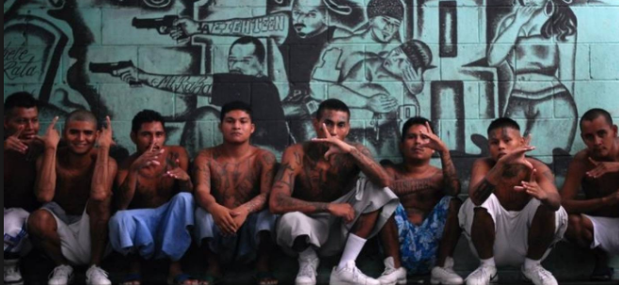
Have you ever been a member of a gang?
No, never

Slide 16
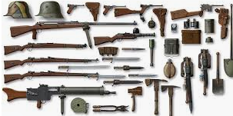
Have you ever sold or given weapons to another person?
No, never

Slide 17
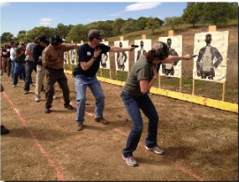
Have you ever received military or weapons training?
No, never

Slide 18
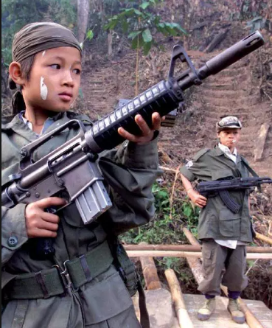
Have you ever forced a child (under 15) to become a soldier?
No, never

Slide 19
Have you ever forced a child (under 15) to help soldiers?
No, never

