Slide 1
N-400 Practice Interview
Part 5: Information About Your Residence

Slide 2
What is your current home address?
My current home address is (street, city, state, zip code)

Slide 3
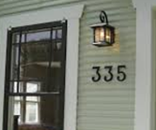
How long have you lived at your Current Home Address?
I have lived at my current home address since (date)

Slide 4
What is your Mailing Address?
My Mailing Address is the same as my Current Home Address.

Slide 5
What is your Previous Home Address?
My previous home address is …
I have lived at my current home address for 5 years.

Slide 6
How long did you live at your Previous Home Address?
I lived at my previous home address from (date) to (date)

