Slide 1
N-400 Part 12 Vocabulary Review
Q14: Acts of Violence

Slide 2
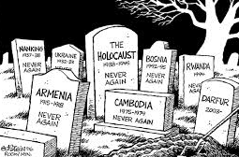
Genocide
To kill a group of people because of their race, ethnicity, religion or gender.

Slide 3
Torture
To hurt a person so that he or she will tell you secrets or information

Slide 4
Kill
To cause a person to die on purpose (not an accident)

Slide 5
Rape
To force a person to have sex.

Slide 6
Religion
How people worship God

Slide 7
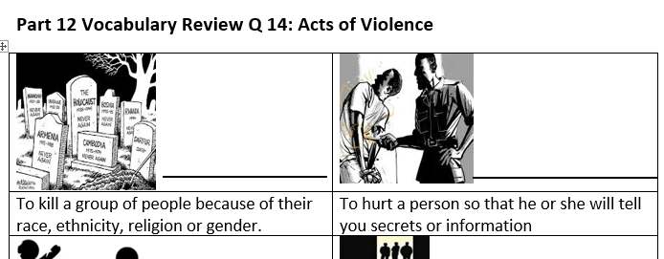
Please take out this sheet:
Match the vocabulary in the Word Bank with the correct definition

Slide 8
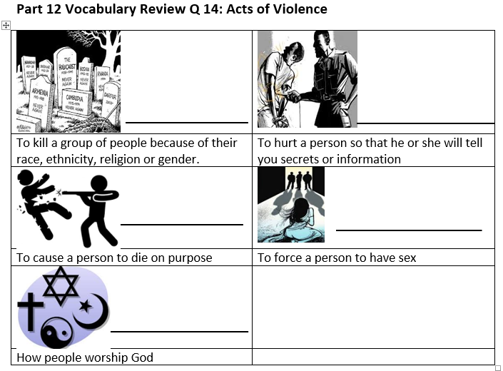
Review:
Genocide
Torture
Kill
Rape
Religion

