Slide 1
N-400 Part 12 Vocabulary Review
Q15: Group Violence

Slide 2
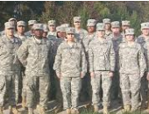
Military Unit
The official armed forces of the national government that protects the country.

Slide 3
Paramilitary Unit
People who act like the military but are not a part of the official military

Slide 4
Police Unit
An official group that enforces the law, protects people, and stops crime.

Slide 5
Self-Defense Unit
A group of people organized to protect their community against crime and violence

Slide 6
Vigilante Unit
A group of people who act like the police but are not part of the official police

Slide 7
Rebel Group
A group that fights against the national government

Slide 8
Guerilla Group
A group of people who use weapons against the military, police, government, or other people

Slide 9
Militia
An army of people – not part of the official military.

Slide 10
Insurgent Organization
A group that uses weapons and fights against the government.

Slide 11
Please take out this sheet:
Match the vocabulary in the Word Bank with the correct definition

Slide 12
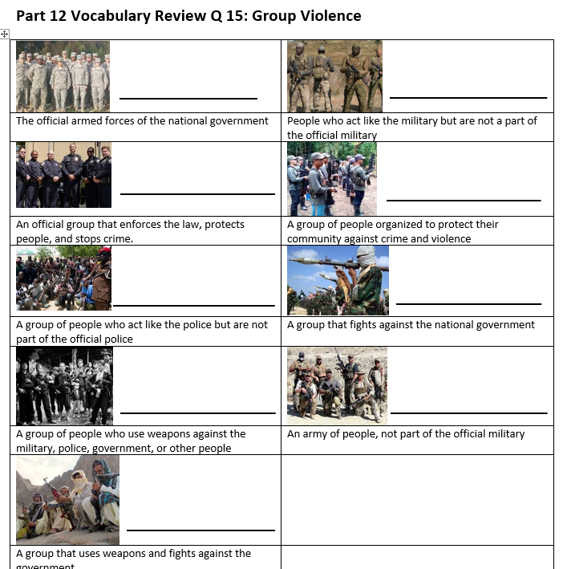
Review:
Military Unit
Paramilitary Unit
Self-Defense Unit
Police Unit
Vigilante Unit
Rebel Group
Guerilla Group
Militia
Insurgent Organization

