Slide 1
N-400 Part 12 Vocabulary Review
Q15: Group Violence

Slide 2
Prison or Jail
A place where people who have been charged with a crime are kept

Slide 3
Prison Camp
A place where enemy prisoners of war are kept

Slide 4
Detention Facility
A place where people are forced to stay temporarily until they are move to a prison, labor camp, or are deported.

Slide 5
Labor Camp
A place where people are forced to work.

Slide 6
Please take out this sheet:
Match the vocabulary in the Word Bank with the correct definition

Slide 7
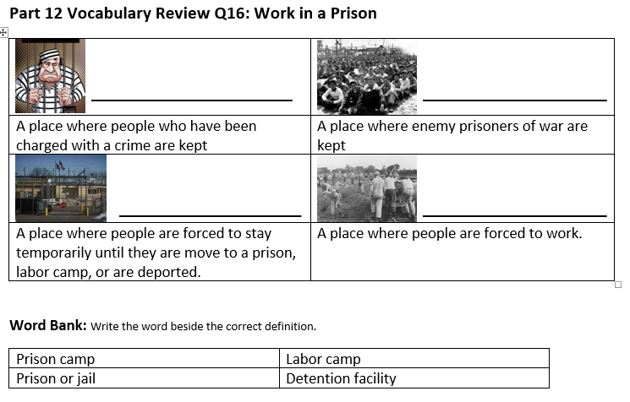
Review:
Prison or Jail
Prison Camp
Detention Facility
Labor Camp

