Slide 1
N-400 Part 12 Vocabulary Review
Q22-29: Criminal Records

Slide 2
Crime
To do something illegal or break the law.

Slide 3
Criminal Record
Information kept by police to show that a person has committed a crime

Slide 4
Arrested
To break the law and go to jail

Slide 5
Cited
An official order for a person to pay a fine or appear in court for doing something illegal

Slide 6
Detained
To be stopped and questioned by the police

Slide 7
Charged
The police, judge, or court say that you have broken the law

Slide 8
Convicted
A court proves that you have committed a crime and must pay a fine or go to jail

Slide 9
Rehabilitation (“Rehab”)
A court-ordered program to cure drug or alcohol problems of addiction

Slide 10
Probation
A period of time during which a criminal is allowed to stay out of prison if he behaves well.

Slide 11
Jail
A place that people are sent to when they break the law and lose their freedom as punishment.

Slide 12
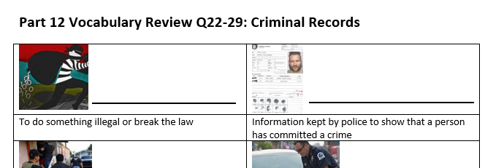
Please take out this sheet:
Match the vocabulary in the Word Bank with the correct definition

Slide 13
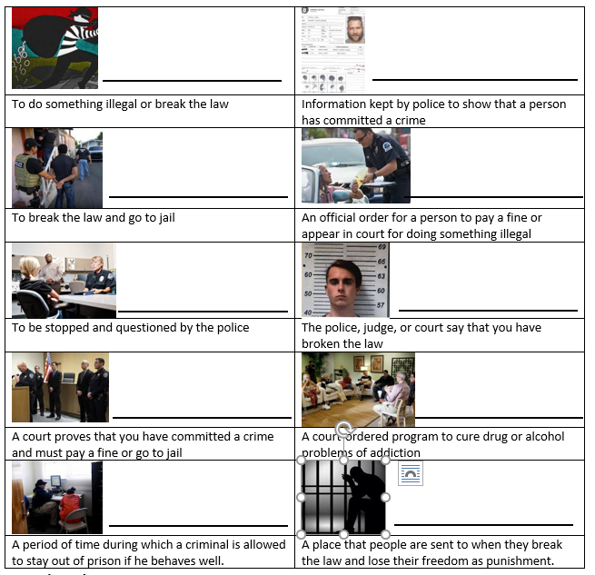
Review:
Criminal Record
Crime
Arrested
Cited
Detained
Charged
Rehabilitation (“rehab”)
Convicted
Probation
Jail

