Slide 1
Preparing for Naturalization Quiz Review
Review

Slide 2
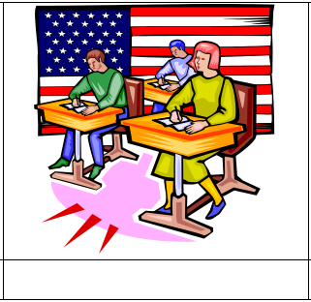
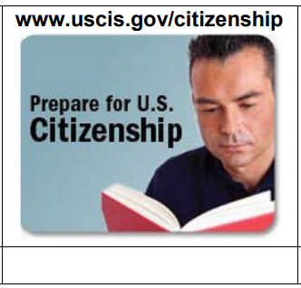
English
Citizenship class
Resources
Civics
History

Slide 3
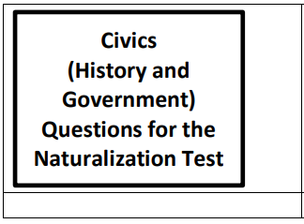
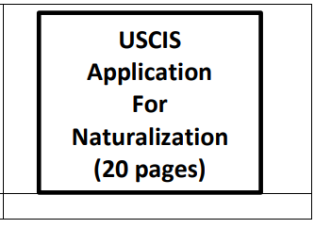
The 100 questions
The N-400
USCIS.gov

Slide 4
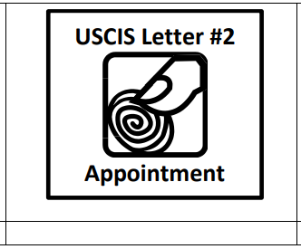
Receipt
Fingerprint
Interview
Speaking test

Slide 5
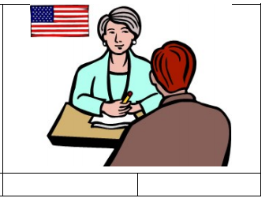
Listening test
Reading test
Writing
test
Civics
test
10
questions
Dictation

Slide 6
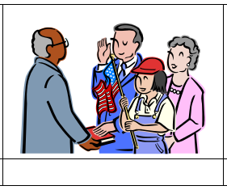
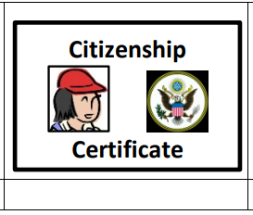
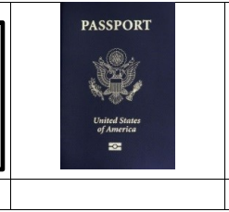
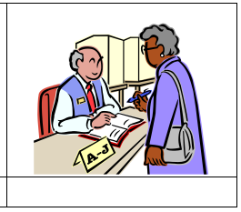
Oath ceremony
Oath of
allegiance
Naturalization
Apply for a
US passport
Register to vote

