Slide 1
Ready for the Interview
N-400 Part 1: Information About Your Eligibility

Slide 2
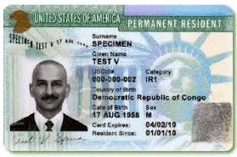
Listen to Maria (1-10)
Key Vocab:
Permanent resident
“Green card”

Slide 3
Maria’s Interview
Q & A:
How long have you been a permanent resident?
Since 2005

Slide 4
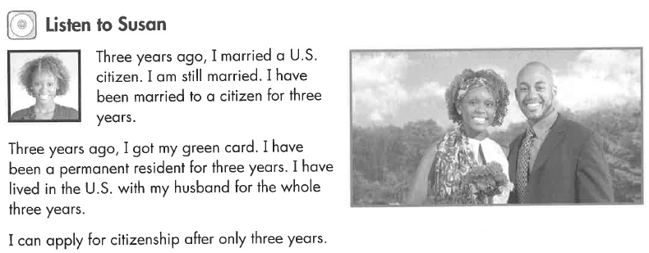
Listen to Susan
Key Vocab:
Married
US citizen

Slide 5
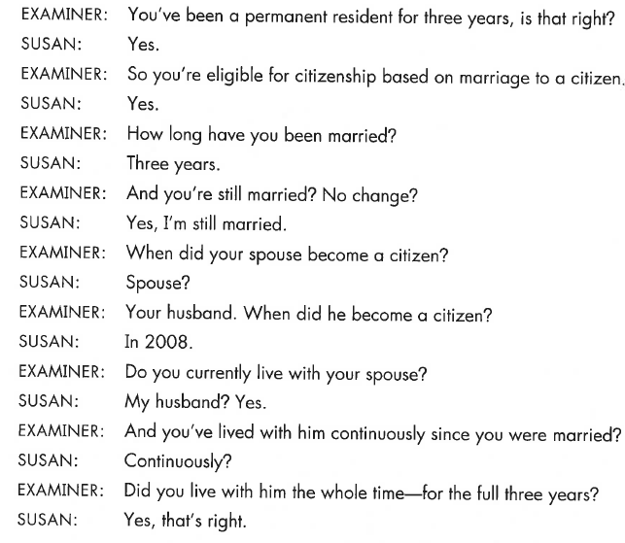
Susan’s Interview
Q & A:
How long have you been married?
3 years

Slide 6
What Will YOU Say?
How long have you been a permanent resident?
How many years have you had your green card?
When did you become a permanent resident?
Since 2012
For 5 years
In 2012

Slide 7
What Will YOU Say?
Is your application based on marriage to a US citizen?
When did your spouse become a US citizen?
When did you get married?
How long have you been married?
When = date
In 2010
How long = number
For 7 years

Slide 8
Practice What You Learn
Eligibility Based on 5 Years
Eligibility Based on Marriage
How long have you been a permanent resident?
How many years have you had your green card?
When did you become a permanent resident?
Is your application based on marriage to a US citizen?
When did your spouse become a US citizen?
When did you get married?
How long have you been married?

