Slide 1
Ready for the Interview
N-400 Part 4: Information to Contact You

Slide 2
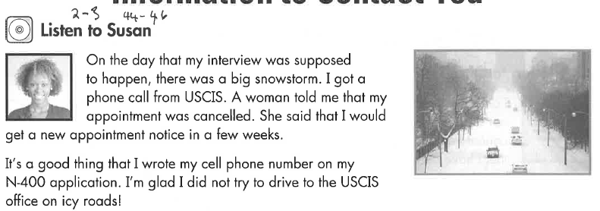
Listen to Susan (2-3)
Key Vocab:
Telephone
Cell ‘phone
Daytime phone
Work phone
Email address

Slide 3
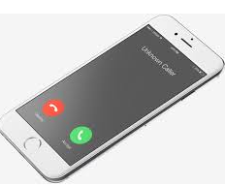
What Will YOU Say?
What is your daytime telephone number?
What is your evening phone number?
What is your cell phone number?
What is your email address?
My daytime phone number is (XXX) XXX XXXX
My evening number is the same as my daytime number.
My cell phone number is the same as my daytime number.
My email address is:

