Slide 1
Regular Citizenship Interview
Q & A

Slide 2
Hello. I am Officer Brown. I will be interviewing you today.
Hello. I’m pleased to meet you.

Slide 3
Why are you here today?
I want to become a US citizen.

Slide 4
Why do you want to become a US citizen?
I want to vote.
I love America.
I want a US passport
I want to live with my family.
There are good opportunities here.

Slide 5
How did you get here today?
I drove my car.
My wife drove me here.
I took a taxi.

Slide 6
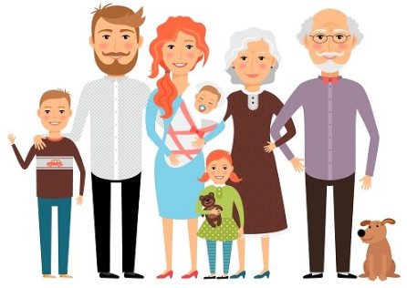
What do you miss about your old country?
I miss my family and friends.
I miss the food.

Slide 7
Are you ready? Do you have any questions before we begin?
I’m a little nervous but I’m ready.
I have no questions right now.

Slide 8
Are you ready to begin? Please stand and raise your right hand. Do you promise to tell the truth, the whole truth and nothing but the truth?
I do.

Slide 9
What did you just promise?
I promised to tell the truth.

Slide 10
Please have a seat.
Thank you.

Slide 11
Explain how are you eligible to become a US citizen.
I have been a:
Permanent resident for 5 years OR
Permanent resident for 3 years and I am married to a US citizen

Slide 12
Show me your Permanent Resident card and photo IDs
Here they are

Slide 13
What is your current legal name? Spell your family name.
My current legal name is (first, middle, last)

Slide 14
Is the name on your Green Card the same as your current legal name?
Yes.
No, I got married and changed my name.

Slide 15
What is your date of birth?
My date of birth is (month, day, year)

Slide 16
What date did you become a legal permanent resident?
I became a permanent resident on (month, day, year)

Slide 17
What is your country of birth?
My country of birth is (country)

Slide 18
What is your country of nationality?
My country of nationality is (country)

Slide 19
Are you requesting an accommodation because of a disability?
No, I’m not requesting an accommodation.
Yes, I am deaf / blind

Slide 20
What was your port of entry?
My port of entry was (San Francisco).

Slide 21
What is your daytime ‘phone number?
My number is (XXX) XXX - XXXX

Slide 22
What is your current home address?
My current home address is (number, street, city, state, zip)

Slide 23
How long have you lived at your current home address?
I have lived there since (month, year)
I have lived there for 6 years.

Slide 24
What was your previous home address?
My previous address was (street, city, state, zip).
I have always lived at my current home address.

Slide 25
Was your mother or father a US citizen before your 18th birthday?
No.
Yes – my mother / father was a US citizen.

Slide 26
How do you support yourself financially? Do you work?
I work at (Wells Fargo)
I go to school and work part-time at (Walgreen’s)
I’m retired and get a pension
My spouse works and supports me
My family supports me.

Slide 27
Have you taken any trips outside the US in the past 5 years?
No, I have not left the US.
Yes.

Slide 28
How many total days were you outside of the US?
I was outside the US for (X) days.

Slide 29
Tell me about your last trip. When did you leave the US?
I left on (month, day, year).

Slide 30
When did you return to the US?
I returned on (month, day, year).

Slide 31
Where did you go?
I went to (country)

Slide 32
What is your current marital status?
I’m single
I’m married
I’m divorced
I’m widowed

Slide 33
How many times have you been married?
I have been married one time / 2 times.
I have never been married.

Slide 34
What is your spouse’s name?
His name is …
Her name is …

Slide 35
What is the date of your marriage?
We got married on (month, day, year)

Slide 36
Is your spouse a U.S. citizen?
Yes: my spouse was born in the US.
Yes: my spouse became a US citizen on (month, day, year)
No: my spouse is a permanent resident.
No: my spouse is a citizen of (Mexico)

Slide 37
Do you have any children? What are their names?
No, I have no children.
Yes, I have one child. S/he is called (Natalie)
Yes, I have 2 children. They are called (Anna and Stefan).

Slide 38
What is your children’s country of birth?
He / she was born in the US.
They were born in (Japan)

Slide 39
Where do your children live?
They live with me.
She lives in San Francisco.
He lives in Taiwan.

Slide 40
Have you ever claimed to be a US citizen?
No

Slide 41
Have you ever voted in any US elections?
No

Slide 42
Do you have any title of nobility in a foreign country?
No

Slide 43
Have you ever been declared legally incompetent?
No

Slide 44
Have you ever failed to file your taxes?
No, I always pay my taxes.

Slide 45
Do you owe any overdue taxes?
No, I don’t

Slide 46
Do you belong to any groups or organizations?
No, I don’t.
Yes, I belong to a church.
Yes, I belong to a book club.

Slide 47
Have you ever been a member of the Communist party? What is Communism?
No.
No freedom, like North Korea or Cuba.

Slide 48
Have you ever been a member of a totalitarian party? What is a totalitarian party?
No.
Like Nazi Germany

Slide 49
Have you ever been a terrorist? What is terrorism?
No, never.
Violence against the government and people, like 9/11

Slide 50
Have you ever advocated the overthrow of any government by force or violence?
No, never.

Slide 51
Have you ever persecuted any person because of race, religion, national origin, member of any particular social group, or political opinion?
No, never.

Slide 52
Have you ever participated in genocide? What is genocide?
No, never.
To kill a whole race of people – like the Holocaust.

Slide 53
Have you ever participated in torture? What is torture?
No, never.
To hurt someone for information.

Slide 54
Have you ever tried to hurt or kill someone on purpose?
No, never.

Slide 55
Have you ever raped anyone? What is rape?
No, never.
Force someone to have sex.

Slide 56
Have you ever stopped someone from practicing his religion?
No, never.

Slide 57
Have you ever participated in a rebel group, militia, or army?
No.

Slide 58
Have you ever been a member of a gang?
No.

Slide 59
Have you ever received military or weapons training?
No.

Slide 60
Have you ever forced a child to become a soldier?
No, never

Slide 61
Have you ever been a habitual drunkard?
No, never

Slide 62
Have you ever been a prostitute?
No, never

Slide 63
Have you ever been arrested?
No, never

Slide 64
Have you ever sold or smuggled illegal drugs or narcotics?
No, never

Slide 65
Have you ever committed bigamy? What is bigamy?
No, never
You are married to more than one person at the same time.

Slide 66
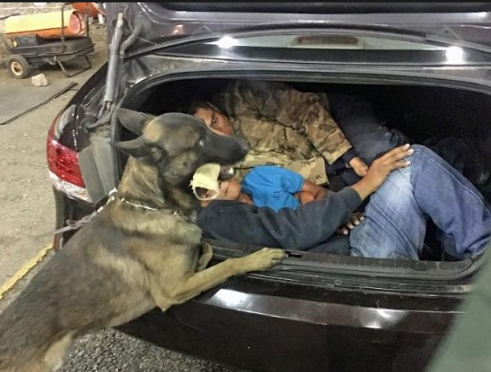
Have you ever helped anyone enter the US illegally?
No, never

Slide 67
Have you ever gambled illegally? What is illegal gambling?
No, never.
You play cards and don’t pay taxes.

Slide 68
Have you ever failed to support your children or pay alimony? What is alimony?
No, never.
Alimony is the money that a court makes you pay monthly to your ex-spouse.

Slide 69
Have you ever lied to the US government to get public benefits?
No, never

Slide 70
Have you ever been deported?
No, never

Slide 71
Do you support the Constitution and the form of government of the US?
Yes, I do

Slide 72
Are you willing to take the full Oath Of Allegiance to the US government?
Yes, I am

Slide 73
If the law requires it, are you willing to bear arms in the US Army? What is “to bear arms”?
Yes, I am.
I will use a weapon to help the US Army.

Slide 74
Are you willing to perform non-combatant services for the US Army? What is “non-combatant”?
Yes, I am.
To help the US Army without using a weapon. Like a nurse.

Slide 75
Are you willing to help the government during a national emergency?
Yes, I am.

Slide 76
Do you promise that everything you said is true?
Yes.

Slide 77
Congratulations! You’re going to make a great US citizen!
Thank you very much!!!

