Slide 1
Small Talk & N-400
At the beginning of the interview, the officer might ask you first some simple “small talk” questions (about every day life) to be friendly and make you feel comfortable.
The purpose is to see if you understand basic English
http://uscitizenshipsupport.com/us-citizenship-test-small-talk/
Notes:
Printable activities and powerpoints for reading and dictation can be found on http://USCitizenshipTeachers.org

Slide 2
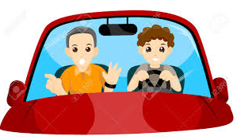
Transportation
How did you come here today?
I drove my car
I took a taxi
My daughter drove me

Slide 3
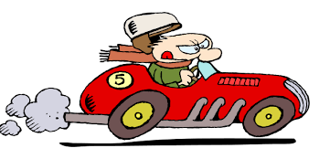
Transportation
Did it take you very long to get here?
No, not long: about 20 minutes
Yes, a long time: it took an hour

Slide 4
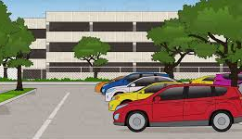
Transportation
Did it take you long to find a parking spot?
Yes, parking is difficult.
No, it was not bad – I was lucky

Slide 5
Transportation
Did you have any problems getting here?
No, no problems – the office is easy to find.
Yes, the office was difficult to find: I got a bit lost.

Slide 6
Transportation
How was the traffic?
The traffic’s not too bad.
The traffic is really bad.

Slide 7
Work in Pairs:
How did you come here today?
I drove my car
My daughter drove me
Did it take you very long to get here?
No, not long – 20 minutes.
Yes, a long time – an hour.
Did it take you long to find a parking spot?
Yes, parking is difficult.
No, it was not bad – I was lucky
Did you have any problems getting here?
No, no problems – the office is easy to find.
Yes, the office was difficult to find: I got a bit lost.
How was the traffic?
The traffic’s not too bad.
The traffic is really bad.

