Slide 1
CitizenVIP ESL
Your Children

Slide 2
Information About Your Children
About Your Children
How many
Son/s
Daughter/s
Address
With you?
Full name
First, Middle, Last
Spell that
Date of birth
Immigration status
Permanent resident
US citizen
Country of birth
US
Abroad

Slide 3
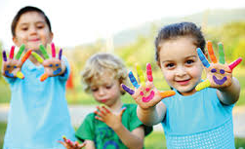
Number of Children
How many sons and daughters have you had?
How many children have you had?
How many children do you have?
I don’t have any children.
OR
I have one son and 2 daughters

Slide 4
Children’s Address
Where do they live?
Are they living with you or at a different address?
S/he lives with me.
They live with me.
OR:
My daughter lives in San Francisco.

Slide 5
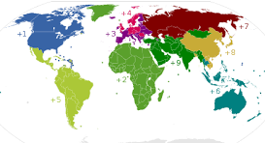
Which Country?
What country does s/he live in?
What country do they live in?
Oversees:
S/he lives in (Japan)
They live in (Japan)
United States:
S/he lives here in the US.
They live here in the US

Slide 6
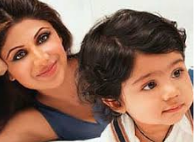
Names
What is your son’s full name?
What is your daughter’s complete name?
What are their full names?
How do you spell that?
My son is called (Yusuf)
My sons are called (Anton and Alexander)
My daughter is called (Anastasia)
My daughters are called (Marie and Anna)

Slide 7
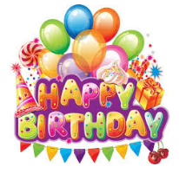
Birthday
When were your children born?
What is their date of birth?
What is your son’s birth date?
What was your daughter born?
(Anna) was born on (month, day, year)

Slide 8
Immigration Status
Singular:
What is the immigration status of your child?
Is s/he a US citizen?
Is your child a permanent residents?
Plural:
What is the immigration status of your children?
Are they US citizens?
Are your children permanent residents?
Singular:
My son is a
My daughter is a
Plural:
They are
US citizens
Permanent residents

Slide 9
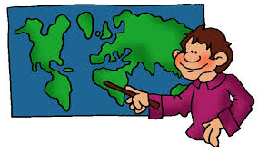
Country of Birth
What country was your child born in?
Where were your children born?
In what country were your children born?
What is the nationality of your children?
What country are your children currently citizens or nationals of?
(Maria) was born in (Peru).
S/he is not a US citizen. S/he is a permanent resident.
They were born in the US. They are US citizens.

Slide 10
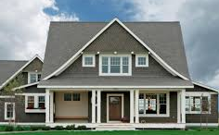
Address
Where do your children live?
Do your children live with you?
(Alex) lives with me.
(Juana) lives in San Francisco.

Slide 11
Practice in Pairs:
How many children do you have?
I have …
Where do your children live?
They live …
What country do they live in?
They live in …
What are their full names?
They are called …
How do you spell that?
Spell, spell, spell …
What is their date of birth??
(Name) was born on …
Are they US citizens?
(Name) is a …
In what country were your children born?
(Name) was born in …

