Slide 1
CitizenVIP ESL
Your Name

Slide 2
Current Legal Name
What is your current legal name?
What is your name?
What is your full name?
What is your complete name?
My legal name is (Martin Luther King)

Slide 3
First Name
What is your first name?
What is your given name?
Spell your first name.
My first name is (Joanna)
J-O-A-N-N-A

Slide 4
Middle Name
What is your middle name?
Spell your middle name.
I don’t have a middle name
My middle name is (Alice)
A-L-I-C-E

Slide 5
Last Name
What is your last name?
What is your family name?
What is your surname?
Spell your last name.
My last name is (Johnson)
J-O-H-N-S-O-N

Slide 6
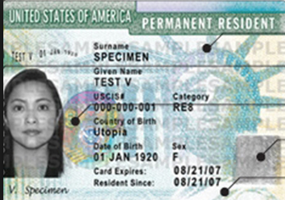
Name on Your Permanent Resident Card
What is your name exactly as it appears on your permanent resident card?
Is your name written correctly on your permanent resident card?
Spell your name exactly as it appears on your permanent resident card.
My name on my Green Card is …
Yes, it is.
J-O-A-N-N-A A-L-I-C-E J-O-H-N-S-O-N

Slide 7
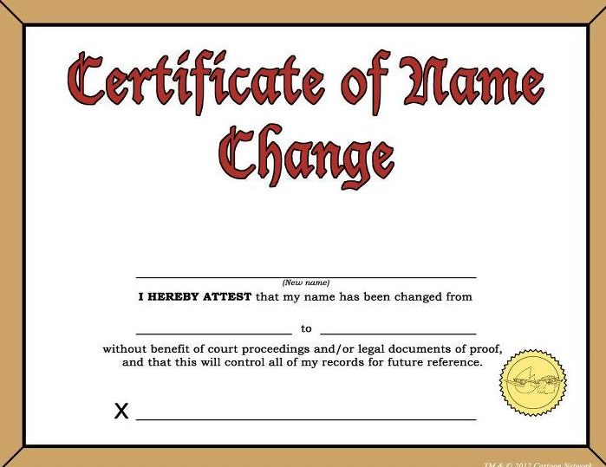
Any Other Name
Have you ever used any other name?
Have you ever used any other name in your life?
Have you ever used a different name?
No, I have not.
Yes, I got married. My maiden name was (Schmidt).
Yes, I legally changed my name. It was ….

Slide 8
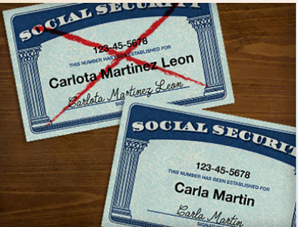
Change Your Name
Would you like to legally change your name?
Would you like to change your name today?
What name do you want to use after you become a US citizen?
What name do you want to use when you become a US citizen?
What name do you want on your naturalization certificate?
No thank you.
Yes, I would like to change my name to … .
I don’t want to change my name.

Slide 9
Practice in Pairs:
What is your current legal name?
My full name is …
What is your first name?
My first name is …
What is your middle name?
My middle name is … / I don’t have a middle name.
What is your last name?
My last name is is …..
What is the name on your permanent resident card?
It is …
Have you ever used any other name?
No, I have not / Yes, I got married; my maiden name is … .
Would you like to change your name today?
No thank you / Yes, I would like to change it to … .

