Slide 1
CitizenVIP ESL
Your Record

Slide 2
Gender
What is your gender?
What sex are you?
Are you male or female?
I am male OR
I am female

Slide 3
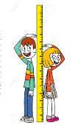
Height
What is your height?
How tall are you?
I am 5 feet 6 inches.

Slide 4
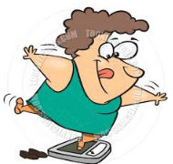
Weight
What is your weight?
How much do you weigh?
I weigh one hundred and sixty (160) pounds.

Slide 5
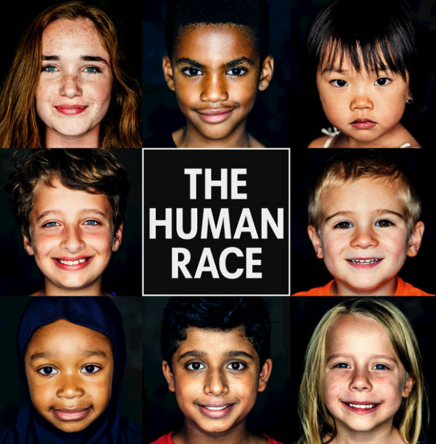
Race
Are you Hispanic or Latino?
What is your race?
What is your ethnic background?
Are you White?
Are you Asian?
Are you Black or African American?
Are you American Indian or Alaskan Native?
Are you native Hawaiian or Pacific Islander?
I am (race)

Slide 6
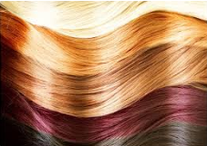
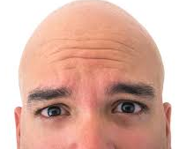
Hair Color
What is your hair color?
What is the color of your hair?
What color is your hair?
My hair is brown / black / blonde / red / gray
I’m bald

Slide 7
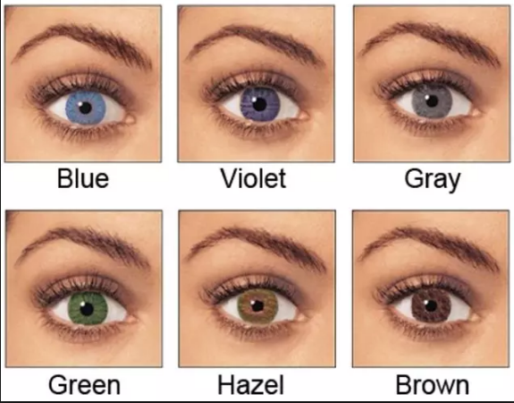
Eye Color
What is your eye color?
What is the color of your eyes?
What color are your eyes?
My eyes are brown / blue / gray / green

Slide 8
Practice in Pairs:
What is your gender?
I am …
What race are you?
I am …
How tall are you?
I am …
How much do you weigh?
I weigh XXX pounds
What color is your hair?
My hair is …
What color are your eyes?
My eyes are …

